Slide 1
TOPIC: Structure and Functions of Schools and community in Pakistan

Slide 2
CONTENTS
Community Definition:
School Definition:
Structure of Education in Pakistan.
KINDS:
Pre-school
Primary School.
Middle School.
High School.
Higher Secondary School
University Level.
Functions of Schools.
Role of school in Community of Pakistan.

Slide 4
COMMUNITY Definition:
It is defined as a group of people living in the same place and having some common characteristics. In simple words community refers to ‘’a unified body of individuals’’. In a tribal society community is a group of people who have same culture, commonality of ancestors, etc.

Slide 5
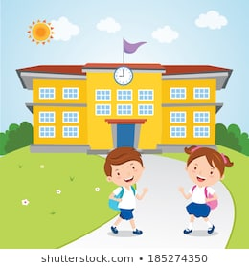
SCHOOL:
Schools are organizations which are established for educating children. Education may be defined broadly as
attaining of knowledge,
experience, and wisdom.

Slide 6
STRUCTURE Of Education In Pakistan
Education system in Pakistan is
generally divided into 6 levels.
1) Pre-School :
Pre-school is also known as nursery school or pre
-primary school. It offers early childhood education
before the beginning of compulsory education at
Primary school. It is for the children between 3 to 5 years
of age.

Slide 7
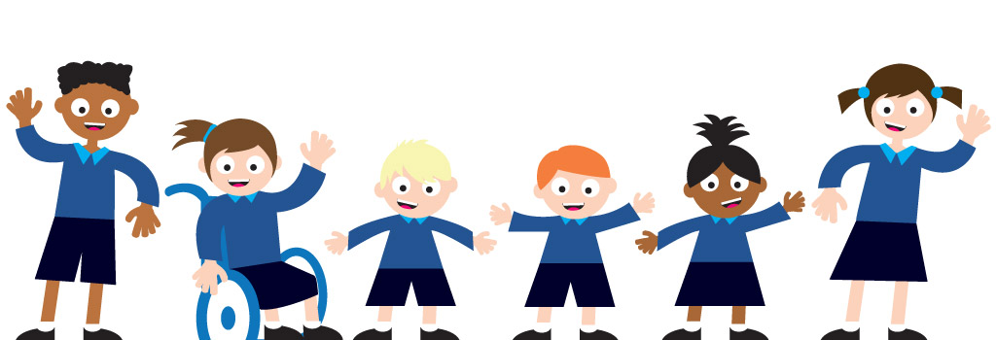
2) PRIMARY SCHOOL
It is the first stage of formal
education in Pakistan. This stage
consists of 5 classes i.e; grade 1 to 5
and enrolls children of age 5-9 years.

Slide 8
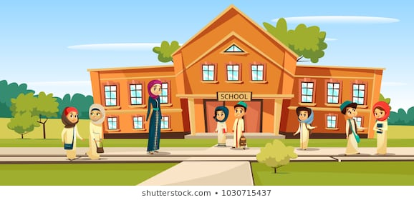
3) MIDDLE SCHOOL:
The middle school is of three years
duration. It consists of classes 6th, 7th
and 8^{th .} The age group is 10-12yrs.

Slide 9
4) HIGH SCHOOL
The high school children stay for two years in class 9th and 10th. The Board of Intermediate and secondary Education (BISE) conducts the exams. Certificate of secondary school is awarded to the
successful students and they
can then take admission
in colleges.

Slide 10
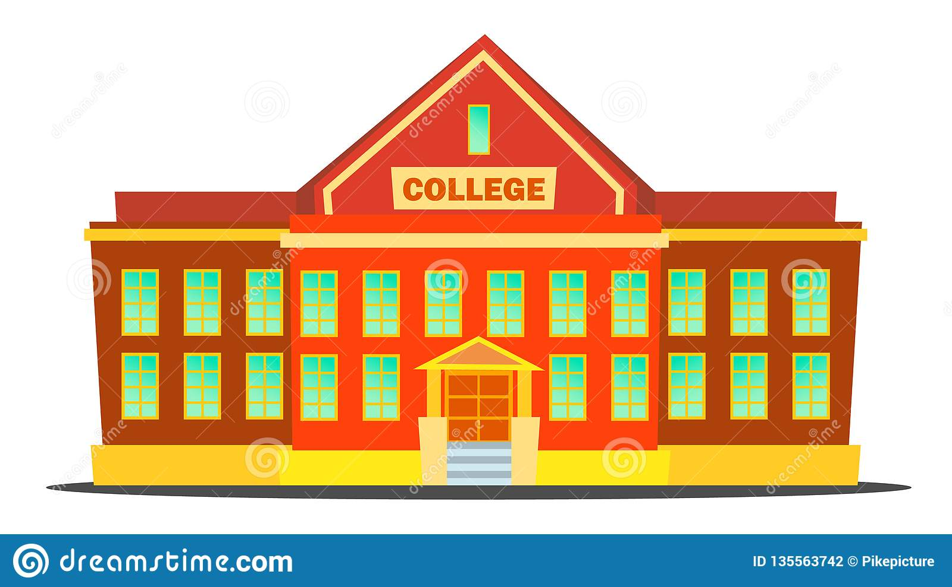
5) HIGHER SECONDARY
EDUCATION:
This stage is also called “Intermediate level”. It is considered “college education” and includes class 11th and 12th. The BISE conducts inter exams annually and awards HSSC( Higher Secondary School Certificate).

Slide 11
6) UNIVERSITY LEVEL:
To obtain a degree , 4 years of higher education is required. It includes 2 years of Bachelors degree and 2 years of masters degree. Presently, it is known in Pakistan as ‘’BS system’’.

Slide 12
FUNCTIONS OF SCHOOL
1) Children gain knowledge through schooling.
2) Lecturers and teachers teaches discipline to the students.
3) Schools give moral education and teaches differentiate between good and bad.
4) It performs the function of protection of culture.
5)Schools focus on all-round (complete) development of learners.

Slide 13
6) school focuses on training of citizens in every sphere of life.
7) Character building of students is also an important function of schools.

Slide 14
ROLE OF SCHOOLS IN COMMUNITY
School makes citizen useful members of community.
A positive being. A educated person will always be a positive –minded member of society.
3)Makes citizens responsible about their duties.
4) Improves confidence level of a person.

Slide 15
5) Makes person aware about goods and evils of Society. So he does whatever is beneficial for society.
6) Brings economic development by providing jobs to educated citizens.

Slide 16
THANK YOU

