Slide 1

TYPES OF SOCIAL INTERACTION

Slide 2
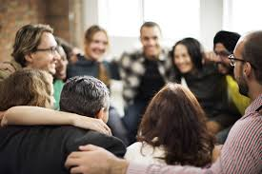
1.COOPERATION
To help each other.
When a group of people work together in order to achieve a common goal.
Without cooperation, no institution beyond the individual would develop; any group behavior is an example of cooperation.

Slide 3


TYPES
There are three main types of cooperation: coerced, voluntary, and unintentional.
1.COERCED COOPERATION; is when cooperation between individuals is forced. Individuals are forced to enlist in the military and cooperate with one another and the government, regardless of whether they wish to.

Slide 4
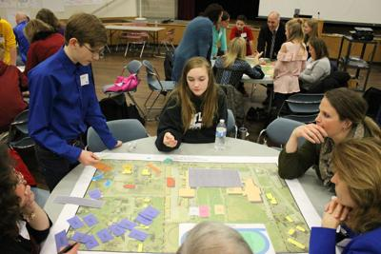
2. VOLUNTARY COOPERATION; is cooperation to which all parties consent. An example of voluntary cooperation would be individuals opting to complete a group project for school when given the option of a group project or an individual project.

Slide 5
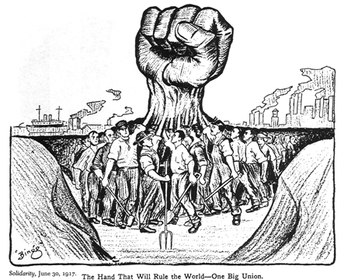
3.Unintentional cooperation; is a form of cooperation in which individuals do not necessarily intend to cooperate but end up doing so because of aligning interests. The free hand of a capitalist economy is an example of unintentional cooperation, where individuals will take actions based on their own interests resulting sometimes in unintentional cooperation.

Slide 6
2.COMPETITION
The activity or condition of striving to gain or win something by defeating or establishing superiority over others.
When a group of people oppose each other is known as competition.
Many philosophers and psychologists have identified a trait in most living organisms that can drive the particular organism to compete. This trait, unsurprisingly called “competitiveness,” is viewed as an innate biological trait that coexists along with the urge for survival.

Slide 7

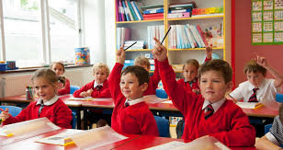
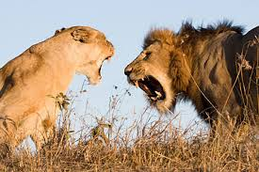
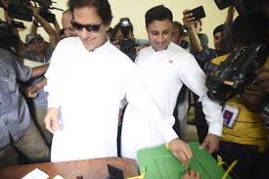

Competition can be;
Healthy competition.
School competition.
Competition between animals.
Sports competition.
Political competition etc.

Slide 8
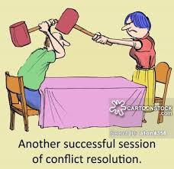
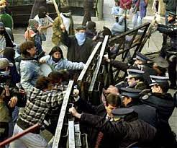
3.CONFLICT
The delibrate attempt to force others.
Social conflict is the struggle for agency or power within a society to gain control of scarce resources.
It occurs when two or more people oppose one another in social interactions, reciprocally exerting social power in an effort to attain scarce or incompatible goals, and prevent the opponent from attaining them.

Slide 9

4.ACCOMODATION
The term ‘accommodation’ is derived from experimental psychology, where it denotes how individuals modify their activity to fit the requirements of external social world.
It simply means adjusting oneself to the new environment. For adjustment (physical or social), one has to adopt new ways of behaving.

Slide 10
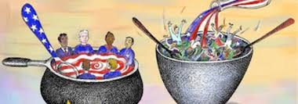
5. ASSIMILATION
Assimilation describes the process by which a minority integrates socially, culturally, and/or politically into a larger, dominant culture and society.
The term assimilation is often used in reference to immigrants and ethnic groups settling in a new land. Immigrants acquire new customs and attitudes through contact and communication with a new society, while they also introduce some of their own cultural traits to that society.

Slide 11


6. EYE CONTACT
Eye contact is the meeting of the eyes between two individuals. In humans, eye contact is a form of nonverbal communication and has a large influence on social behavior
Teacher to students and students to teacher eye contact is must in class rooms

Slide 12
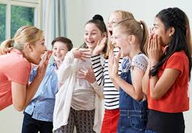

7. BODY LANGUAGE
Body language is a form of human non-verbal communication, which consists of body posture, gestures, facial expressions, and eye movements. Humans send and interpret such signals almost entirely subconsciously.
Body language may provide clues as to the attitude or state of mind of a person. For example, it may indicate aggression, attentiveness, boredom, relaxed state, pleasure, amusement, and intoxication, among many other clues.

Slide 13
REFERENCES
https://courses.lumenlearning.com/boundless-sociology/chapter/types-of-social-interaction/
http://www.preservearticles.com/sociology/accommodation-definitions-nature-and-other-details/30478

Slide 14


