Slide 1
3.1 MAIN CHARACTERISTICS OF CULTURE

Slide 2
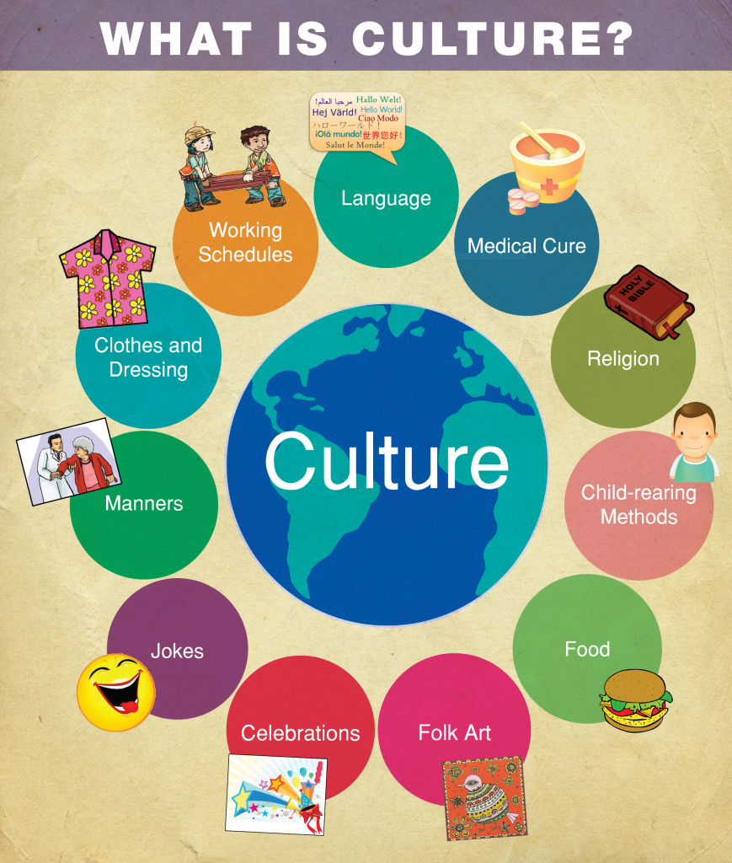
MAIN CHARACTERISTICS OF CULTURE

Slide 3
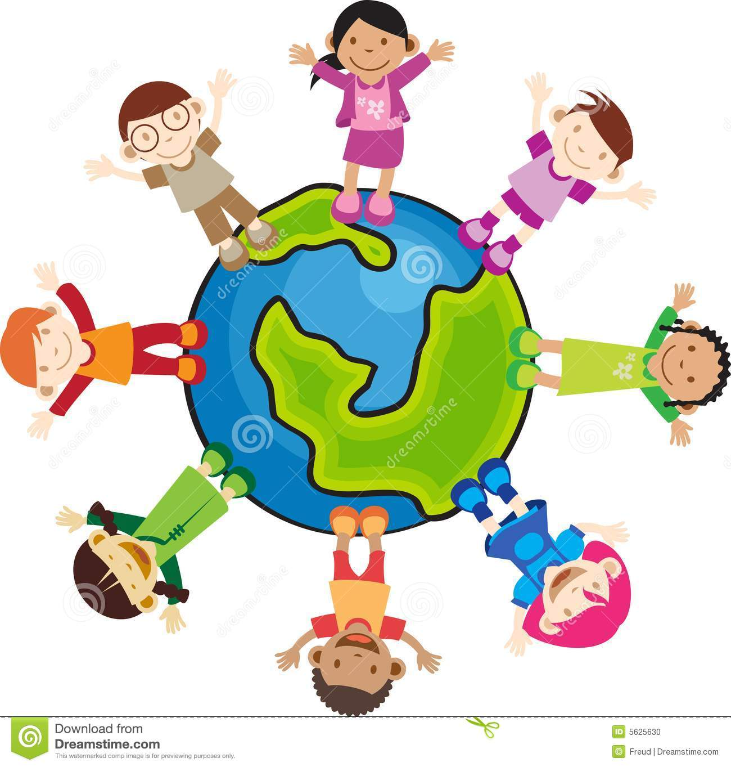
CULTURE
HORTON AND HUNT DEFINITION
Culture is everything which is socially shared and learned by the member of society.

Slide 4
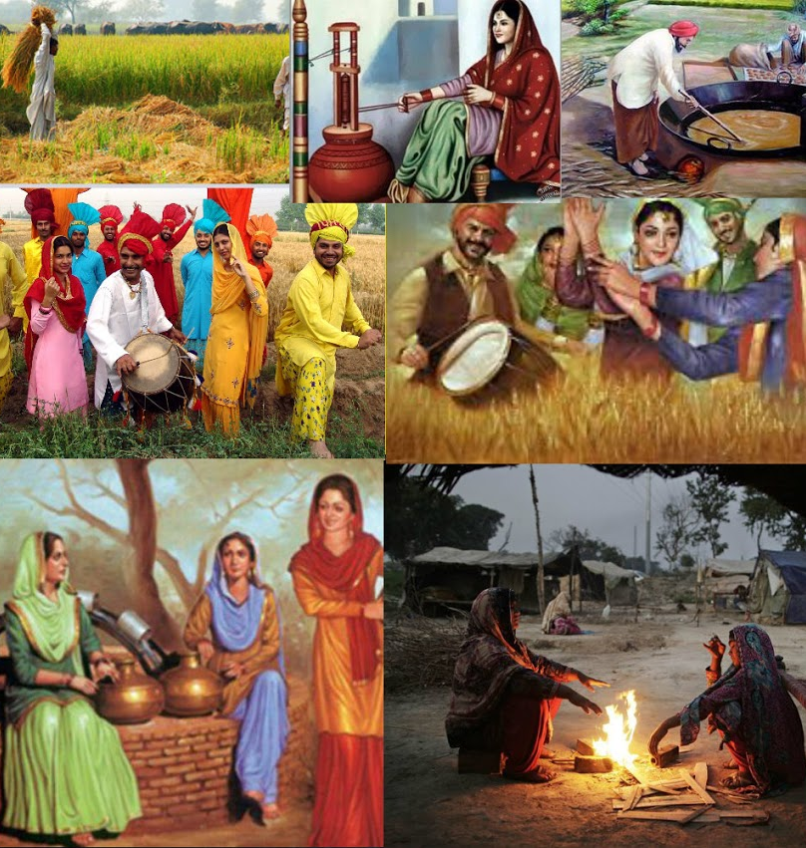
According to TYLOR,
It is the complex whole including beliefs, Arts, Region, Values, Norms, Ideas, Law, Knowledge, Custom and capabilities acquired by a man as a member of society.

Slide 5
MAIN CHARACTERISTICS OF CULTURE
Some of the important characteristics of culture are:
Culture is learned
Culture is shared
Culture is social
Culture is transmitted
Culture is dynamic
Culture is accumulative

Slide 6
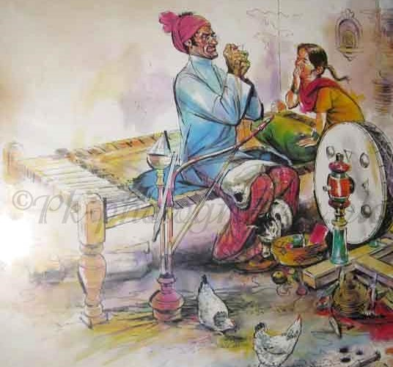
CULTURE IS LEARNED
Culture is a learned behavior.It is not inherited biologically but it is learnt socially by a man in a society through his senses and experiences.
People can learn about their culture through interaction with parents, guardians and friends and social media.For example Dressing, Behaving, eating etc all are learnt by man.

Slide 7
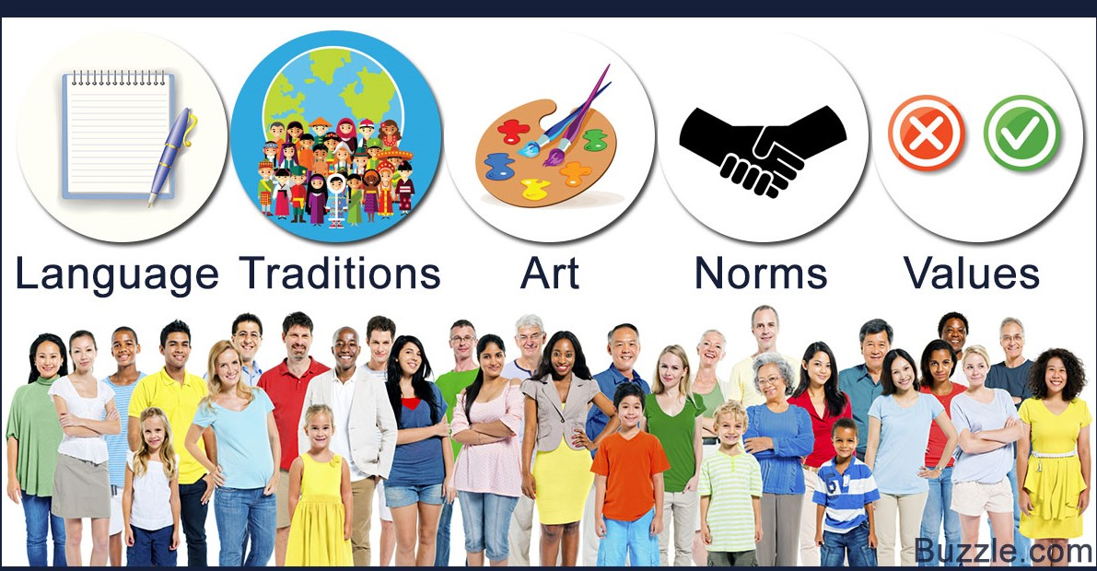
CULTURE IS SHARED
Culture cannot exist without society.
All members of a society living together will hold a shared set of values, ideas and Perception.They shared their culture with each other.
For example, languages, customs, traditions, values, beliefs are all shared by man in a society.

Slide 8

CULTURE IS SOCIAL
Social Culture is not an individual phenomena but it is a group product of society.
No man can acquire it without the association of others.
It is developed through social interaction by many persons in a group of society.
This include households, families associations, business interactions and power relations including politics.

Slide 9
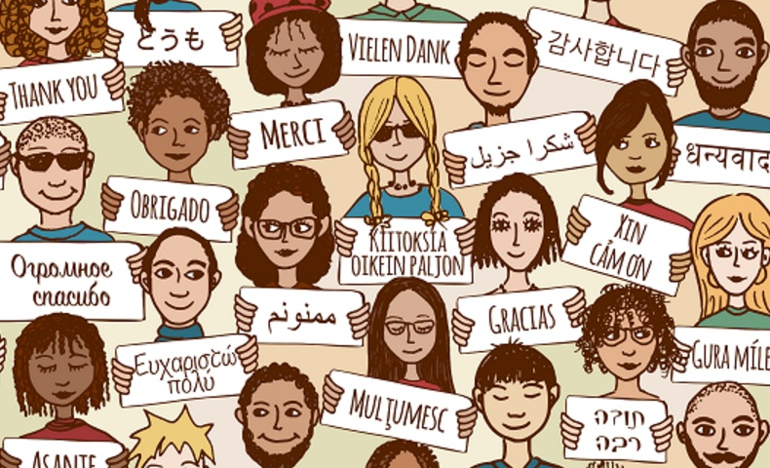
CULTURE IS TRANSMITTED
Culture is capable of transmitted from one generation to the next. Parents transmit their cultural traits to their children and in return they pass to their children and so on.
It is not transmitted through genes but through language.
Language is means to communication which passes cultural traits from one generation to another.

Slide 10
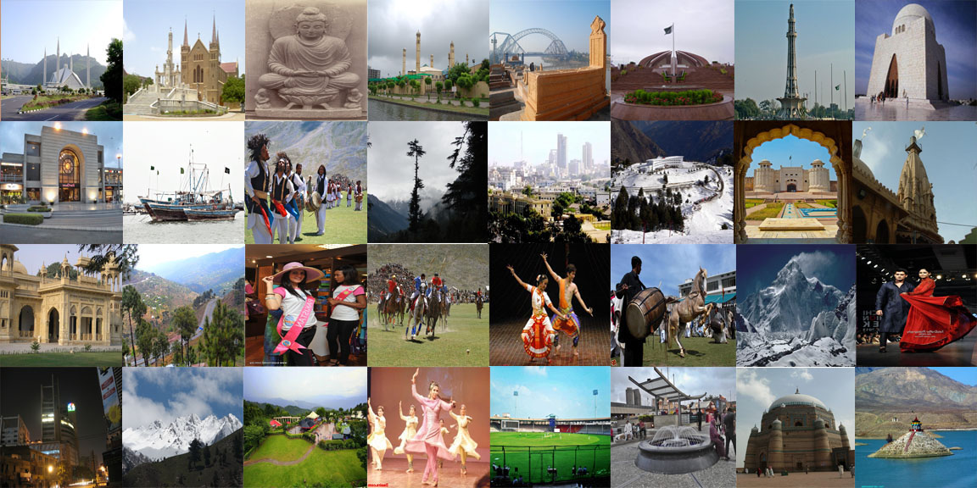
CULTURE IS DYNAMIC
No culture is ever in a permanent state it is dynamic.
Culture is constantly changing because new ideas, techniques and knowledge are added and old ways are constantly modified and discarded.

Slide 11
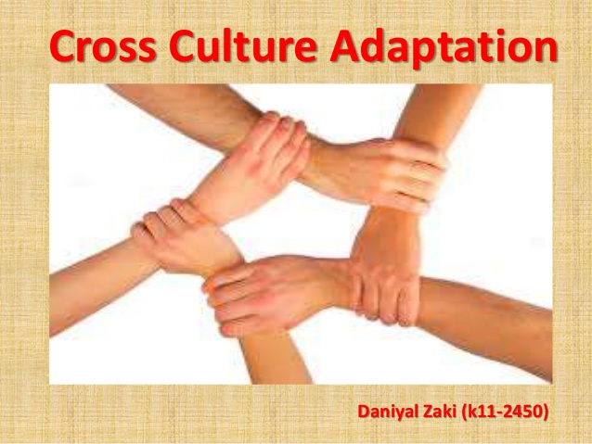
CULTURE IS ACCUMULATIVE
Culture is the continuous process and adding up of new cultural traits.
Many cultural traits are borrowed from out side and these are absorbed in that culture which adopt it, as culture is accumulative, it combines the suitable cultural traits.

Slide 12
REFRENCES http://www.studylecturenotes.com/social-sciences/sociology/112-what-is-culture-(retrieved on 12.10.19) https://slideplayer.com/slide/4375681/(retrieved on 12.10.19) https://www.slideshare.net/marssalmero/characteristics-of-culture-15591237(retrieved on 13.10.19) https://www.slideshare.net/maryracedacayanan/characteristics-of-culture-30287668?next_slideshow=1(retrieved on 13.10.19)

Slide 13


