Slide 1
Elementary concepts of culture

Slide 2
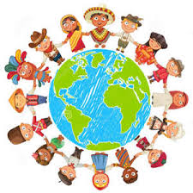
Definition of culture
Culture is that complex whole which includes knowledge, believes, arts, morals, laws, customs and any other habits and capabilities acquired by a man as a member of society.
A set of shared ideas, actions, principals, beliefs and values.

Slide 3
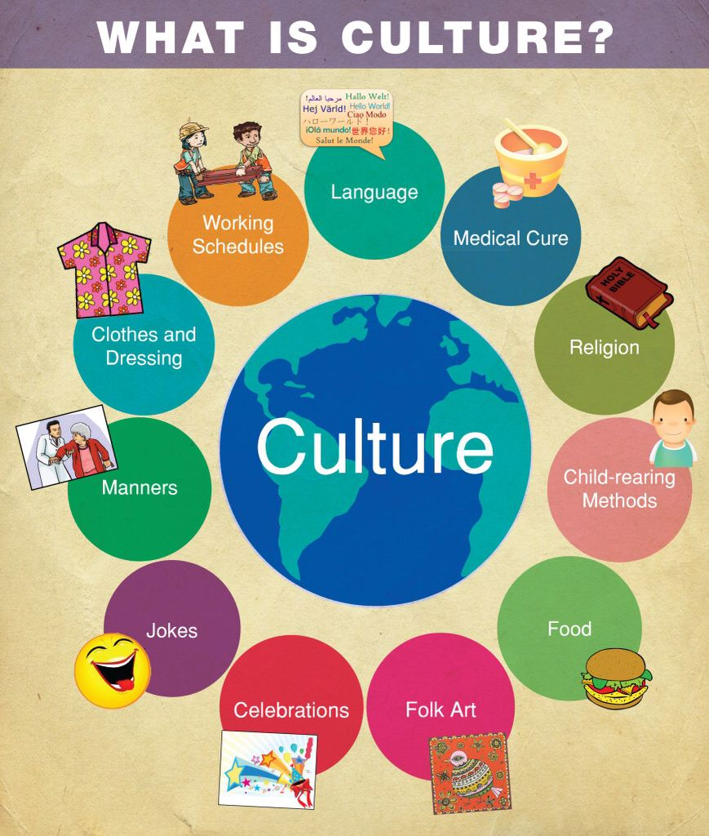
Elementary concepts of culture
1 Cultural Trait
2 Cultural Complex
3 Cultural Pattern
4 Cultural lag

Slide 4
Cultural Trait
Simplest level An individual tool, act,object,technique or belief that is related to a particular situation or need. EX: Using knives, spoons, forks Saying hi to friend
The least unit of culture is called Culture Trait.
What's interesting about cultural traits is that they are not necessarily static. Cultural traits can combine with each other.

Slide 5

Cultural traits are things that allow one part of a culture to be transmitted to another. For example, the famous football chant of ''Ole, Ole, Ole'' likely arose in Spain but has since become a cultural trait of many soccer fans around the world.
Culture trait is something that has been passed on from one generation to another

Slide 6
Cultural Complex
a group of culture traits all interrelated and dominated by one essential trait: Nationalism is a culture complex.
Culture traits are interrelated with each other, their collective function forms culture complex.

Slide 7
Now, when you talk about culture complex, then patriotism is a culture complex. Even in different countries, people adore different sports say for e.g. football.
Now, when different nations plays football. In different countries, they have their own culture around football and they pass it from one generation to another.

Slide 8
Now, when the game of football is played internationally, you find certain rules which every countries follow to play the game of cricket. The rules which is common to all culture traits is a culture complex.
Culture complex is a one common traits among all different culture traits.

Slide 9
Cultural Pattern
Members of a culture generally have a preferred set of responses to the world.
•

Slide 10
What Is a "culture Pattern"?
A "culture pattern" is a set of related traits and characteristics that describe a particular group of people.
The term is commonly used in the field of sociology when studying how groups differ from one another.
By doing so, they can better understand how individuals within a particular culture relate to one another as well as what makes modern cultures differ from one another.
.

Slide 11
Due to patterns we found uniformity in human behavior. For example, the same kind of behavior is expected from the individuals belonging to the particular age group, sex , class, occupation etc. the number of patterns in a culture is less as compared to cultural complexes

Slide 12
Cultural Lag
Cultural lag refers to the fact that culture takes time to catch up with technological innovations, resulting in social problems.
W.F. Ogburn - an American sociologist who introduced the concept of ‘Cultural Lag’ in his book “Social Change: which was published in the year 1920.

Slide 13
Cultural lag is a term to describe what happens in a social system when the cultural ideas used to regulate social life do not keep pace with other social changes.
The spread of cultural ideas from their place of origin to other regions, groups or nations.

Slide 14
Cultural lag theory
Cultural Lag is the notion that culture takes time to catch up with technological innovations, and that social problems and conflicts are caused by this lag.

Slide 15
EXAMPLES:
The development in the field of industry requires a corresponding change in the system of education.
The failure of education to meet the needs of modern industrial development leads to cultural lag.

Slide 16
Over come cultural lag
Educational development
Awareness of people
More concentration on physical development
Emphasis on technological development
More attention on social changes
High opportunity to use modern technology
Control market price
Increasing GDP

Slide 17
References
https://www.lcps.org/cms/lib4/VA01000195/Centricity/Domain/863/Culture%20Patterns%20and%20Processes.ppt
https://www.reference.com/world-view/culture-pattern-7341b57dc5e8c7ae(retrieved on 2.10.19)
https://www.slideshare.net/misrar123/presentation-on-culture-prepared-by-misrar(retrieved on 9.10.19)
  https://www.slideserve.com/sandra_john/cultural-patterns(retrieved on 8.10.19)
http://web.mnstate.edu/shoptaug/HUM%20211/Traits%20of%20culture.ppt(retrieved on 2.10.19)

Slide 18


