Slide 1
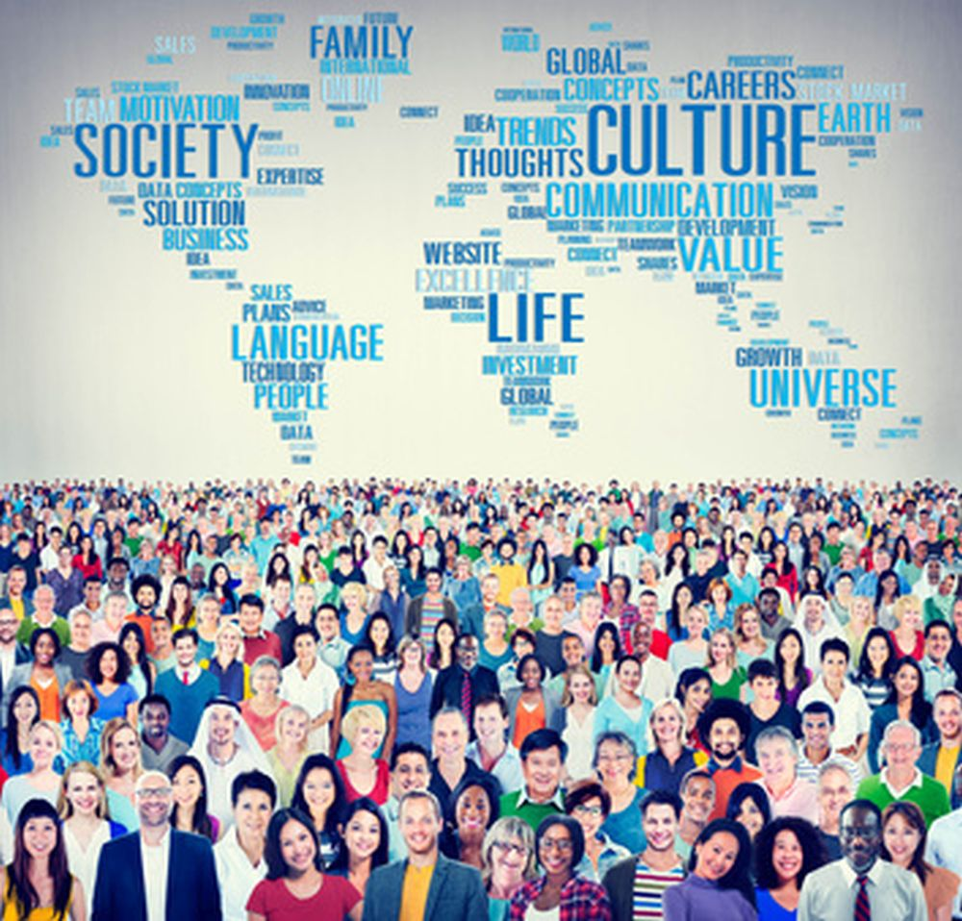
Culture and its elements in a PAKISTANI Community

Slide 2
Introduction
Culture is derived from Latin word ‘’Cultura’’ which means to ‘’Grow or to civilize’'
Culture is a system of knowledge shared by relatively a large group of people.
Culture is a learned behaviour of a society or a sub-group.
Reflects the values of a society.
It defines complete behaviour of human beliefs and behaviour.

Slide 3
According to Edwards Taylor,
Culture is that complex whole that includes knowledge, Beliefs, Law, Art, Customs, and any other capabilities and habits acquired by man as a member of a society.

Slide 4
ELEMENTS OF PAKISTANI CULTURE
Pakistani culture has the following characteristics:
Islamic values
Languages
Mixed culture
Food
Variety of dresses
Religious festivals

Slide 5
Islamic values
Majority of population comprises of muslims and follow teachings of Islam
Belief in one Allah
Prophet hood of Hazrat Muhammad(P.B.U.H)
Brotherhood
Equality and social justice
Islam is religion of peace and patience.

Slide 6
National and Regional languages
A number of languages are spoken in Pakistan
National language: Urdu
Regional languages:
Punjabi
Pashto
Sindhi
Balochi

Slide 7
MIXED CULTURE
People entered the sub-continent from Iran, Turkey, Saudi Arabia, Iraq etc. and adopted the sea route to reach the soil of sub-continent.
They brought their traditions, customs, festivals and way of life.
The local culture mixed with the culture of new arrivals created a multi-coloured culture on the soil of Pakistan.

Slide 8
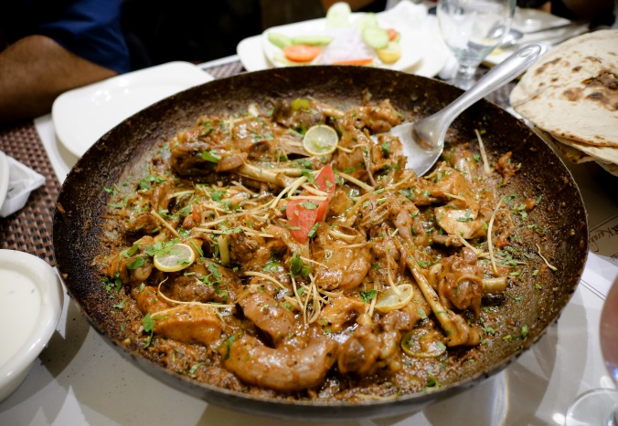
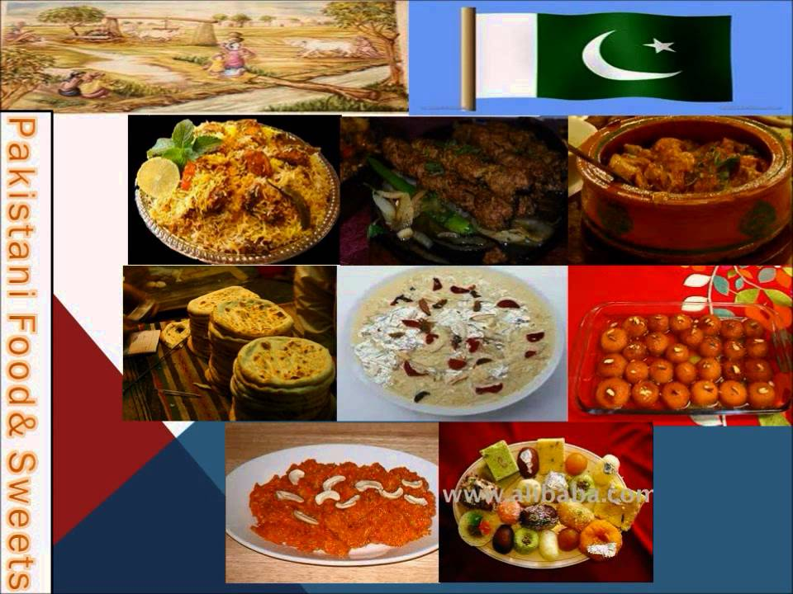
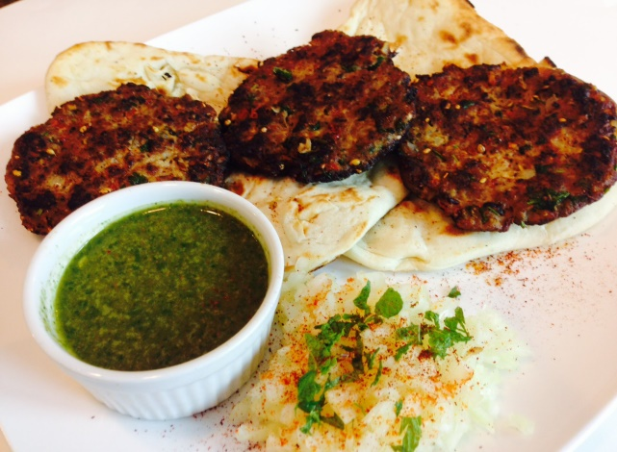
Food
Due to regional and climate variations in Pakistan, variety of food is available in Pakistan
Punjab: Paratha, Makkan, Lassi etc.
Sindh: Fish, Sea foods
KP: Sajji, Chapli kabab, karhaahi.
Balochistan: Dry fruits, Dates, Pulses etc.

Slide 9
Rich Literature
Pakistani culture is rich in the literature of
Urdu
punjabi
Sindhi
Balochi
Baruhi
Kashmiri languages

Slide 10
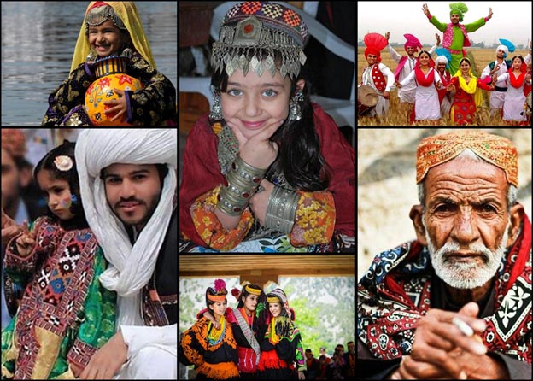
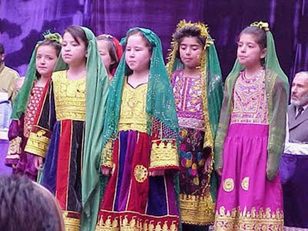
Dresses
Pakistani culture is rich in variety of dresses.
These dresses are colourful, prominent and give attractive look during national fairs and festivals.

Slide 11
Religious festivals
Muslim religious festivals are celebrated according to Islamic calendar.
Some main festivals celebrated in Pakistan are:
Eid.ul.Azha
Eid.ul.Fitr
Milad.un.Nabi
Shab.e.Baraat
Shab.e.Qadar
Youm.e.Aashura

Slide 12
National festivals
Independence day (August, 14)
Defence day (September, 6)
Pakistan day (March, 23)
Air force day (September, 7)
Iqbal day (November,9)
Quaid.e.Azam birthday (December, 25)

Slide 13
Conclusion
Islam has described the rights and duties of every individual even in drinking, eating and dressing.
We have to observe certain rules prescribed by Islam.
So it may be said that Pakistani culture represents the true picture of Islamic culture.

Slide 14
sources
https://courses.lumenlearning.com
www.methacton.org
www.csub.edu
https://www.researchgate.net
Spencer-Oatey, H. (2012);What is Culture? A Compilation of Quotations
https://www.sociologygroup.com
https://2012books.lardbucket.org › books › sociology-brief-edition-v1.1

