Slide 1
Role of Education and School in Protection and Transmission of Culture
Unit No. 3
Topic No. 3.5

Slide 2
Cultural Transmission Definition
Cultural Transmission is a transmission of preference beliefs and norms of behavior which is the result of social interactions across and within generations.
Cultural transmission is an object of study of several social sciences eg. Evolutionary anthropology, sociology, social psychology, economics as well as evolutionary biology.

Slide 3
According to Anthropology & Education
Education is cultural transmission. "A calculated involvement in the learning process." (Anthropology and Education, George & Louise Spindler)

Slide 4
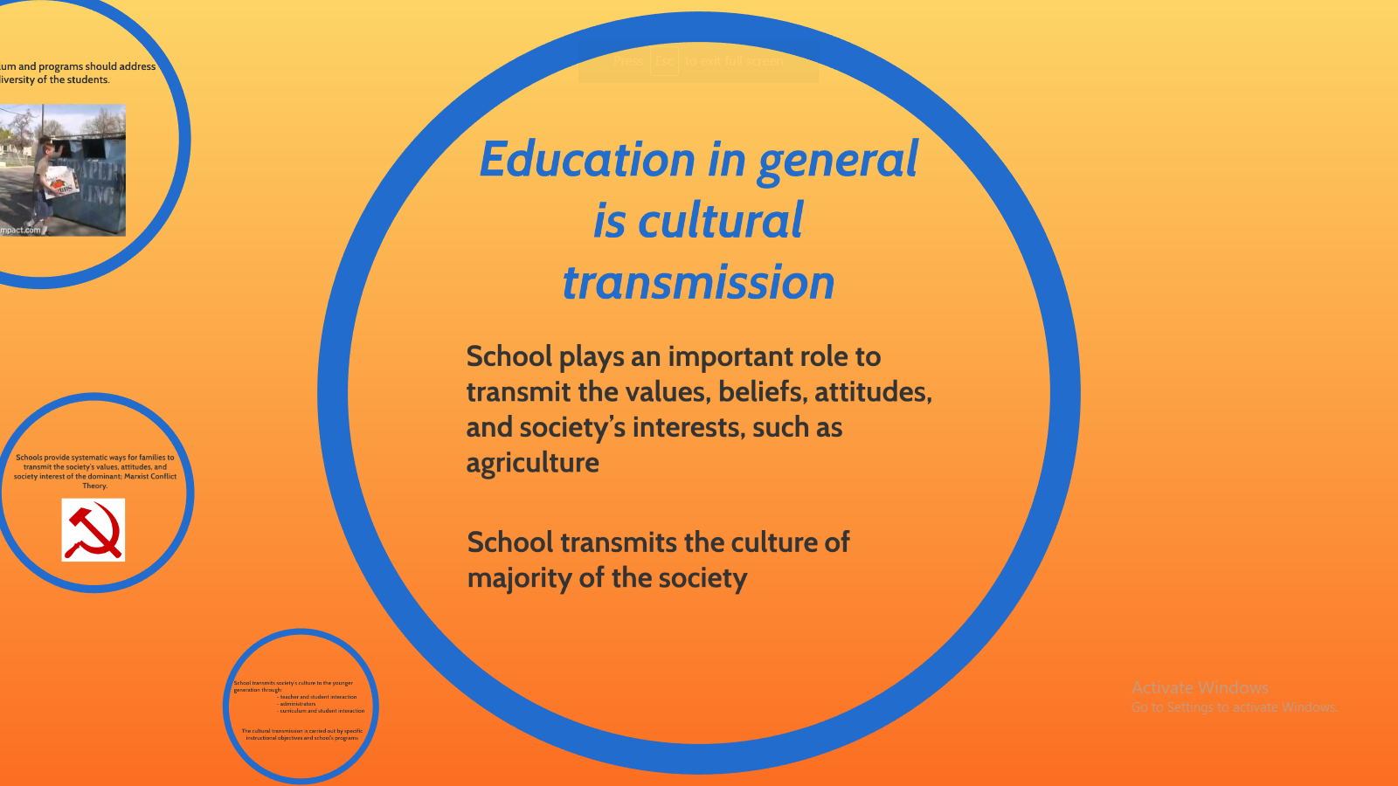
Role of education in Transmission of Culture
Cultural Transmission Definition
Cultural transmission is an object of study of several social sciences eg. Evolutionary anthropology, sociology, social psychology, economics as well as evolutionary biology.

Slide 5
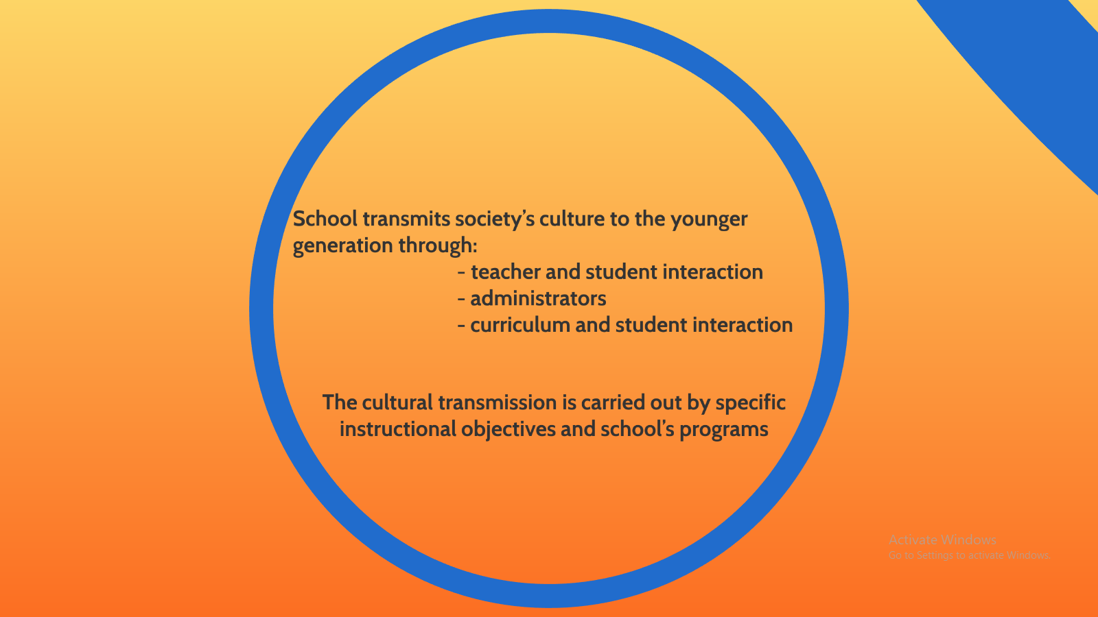
Role of education in Transmission of Culture
Cultural Transmission Definition
Cultural transmission is an object of study of several social sciences eg. Evolutionary anthropology, sociology, social psychology, economics as well as evolutionary biology.

Slide 6
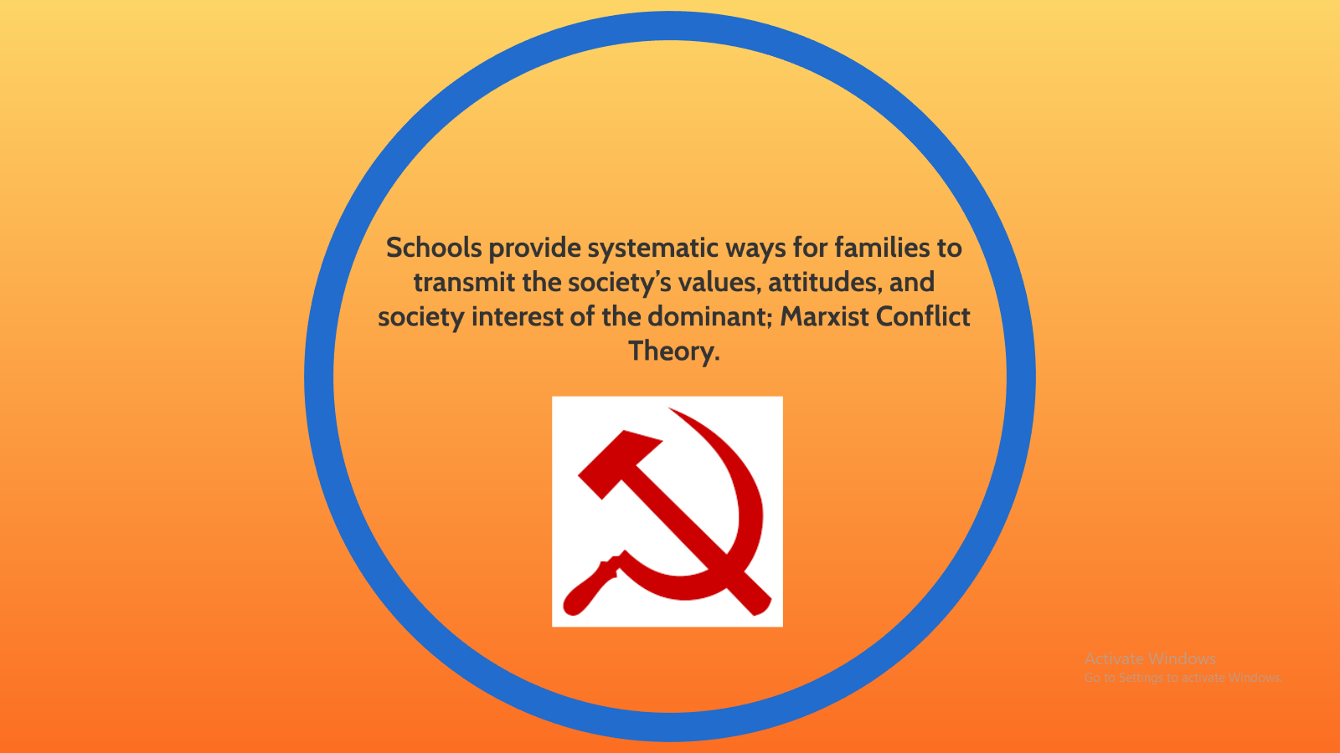

Slide 7
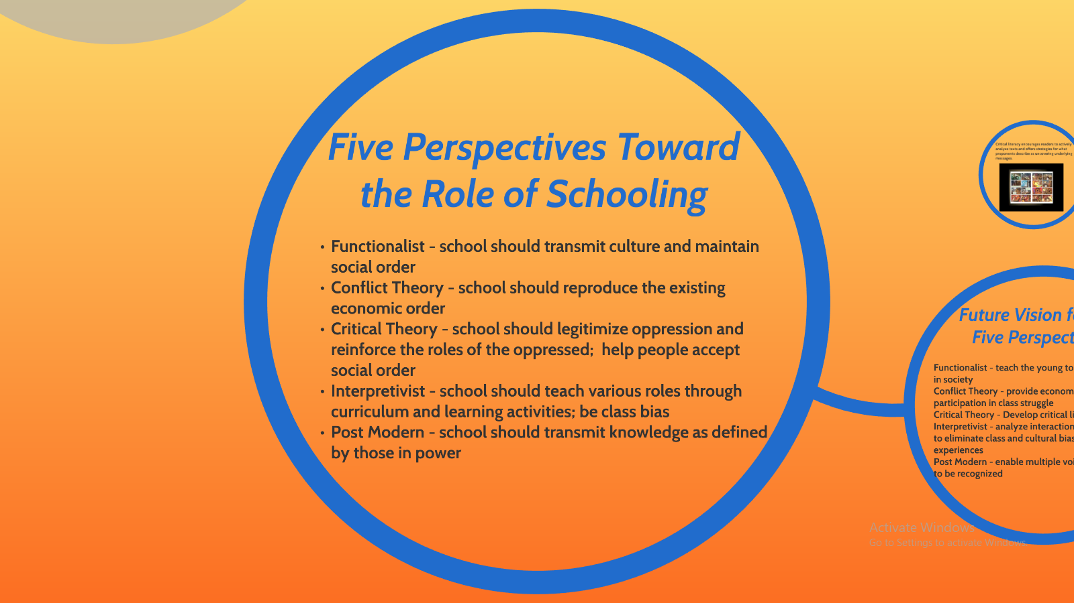
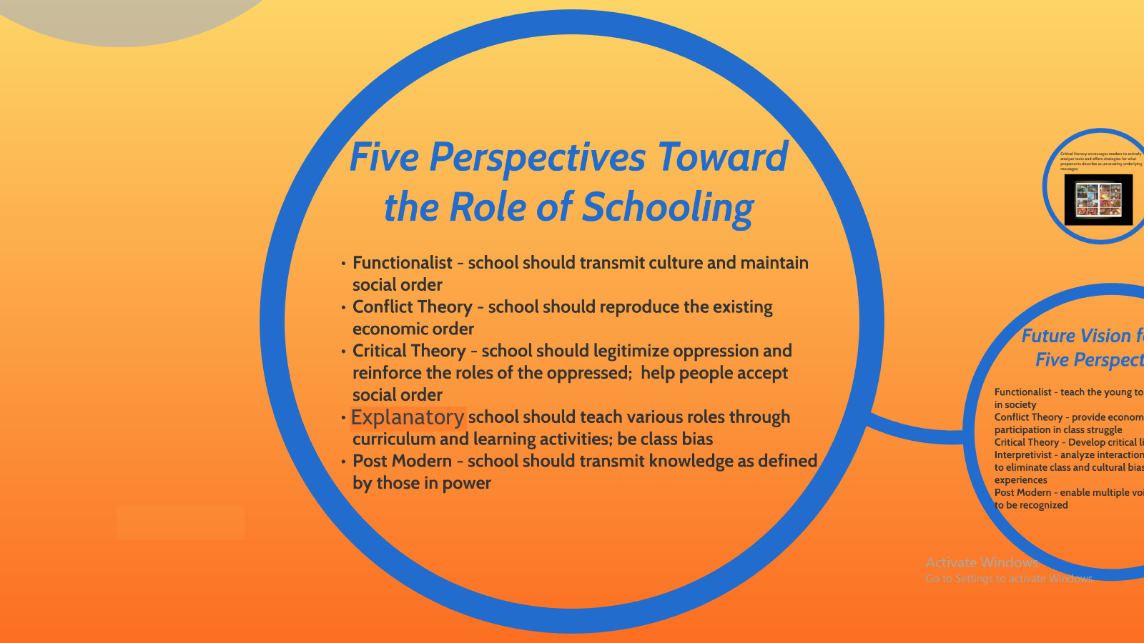
Explanatory

Slide 8
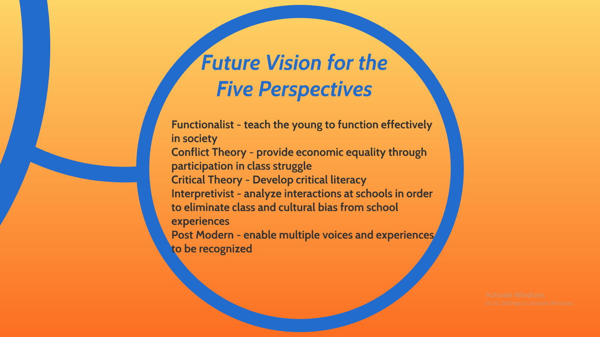

Slide 9
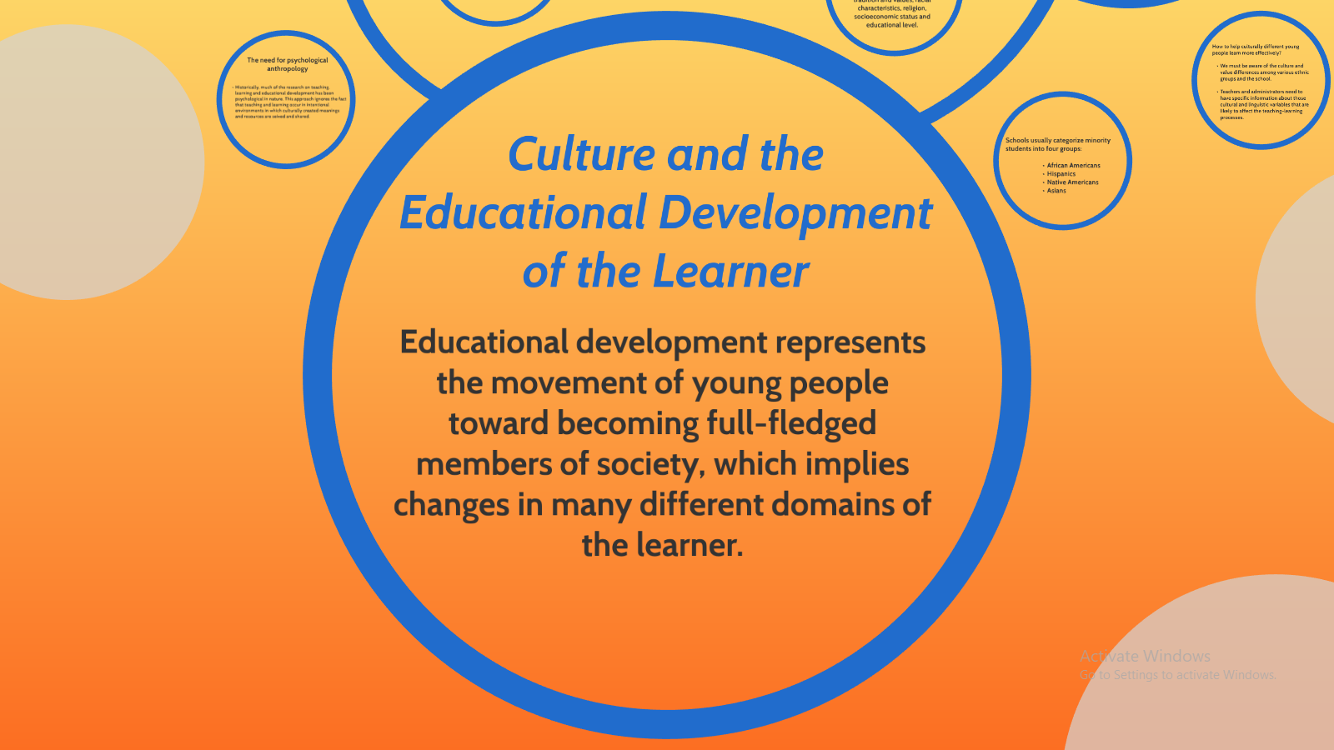

Slide 10
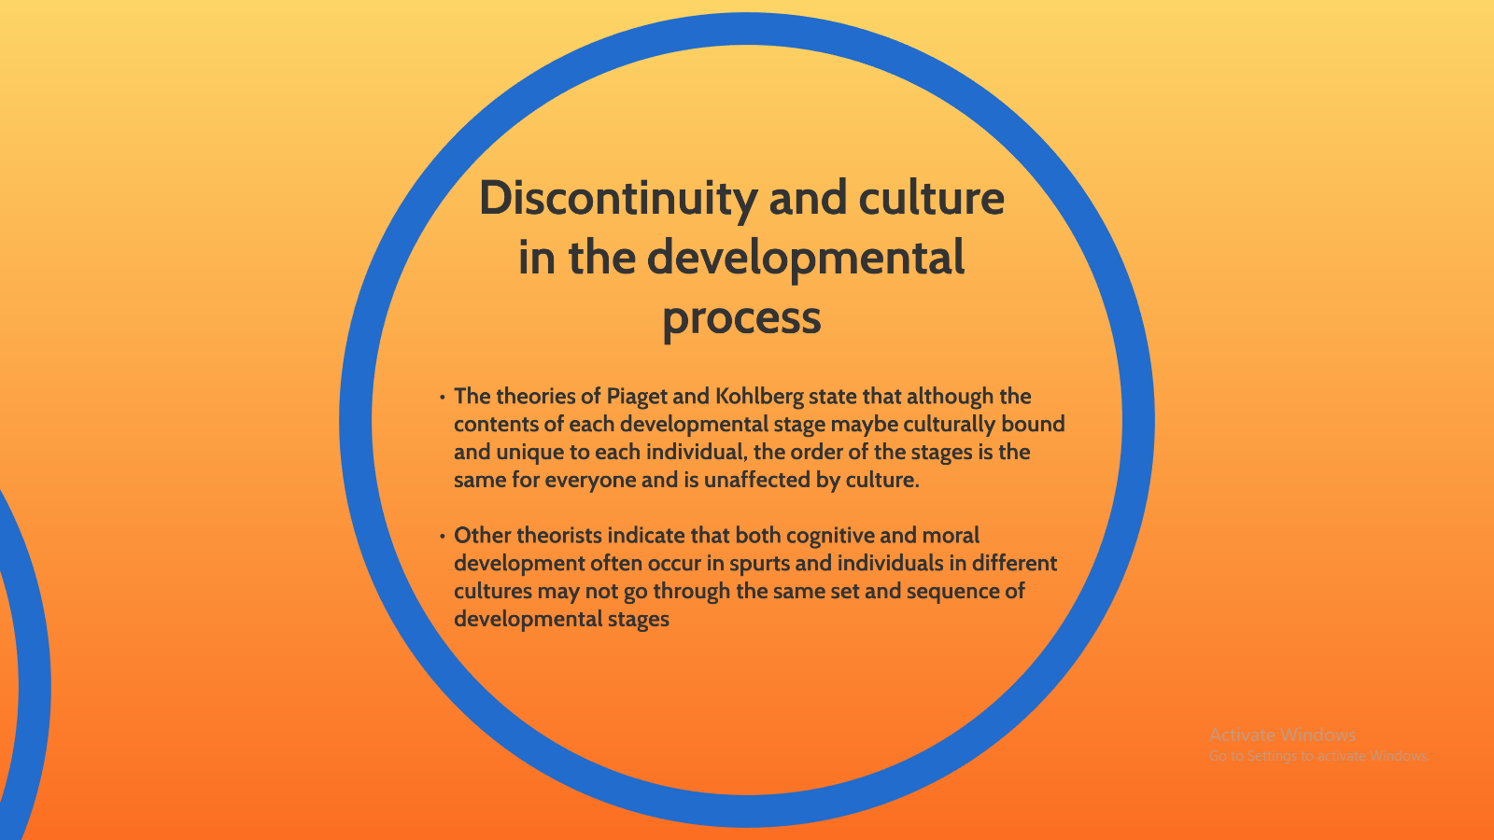

Slide 11
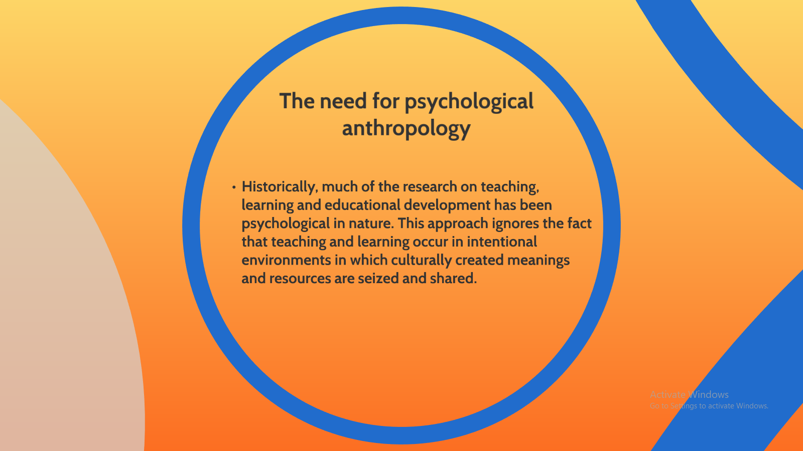

Slide 12


Slide 13
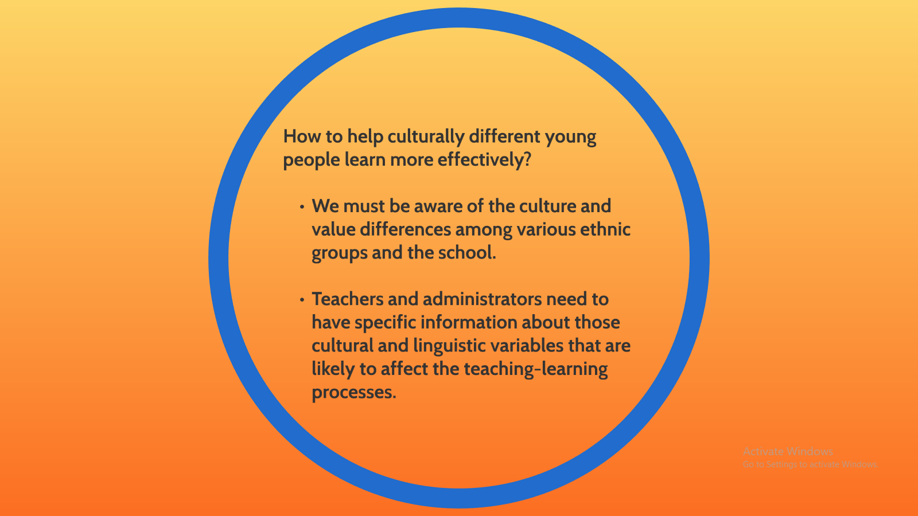

Slide 14
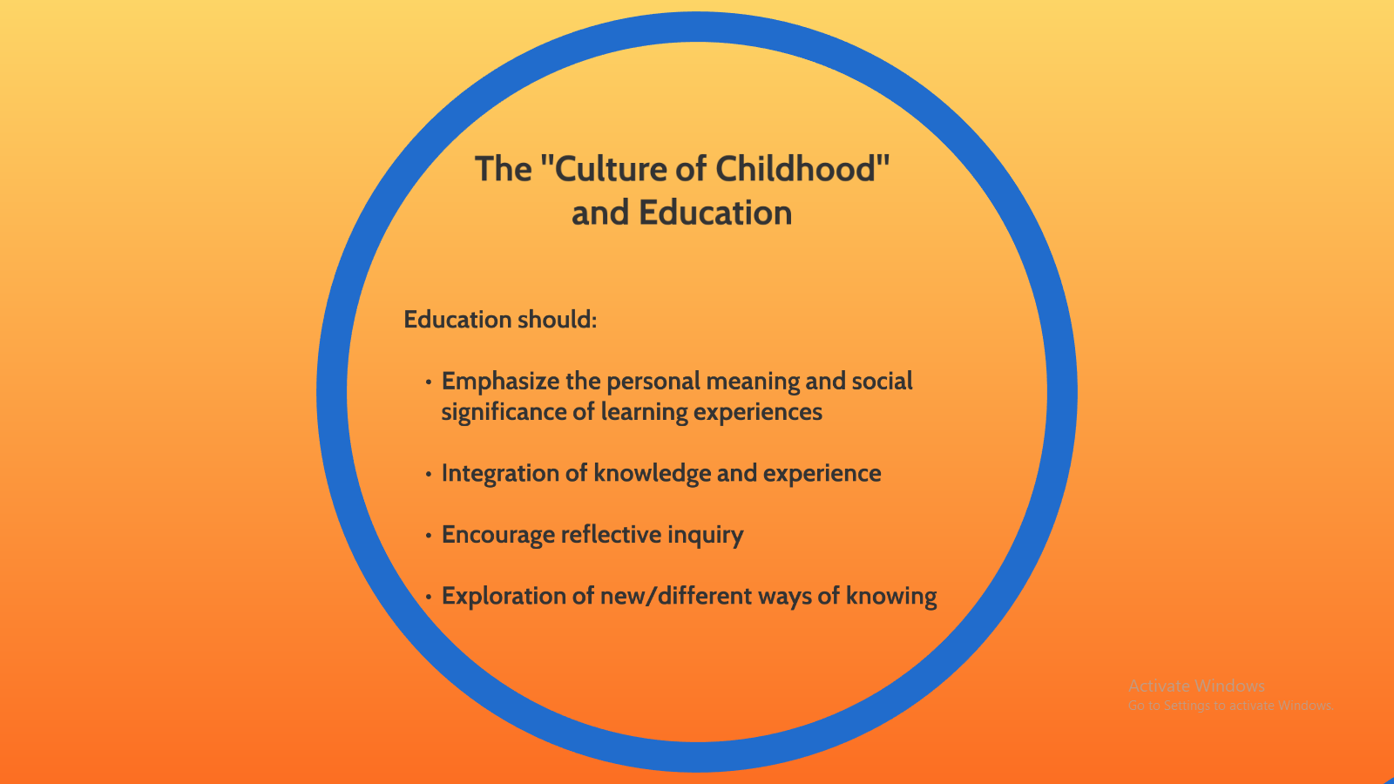

Slide 15
References
https://prezi.com/sgep3gaseycv/education-in-general-is-cultural-transmission/ Retrieved on (12-10-2019)
https://www.slideshare.net/erodelavega/cultural-transmission-task-of-education?qid=95d04d0c-5c92-423d-b862-60be2bcdd845&v=&b=&from_search=1 Retrieved on (12-10-2019)

Slide 16


