Slide 1
Distillation
It is a method of separating volatile substances which differs appreciably in their vapour pressures.
It is used in pharmacy either to extract volatile active principles from vegetable drugs or to separate volatile substances from their less volatile impurities.
It also provides a method of recovering volatile solvents notably, alcohol for further use.

Slide 2
Simple distillation
It is the process of converting a liquid into its vapors, transferring the vapors to another place and recovering the liquid by condensing the vapors usually by leading it into contact with a cold surface.
The apparatus used is essentially consist of three parts.
Still: In which the volatile material is vaporized
Condenser: In which the vapors are condensed
Receiver: In which the distillate is collected

Slide 3
Simple distillation is generally used for the separation of liquids from non-volatile solids.
e.g. preparation of distilled water and recovery of alcohol in the preparation of dry extracts.

Slide 4
Simple distillation under atmospheric pressure
For simple distillation in the laboratory, a distillation flask with a side arm sloping downwards is used.
The temperature at which the vapors distil is observed on a thermometer, inserted through a cork and having its bulb just below the level of the side arm.

Slide 5
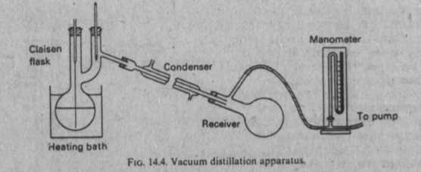

Slide 6
The flask should be of such a size that it is one-half to two-thirds full of the liquid to be distilled.
Bumping due to superheating is avoided by adding a small chip of porous pot before distillation.
Pot should not be added to the super heated liquid otherwise an instantaneous evolution of a large volume of vapors will occur.
(These stones have pores inside which provide cavities both to trap air and to provide spaces where bubbles of solvent vapor can form. These bubbles ensure even boiling and prevent bumping and boiling over and loss of the solution)

Slide 7
Condenser
It is a heat exchanger. It consist of a very large surface area which is kept cold by a stream of water on one side and the vapors are condensed on the other side.
A large volume of cooling water is required on account of the latent heat of vaporization which is evolved on condensing the vapors.

Slide 8
In cooling 1g of water from 100⁰ to 15⁰, approximately 360 J are evolved
In condensing 1g steam to water at 100⁰, 2.27 KJ are evolved.
The latent heats of vaporization of alcohol and ether are 8.48 KJ and 3.78 KJ, respectively.

Slide 9
For the condensation of liquids which boil at from about 120⁰ to 150⁰, a stream of cooling water may cause the condenser walls to crack, owing to the high temperature gradient across the walls; stationary water in the jacket is usually used in these cases.
For liquids boiling above about 150⁰ simple air cooling is used.

Slide 10
The main points in condenser are as follow
The condenser must be so constructed as to be easily cleaned.
The cooling surface must be large because the rate of condensation is proportional to the area of condensing surface.

Slide 11
The condensing surface must be reasonably good conductor of heat because the rate of condensation is proportional to the rate at which the surface conduct away the heat.
For this reason, metal when suitable is preferable to glass

Slide 12
The film of condensed liquid is a bad conductor and must be removed quickly in order to avoid serious impairment of the efficiency of the condenser.
The warmer water in contact with the condensing surface must be quickly carried away and its place taken by fresh cold water.

Slide 13
The cooling water is arranged to move on the counter current principle.
Its direction of flow is opposite to that of the flow of vapors to be condensed.

Slide 14
In carrying out distillation on laboratory scale, the contents of the still are heated gradually and as the liquid begins to boil, the temperature recorded on the thermometer rises rapidly as the vapors ascends the neck of the flask. The temperature remains steady if the liquid is pure.
Heating is then continued at such a rate that a drop of liquid every 1 to 2 seconds falls from the condenser.

Slide 15
When inflammable liquids are distilled, the distillate is collected in a second distillation flask attached to the condenser through a long rubber tubing.

Slide 16
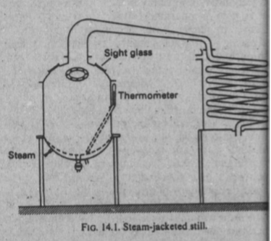
Large scale
When it is necessary to separate a volatile constituent such as alcohol or acetone from non-volatile extracts a simple form of still is used.

Slide 17
Simple distillation under reduced pressure
Small scale
Liquids which are unstable at their boiling point under atmospheric pressure, may be distilled at much lower temperature under reduced pressure with less decomposition.
Solutions of thermolabile substances may be concentrated in the same way.

Slide 18
Distillation under reduced pressure is very commonly used for the evaporation of menstruum in the preparation of extracts.
Vacuum distillation is most conveniently carried out in a claisen flask.
The second neck prevents splashing of the violently agitated liquid.

Slide 20
Bumping occurs very readily during vacuum distillation but very easily prevented by means of a stream of air bubbles drawn out through a capillary dipping in the boiling liquid.
It is advisable to use a water bath maintained at about 20⁰ higher than the boiling point of the liquid under reduced pressure.

Slide 21
A small pressure guage (manometer) should be inserted between the pump and the receiver.
In carrying out the distillation, heating is not commenced until the required vacuum is attained.
Thin walled glass apparatus such as flat bottomed flasks and conical flasks should never be used for vacuum distillation.

Slide 22
In some instances persistent foaming occurs during vacuum distillation.
This may be overcome by adding capryl alcohol to the liquid to be distilled or by inserting a second air capillary in the thermometer neck of a claisen flask.

Slide 23
Vacuum stills
These are employed for distilling substances that have a high boiling point at atmospheric pressure or for substances that are damaged by high temperature or for removing the last traces of volatile solvents.
To facilitate the collection and removal of the distillate without stopping the distillation, two receivers are fitted that may be used alternately.

Slide 24
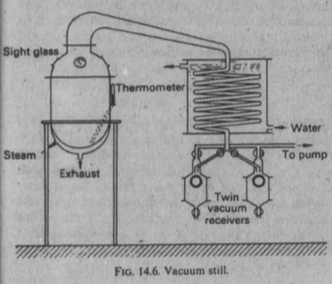

Slide 25
Fractional distillation
Fractional distillation is the process employed to separate miscible volatile liquids having different boiling points.

Slide 26
Vapor pressure of miscible liquids
When the two components of a binary mixture are completely miscible the vapor pressure of the mixture is a function of the composition as well as the vapor pressures of the two pure components.

Slide 27
According to Raoult's law
The partial vapor pressure of each volatile component is equal to the vapor pressure of the pure component multiplied by its mole fraction
Thus for a mixture of A and B
P_{A}=P_{A}⁰ X_{A}
P_{B}=P_{B}⁰ X_{B}

Slide 28
Where
P_{A} and P_{B} are the partial vapor pressures of the components when the mole fractions are X_{A} and X_{B} respectively.
The vapor pressure of the pure components are P_{A}⁰ and P_{B}⁰
The total vapor pressure P of the system is then
P_{A} + P_{B}

Slide 29
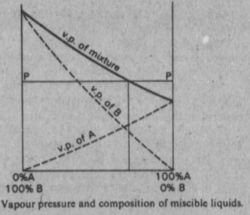

Slide 30
Binary mixtures that follow Raoult's law are those where the attraction between A and B molecules is the same as those for the pure components.
e.g. benzene/toluene and paraffin mixtures.
When the interaction of A and B molecules is less than between the molecules of pure constituents, the presence of B molecules reduce the A-A interaction and similarly the A molecules reduce the B-B interaction.

Slide 31
The partial vapor pressure is now greater than expected from Raoult's ideal solution law and the system is said to exhibit positive deviation
e.g. benzene/ethyl alcohol , chloroform/ethyl alcohol.
Negative deviation occurs when the A-B attraction is greater than the A-A or B-B attraction and the vapor pressure is less than expected, e.g. chloroform/acetone

Slide 32
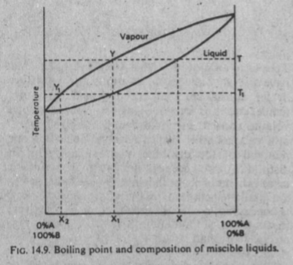
Boiling point diagram and fractional distillation

Slide 33
The lower curve shows the manner in which the boiling point of the mixture changes with composition
The upper curve relates the composition of the vapors in equilibrium with the liquid at the same temperature.
The boiling point of the mixture X is T.
The vapors at T will have a composition fixed by point Y, which corresponds to a mixture richer in B than in A.

Slide 34
If this vapor is condensed, a liquid having the composition (X₁) will be obtained.
The boiling point of the mixture X₁ is T₁ and when it is boiled, vapor having the composition Y₁ which yields a liquid X₂ on condensation is obtained.
X₂ is nearly pure B.

Slide 35
Hence in this example, extensive fractionation has been achieved by boiling the mixture and condensing the vapors in equilibrium with the liquid and repeating the process with the condensed vapors.

Slide 36
The volume of distillate (composition X₂), obtained will be small, since as the vapor is drawn off, the liquid remaining in the still gradually becomes poorer in composition B and its boiling point rises.
Fractional distillation is based on these principles.

Slide 37
Azeotropic mixtures
An Azeotropic mixture or constant boiling point mixture is one in which the composition of the liquid and the vapor in equilibrium with it is the same.
Thus the mixture behaves like a pure liquid.
Miscible binary liquids form Azeotropic mixtures when the vapor pressure curve of the mixture exhibits a maximum or minimum.

Slide 38
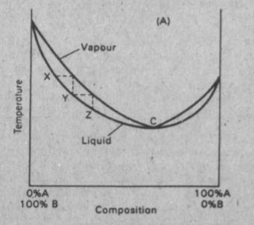
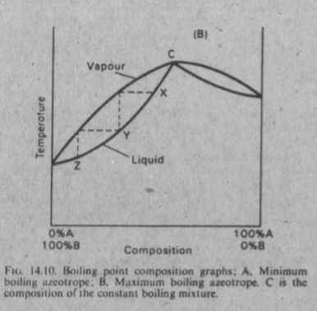

Slide 39
Such mixtures cannot be separated into pure components by distillation.
It is possible to separate them into one component and a constant boiling mixture.
Graph A; represents a mixture which posses a maximum vapor pressure, i.e. low boiling point azeotrope
Graph B; represent a mixture with minimum vapor pressure, i.e. high boiling point azeotrope

Slide 40
From A, it can be seen that repeated fractionation will produce a distillate tending to the composition of the Azeotropic mixture represented by point C.
The material left in the still will be richer in B than it was original; eventually pure B will be left after the whole of A has been distilled off in the form of the Azeotropic mixture.
If the original composition lies to the right of C then by similar reasoning A will be left in the still.

Slide 41
Mixtures of minimum boiling point are more common than mixtures exhibiting a maximum boiling point, e.g. alcohol and water, alcohol and benzene, alcohol and chloroform.b n
The boiling point of alcohol is 78.3⁰ and the Bpt of water is 100⁰. when mixed to gather they form a mixture of minimum Bpt 78.15⁰, containing 95.57 per cent w/w alcohol.

Slide 42
The composition of mixtures of minimum Bpt varies with pressure as for example water and alcohol can be completely separated by distilling at 28⁰ under 7cm pressure.
On distilling a mixture of maximum Bpt, the distillate will be richer in the component A or B depending on whether the original concentration lies to the right or left of C.

Slide 43
Ternary mixtures
Mixtures of three components which do not form azeotropes may be separated by fractional distillation in the same way as binary mixture.
Azeotropic ternary mixtures of maximum vapor pressure (minimum Bpt) are important.

Slide 44
Water boiling point 100⁰, alcohol boiling point 78.3⁰, and benzene boiling point 80.2⁰, form a ternary Azeotropic mixture, boiling point 64.85⁰, containing 18.5% of alcohol, 7.4% of water and 74.1% of benzene.
The boiling point of this mixture is lower than the boiling point of any binary mixture of any of the components.

Slide 45
Fractionation of this tertiary mixture is used on large scale for the production of absolute alcohol.
Absolute alcohol can not be obtained by normal fractionation of dilute alcohol since a constant boiling mixture of 95.57 percent w/w is formed.
Benzene is added to the alcohol-water azeotrope and when distilled the mixture yields first the ternary water-alcohol-benzene azeotrope, boiling point 64.85, until all the water is removed from the system.

Slide 46
Next a binary alcohol-benzene azeotrope, boiling point 68.2⁰ distils over and finally absolute alcohol boiling point 78.3⁰ is obtained.
Trichloroethylene may be used instead of benzene in this process.
Just enough benzene is added to the water/ethanol azeotrope to engage all of the water into the ternary azeotrope. When the mixture is then boiled, the azeotrope vaporizes leaving a residue composed almost entirely of the excess ethanol

Slide 47
Chemical action separation
Another type of entrainer is one that has a strong chemical affinity for one of the constituents.
Using again the example of the water/ethanol azeotrope, the liquid can be shaken with calcium oxide, which reacts strongly with water to form the nonvolatile compound, calcium hydroxide.
Nearly all of the calcium hydroxide can be separated by filtration and the filtrate redistilled to obtain 100% pure ethanol.

Slide 48
Fractionating columns
A fractionating column, which is inserted between the still and the condenser, acts by bringing about repeated distillation throughout the length of the column.

Slide 49
The action of the column is partially to condense the vapors rising from the boiling liquid; this condensate will be richer in the more volatile component than the original liquid and it is vaporized again by the condensation of more ascending vapors; the vapors so produced will be still richer in the more volatile components and when condensation and vaporization takes place further up the column, further enrichment in the more volatile components will be effected.

Slide 50
Under ideal conditions this will result in the lower boiling point component arriving at the top of the column and the higher boiling point component being left at the bottom of the column.
Thus a temperature gradient will be established along the column when distillation is in progress, and ultimately the vapor passing out of the column will be very rich in the low boiling point component.

Slide 51
This series of events may be easily visualized by considering the action of a bubble-cap column which is used in large scale distillation plant.

Slide 52
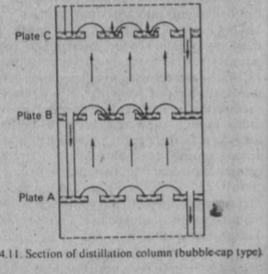

Slide 53
Bubble-cap column
The column consists of a number of plates mounted above one another, over which flows the condensed liquid (reflux) and through which the ascending vapor is made to bubble.
Ascending vapor from the still passing through the bubble-caps on plate A and the vapor rising from it will be richer in the more volatile component.

Slide 54
This vapor passes through the liquid on B, condenses and the heat of condensation partially vaporizes the liquid.
The process of condensation and vaporization will be repeated at C and so on, all the way up the column.
In this column, each bubble-plate has the same effect as a separate still.

Slide 55
Steam distillation
Theory
A mixture of immiscible liquids begins to boil when the sum of their vapor pressures is equal to the atmospheric pressure.
Thus in the case of water and a liquid which boils at much higher temperature than water, the mixture boils below the boiling point of pure water.

Slide 56
The boiling point of turpentine is about 160⁰, but when it is mixed with water and heated the mixture boils at about 95.6⁰.
At this temperature the vapor pressure of water is 647 mm and that of turpentine, 113 mm; the sum 647+113=760 mm which is the normal atmospheric pressure.

Slide 57
From these facts, it will be seen that a high boiling substance may be distilled with water at a temperature much below its boiling point.
For substances which are insoluble in water and not decomposed by it, this provides an alternative to distillation under reduced pressure.
Certain volatile solids e.g. camphor may be distilled in the same way.

Slide 58
For volatile substances which are miscible with water, distillation in steam would involve the same principles as fractional distillation.

Slide 59
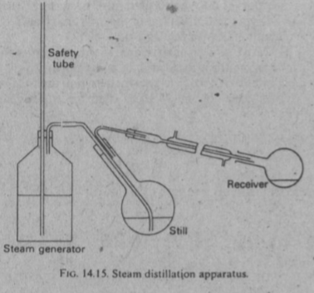
Small scale apparatus

Slide 60
The safety tube in the steam generator permits the expulsion of some water if excessive pressure is developed.
The distillate separates into two layers, water and the other component; these are separated in a separating funnel.
Steam distillation is used to determine volatile oils in drugs.

Slide 61
Large scale apparatus
Steam distillation is used to extract most of the volatile oils such as clove, aniseed, eucalyptus and so on.

Slide 62
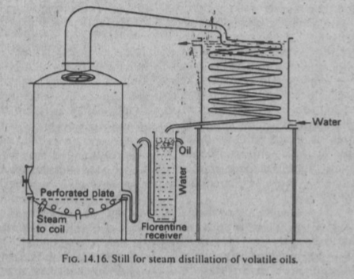

Slide 63
Live steam is injected below the material which is supported on a perforated false bottom.
Means of charging and discharging the still are provided by manholes in the top and sides.
Most volatile oils are lighter than water and will separate from the distillate as an upper layer.

Slide 64
If Florentine receiver is used the water can run off from the spout on the left and can be returned to the still or run to waste.
The oil which collects on the surface is run off from the upper spout.
Some volatile oils are heavier then water in which case the operation is reversed.

Slide 65
Where the specific gravity of the oil is so near to 1.0 that separation does not takes place, it may be necessary to collect the whole of the distillate and extract it with a volatile solvent and subsequently distilling off the solvent from the oil.

Slide 66
Destructive distillation

