Slide 1
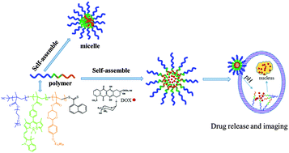
Controlled Drug Release

Slide 2
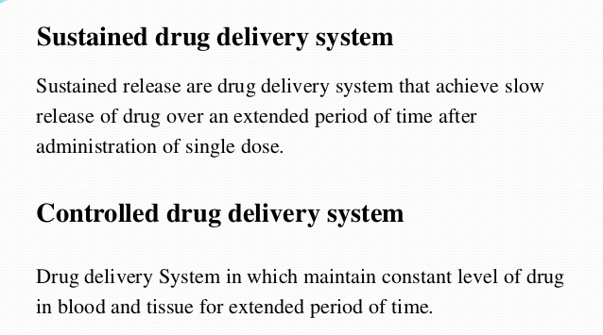


Slide 3
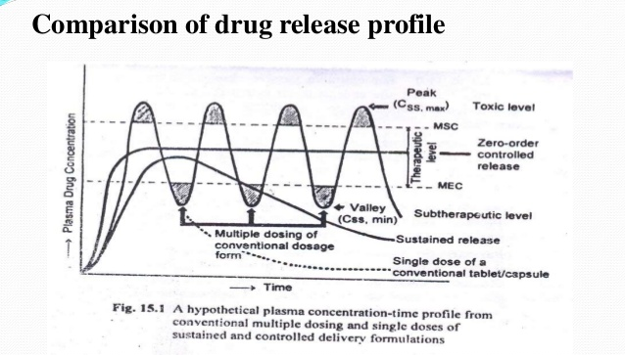

Slide 4
Controlled drug release
Controlled drug release coatings have been around for more than 50 years and their performance has increased significantly since the beginning.¹ The development and improvement of the coatings are partly due to more controlled chemistry during their fabrication. The aim of a pharmaceutical product is to obtain an optimal therapeutic and benign treatment.² It consists of a combination of an effective active pharmaceutical ingredient and a tailored controlled release (CR) rate. It also involves a minimization of the amount of drug that is needed and a reduction of plausible side effects.^{3–5} Different aspects need to be addressed to obtain the specific drug release behaviour that is intended.

Slide 5
Very often, concerning oral CR formulations, the gastrointestinal (GI) tract is of great importance to consider since it is the location of the drug release and from which the drug will be further transported to the target location
The pH-value varies throughout the GI tract and does also vary depending on fed or fasting condition. The pH value varies between 1 and 5.5 in the upper part while it is between 5.5 and 7 in the lower part.^{7,8} The different pH values of the different parts need to be taken into account when, for example, selecting the soft material to be designed to dissolve in the upper GI tract.

Slide 6
Immediate release (IR) formulations, also denoted as conventional formulations, give a rapid release of the drug from the formulation. IR can be provided by several formulation systems, such as tablets, capsules, and pellets, through adding a coating that surrounds the drug. The IR formulations are desired for occasions, such as acute drug delivery targeting diseases in the GI tract or infections that need a fast delivery of the drug.^{9,10} Another application of IR formulations is to provide a barrier to prevent oxygen degradation. Some drugs are sensitive to the presence of oxygen. They can oxidize and thus degrade, and in such cases an IR coating can act as an oxygen barrier. Studies performed on free polymer films indicate a reduction in penetration rate of oxygen through the free polymer films. This effect can be used to increase the durability of the product.¹² However, if controlled drug release over a longer period of time is desired, then the choice of material is CR formulations. The fundamental constituents of a CR formulation are either a drug core coated with a film (also denoted as membrane) or a matrix in which the drug is dispersed.

Slide 7
A common factor for both IR and CR are that they are very frequently soft materials consisting of a combination of polymers for a tailored release. Both natural and synthetic polymers are used. Examples of natural polymers are various types of modified cellulose: cellulose derivatives. They are frequently used due to their susceptibility to chemical modification offering possibilities for material design.
The purpose of the formulations is to increase the pharmaceutical efficiency for the patient, all involved materials need to fulfill the requirements for being human-body friendly. Hence, free from toxicity and not being harmful either before or after degradation.

Slide 8
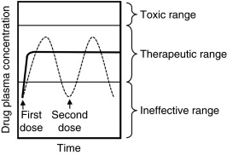
The major difference between IR and CR is thus the drug release rate. The intake of IR formulations usually occurs as a repeated administration. When the drug has done its impact, the administration of a new IR formulation occurs, while a CR formulation lasts for a longer period of time. Fig.1 shows the different drug plasma concentrations corresponding to IR and CR formulations, where two administrations of IR formulations and one administration of CR formulation occur during the illustrated time period.
Figure 1. Illustration of the Different Drug Plasma Concentrations
For immediate release (IR) formulations, broken line, and controlled release (CR) formulations, solid line. Two administrations of the IR formulations are marked with arrows and denoted as first and second dose. The different drug plasma concentrations are marked with thinner solid lines, which are toxic range, therapeutic range, and ineffective range.

Slide 9
Drug Delivery System
A drug delivery system (DDS) is defined as a formulation or a device that enables the introduction of a therapeutic substance into the body and improves its efficacy and safety by controlling the rate, time, and place of release of drugs in the body.
When developing drug delivery system, it is important to control:
The amount of drug to be released:
If too much drug is delivered, it will be harmful for the body and if minute amounts are released then the effectiveness of drug will be limited.
2. The system should be able to deliver optimal dosage of drug for optimal length of time in order to make it more effective and powerful.

Slide 10
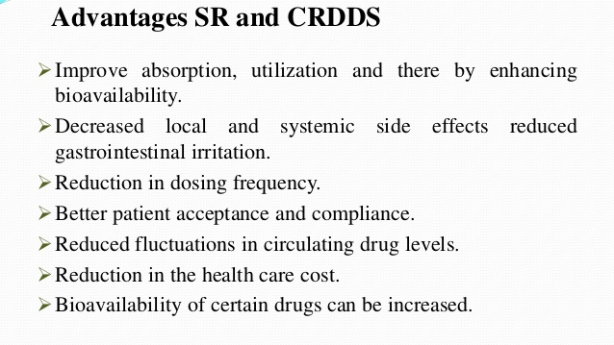

Slide 11
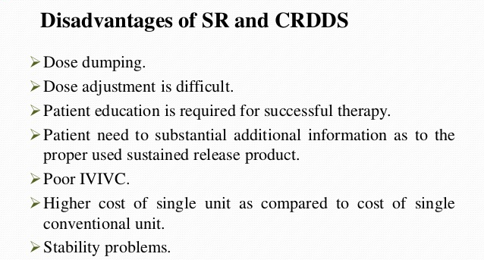

Slide 12
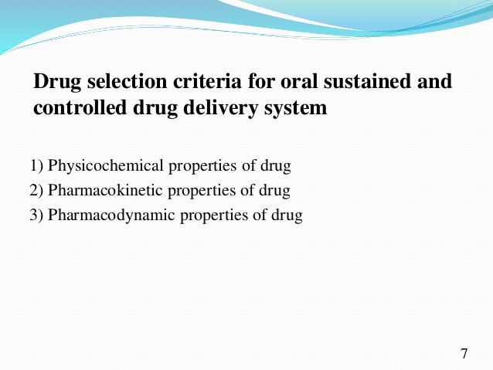

Slide 14
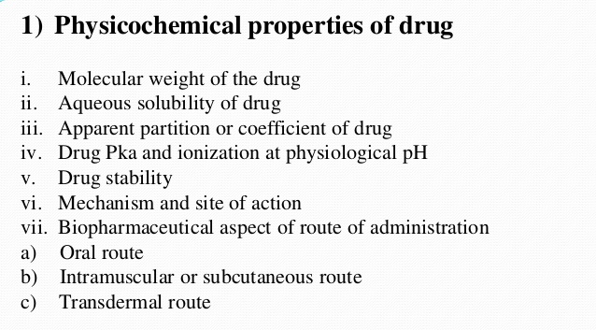

Slide 15
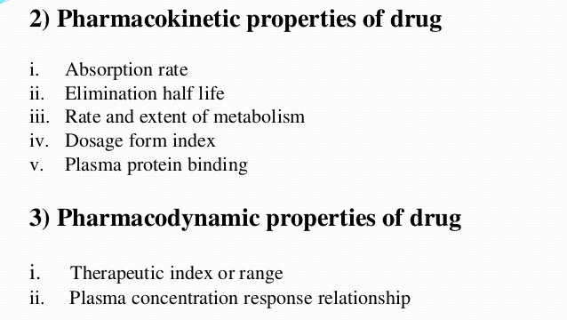

Slide 16
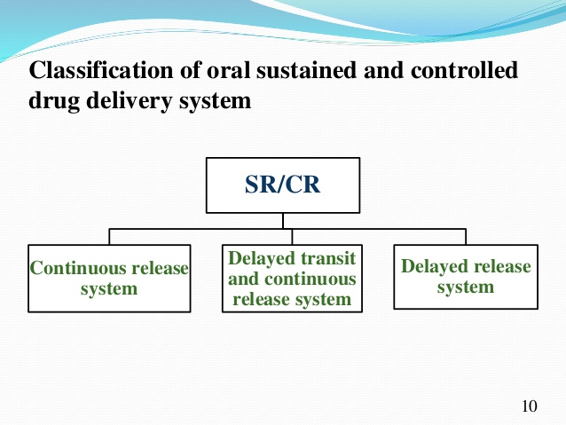

Slide 17
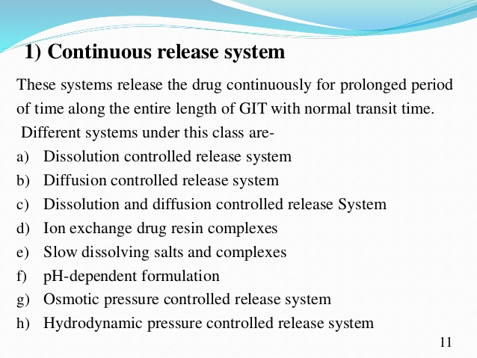

Slide 18
IMPORTANCE OF CONTROLLED DRUG DELIVERY SYSTEM
Control over the drug delivery is important when traditional oral or injectable formulations cannot be used
In situations like:
Slow release of water soluble drugs
Fast release of low solubility drugs
Drug delivery to specific site
Drug delivery using nano particle system
Delivery of two or more agents with same formulations

Slide 19
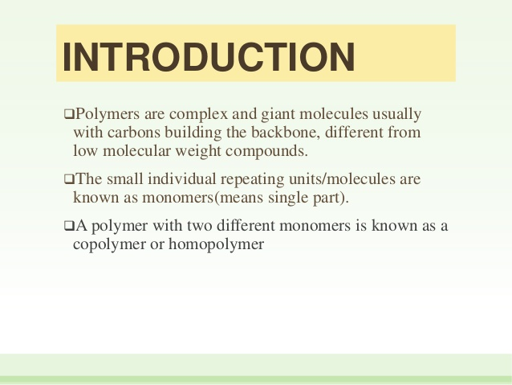

Slide 20
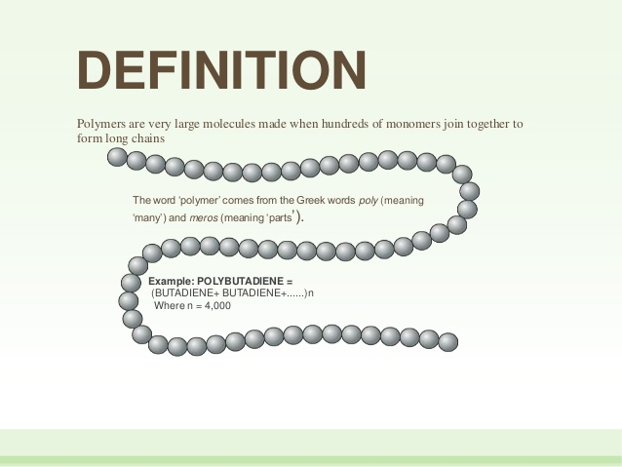

Slide 21
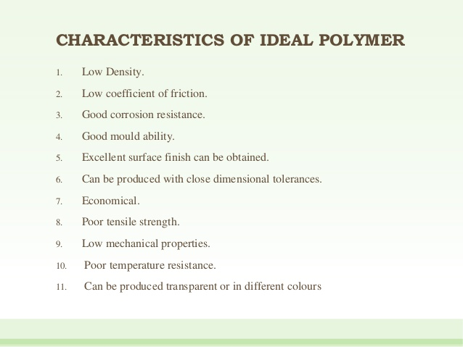

Slide 22
Polymer-Based Drug Delivery Systems
In addition to widespread applications of polymers in manufacturing different materials , they are used in several formulations and devices for drug delivery.
Polymers applied to controlled drug release are often referred to as treatment polymers.
The main purpose of the application of polymers for drug delivery systems is in controlled drug release. In these usages, drugs are trapped or mixed in polymer matrices

Slide 23
Characteristics of polymers
The polymers have some unique characteristics that make them versatile in drug delivery systems. These are:
Wide molecular weight distributions
Variety of visco-elastic properties
Special characteristics associated with phase transitions
Able to contract when heated
Variety of dissolution times
Specialized chemical reactivities
Tolerate a variety of manufacturing methods

Slide 24
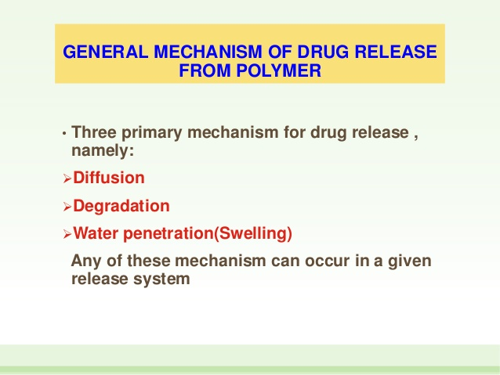

Slide 25
ADVANTAGES
These systems introduced the following advantages compared with other methods of delivery:
the possibility of maintaining plasma drug levels in the optimal therapeutic range.
the eventuality to remove or decrease damaging side effects from systemic drug delivery by the local administration from a controlled release system
drug execution may be improved and facilitated in organs that are not under good medical supervision
the administration of medications with a short half-life inside the body is probably seriously facilitated
steady small doses of drug may be less painful compared with several large doses for patients
improvement of patient satisfaction
the application of drug delivery systems may lead to relatively cheaper products and less drug waste

Slide 26
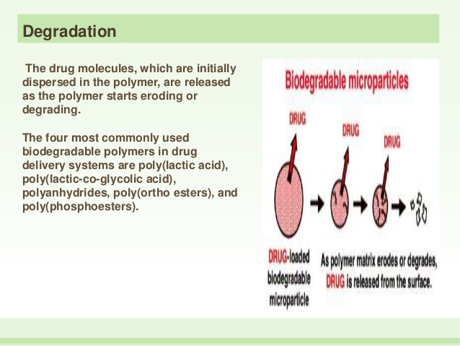

Slide 27
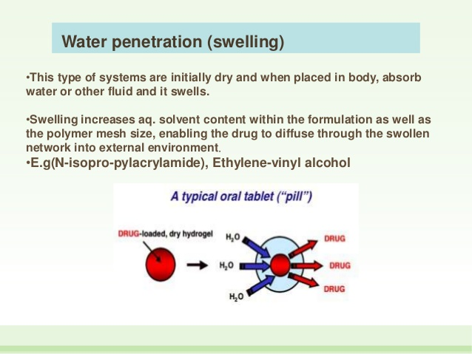

Slide 28
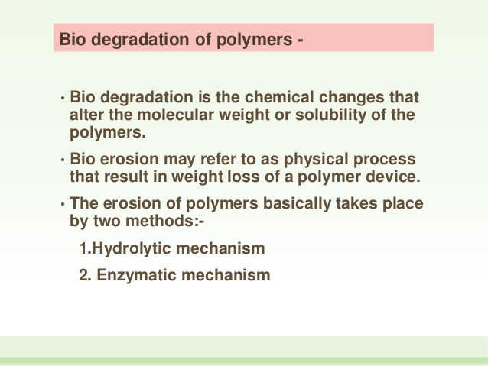

Slide 29
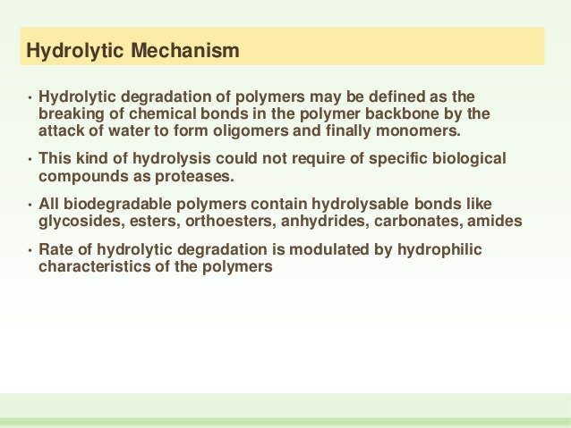

Slide 30
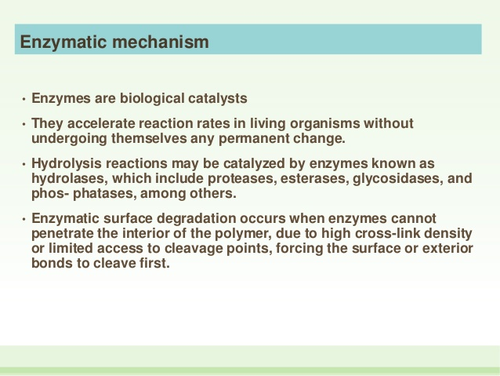

Slide 31
ADVANTAGES OF CONTROLLED DRUG RELEASE OVER CONVENTIONAL RELEASE
There are many characteristic properties of polymer but three characteristics that make polymers ideal for drug delivery are
Biocompatibility
biodegradibility
Non toxicity

Slide 32
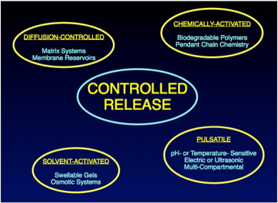
Types of controlled drug delivery systems

