Slide 1
Cell Biology: Lecture 13b
Chloroplast Remaining:
Structure of chlorophyll
Light Reaction
Dark Reaction

Slide 2
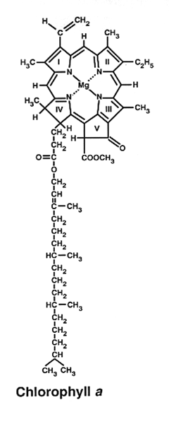
Structure of Chlorophyll

Slide 3
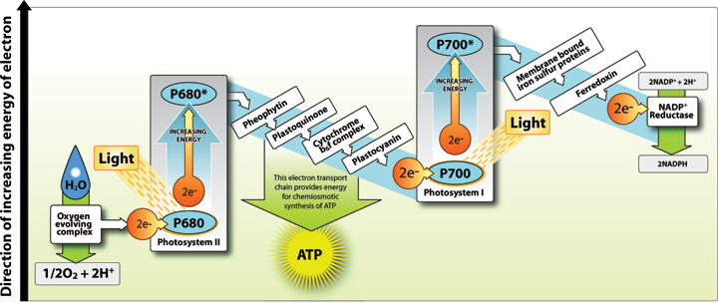

Slide 4
