Slide 1
SOLVENT ,DIFFUSION AND CHEMICALLY CONTROLLED DRUG RELEASE SYSTEM

Slide 2
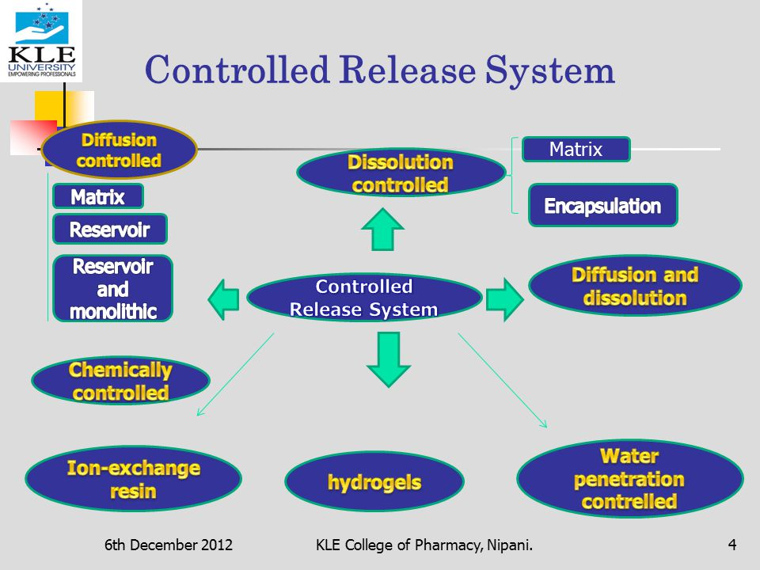

Slide 3
DRUG RELEASE FROM POLYMERIC SYSTEMS
There are three types of polymeric controlled drug delivery systems, these are:
DIFFUSION-CONTROLLED SYSTEMS
Monolithic (Matrix) devices
Reservoir devices
2. SOLVENT-CONTROLLED SYSTEMS
Osmotically controlled devices.
Swelling-controlled devices
3. CHEMICALLY-CONTROLLED SYSTEMS

Slide 4
SOLVENT-CONTROLLED SYSTEMS

Slide 5
solvent-controlled systems
In solvent-controlled systems, the active agent is released as a consequence of controlled penetration of a solvent (water) into the device.
Two general mechanism are
Osmosis
swelling

Slide 6
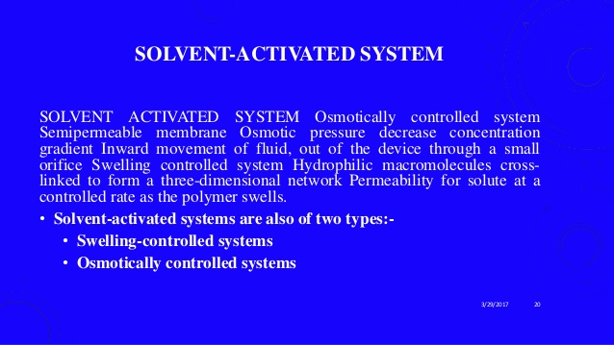

Slide 7
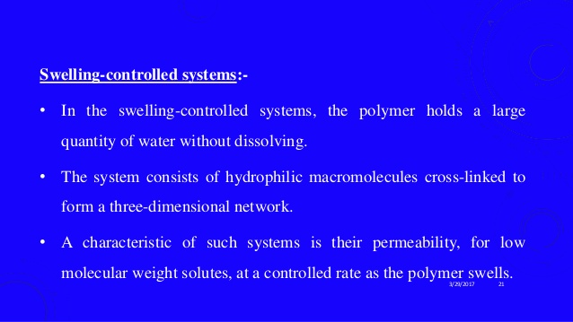

Slide 8
SWELLING CONTROLLED DEVICES
The active agent is homogeneously dispersed in a GLASSY polymer.
When the device is placed in aqueous environment, water begins to penetrate in the matrix and swelling takes place.
As a consequence, monomer chains relax and the active agent begins to diffuse from the swollen layer.

Slide 9
RELEASE RATE
Drug release is a function of rate of uptake of water from the surrounding media and the rate of drug diffusion.
Matrix design/composition, as well as drug affect the release rate

Slide 10
EXAMPLE
Syncro-Mate-B implant
Ethylene glycomethacrylate
Hydrogels (Hydron S):
For subcutaneous administration of norgestomet
Potent progestin

Slide 11
ADVANTAGES/DISADVANTAGES
ADVANTAGES:
Bio compatibility
Good permeability of the drug molecules as the matrix swell
DISADVANTAGES:
Potential variability in drug release
Low tensile strength upon swelling

Slide 12
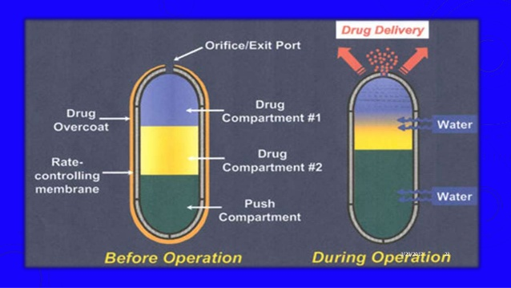

Slide 13
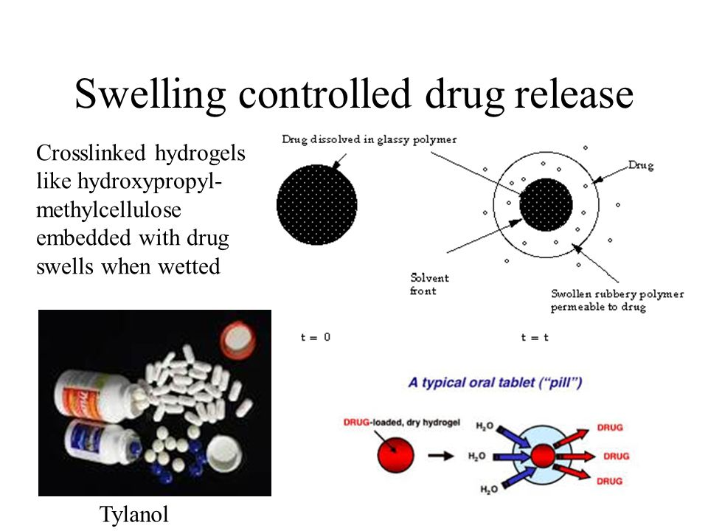

Slide 14
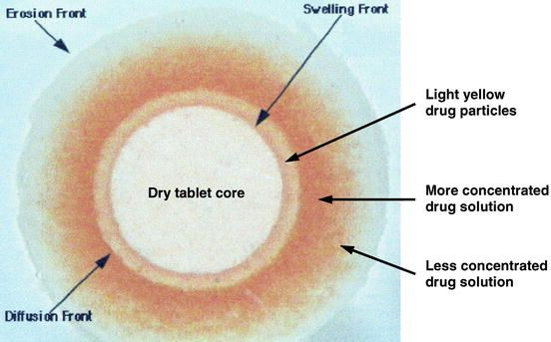

Slide 15
OSMOTICALLY CONTROLLED DEVICES
An external fluid containing a very low concentration of drug moves across semi permeable membrane to a region inside a device where drug is in high concentration.
The inward movement of the fluid forces the dissolved drug out of the device through a small orifice.

Slide 16
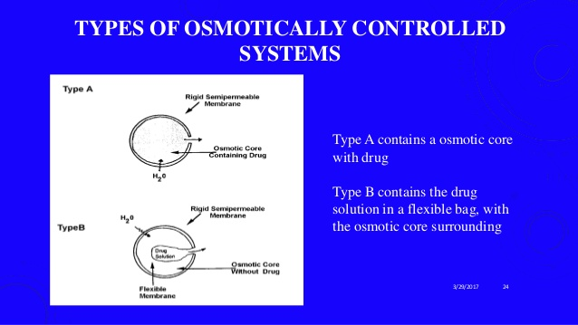

Slide 17
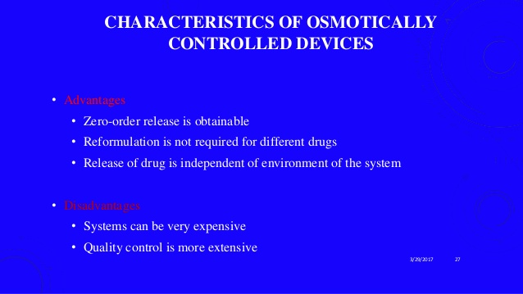

Slide 18
EXAMPLES
ALZA osmotic pumps.
ADVANTAGES:
Operation independent of active agent properties
Ability to deliver macromolecules
Constant delivery rates higher than those acheivale by diffusional devices
DISADVANTAGES
Principal barrier to development
Membrane must have an extremely high water permeability to produce an osmotic pressure high enough to achieve useful drug release

Slide 19
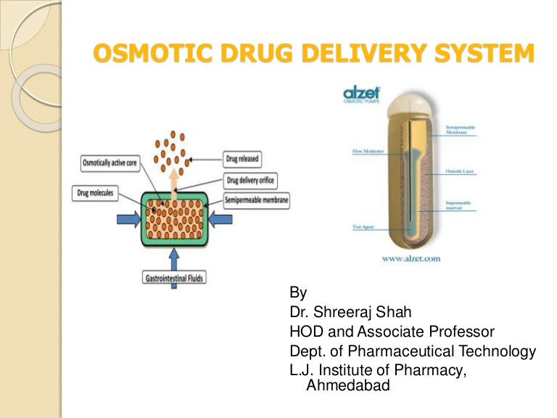

Slide 20
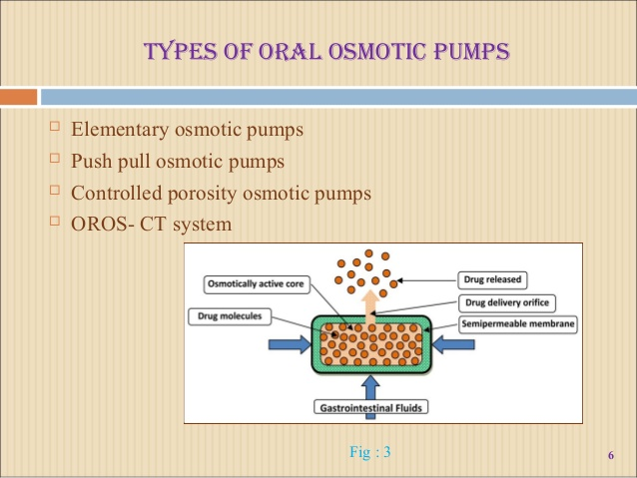

Slide 21
DIFFUSION CONTROLLED SYSTEMS

Slide 22
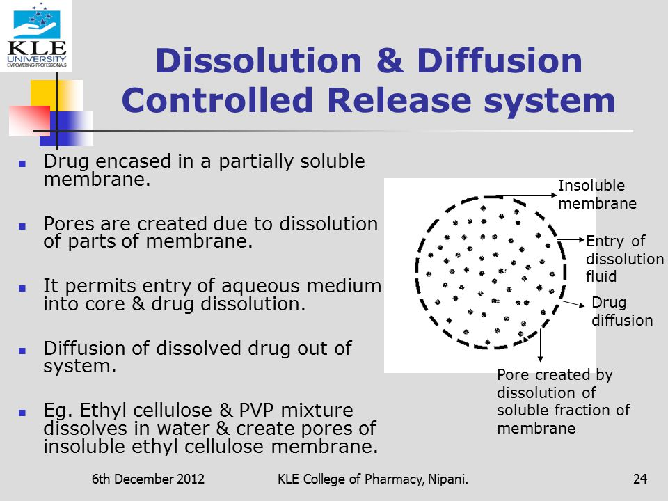

Slide 23
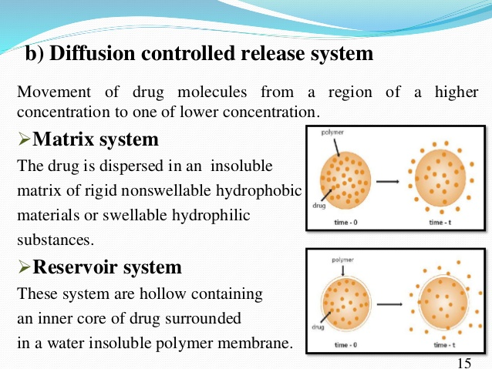

Slide 24
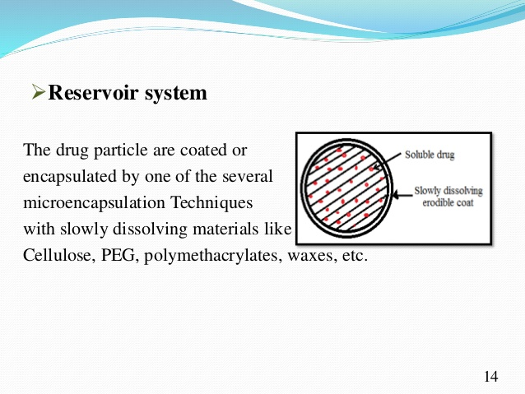

Slide 25
RESERVOIR DEVICES
The active agent is surrounded by a nonporous, homogeneous rate-controlling membrane.
RELEASE RATE: zero order
ADVANTAGE
Constant release
DISADVANTAGE
Possibility of drug dumping
Boundary layer effects
Complex manufacturing process
EXAMPLE:
Ocusert

Slide 26
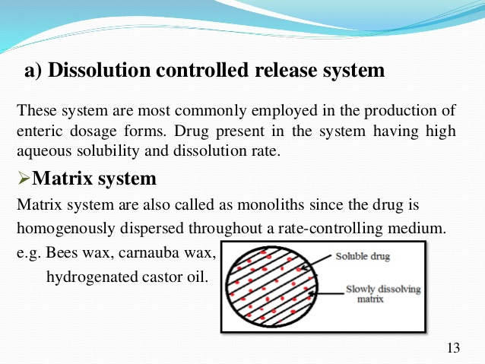

Slide 27
MONOLITHIC(MATRIX) DEVICES
The therapeutic agent is intimately mixed in a rate controlling polymer.
Active agent may be dissolved or dispersed within the polymer matrix.
Release rate: first order
ADVANTAGE:
simple and convenient preparation.
Drug dumping is not a problem.
DISADVANTAGE:
Variable release rate

Slide 28
CHEMICALLY-CONTROLLED SYSTEMS

Slide 29
Rate of active agent release from the polymer is controlled by a chemical reaction that can be hydrolytic or enzymatic cleavage of a labile bond, ionization or protonation.
Drug is covalently attached to the polymer backbone, possibility of targeting,.
Drug contained in a core surrounded by a bioerodible rate-controlling membrane. Combine the attributes of a reservoir type device and bioerodibility.
Drug is homogeneously dispersed in a polymer, release is controlled by diffusion, by a combination of diffusion and erosion or by erosion as shown in figures.
ADVANTAGE: biodegradation and elimination of the device, particularly important for implants

Slide 30
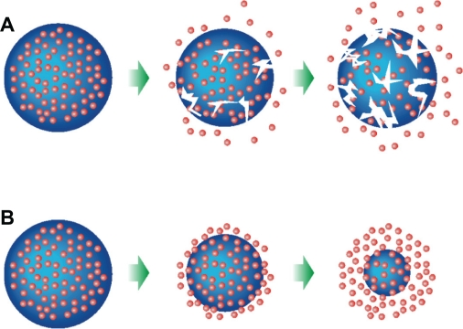

Slide 31
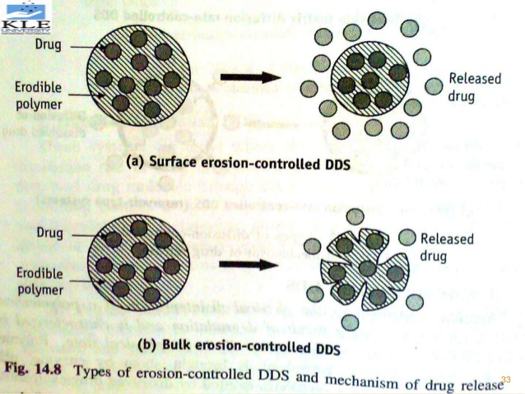

Slide 32
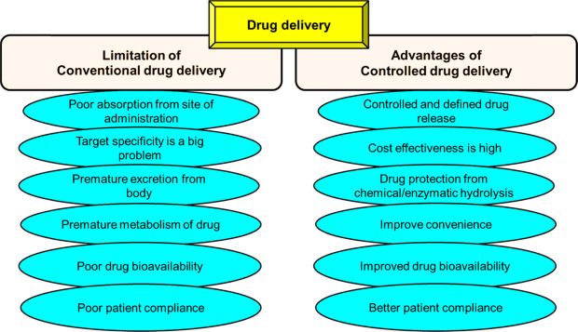

Slide 33
