Slide 1
Cell Biology: Lecture 15
Cellular Respiration
Glycolysis
Krebs Cycle
Electron Transport Chain

Slide 2
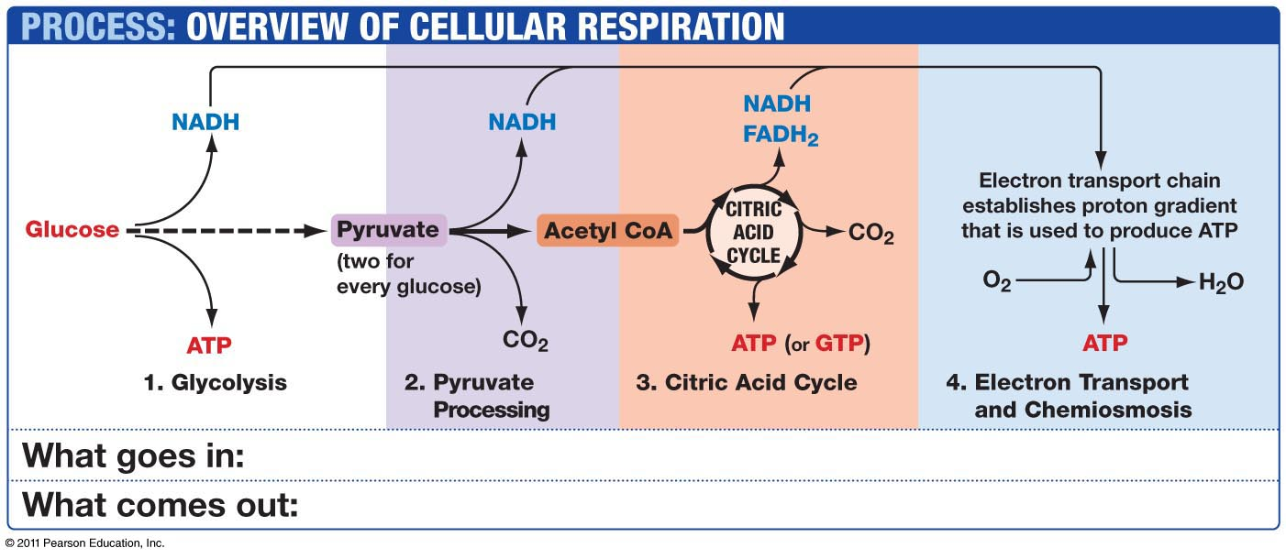

Slide 3
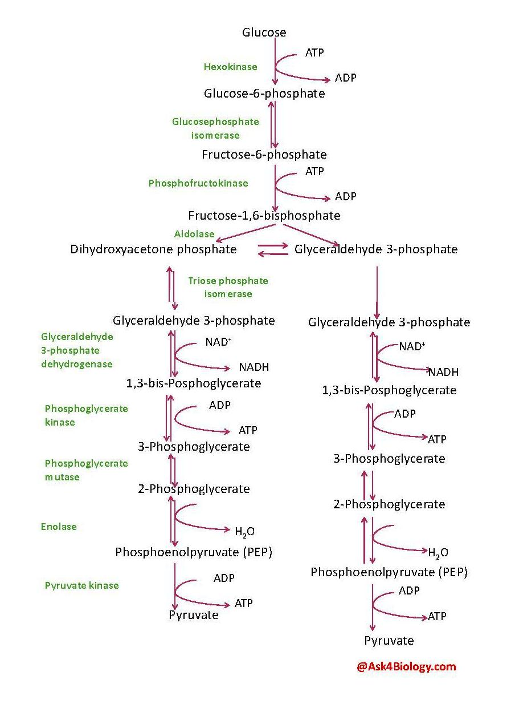

Slide 4
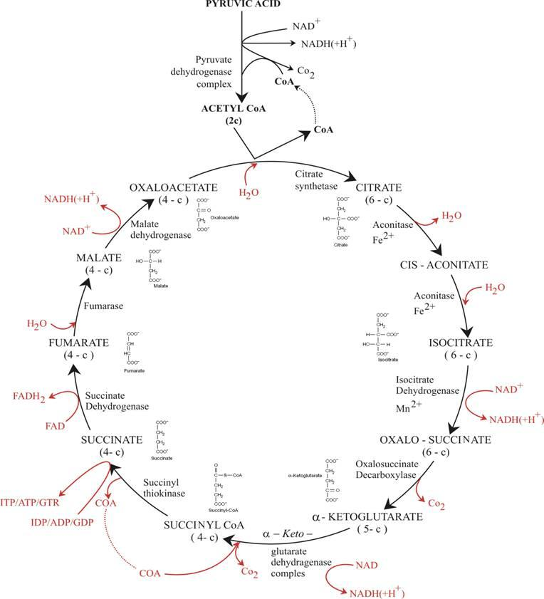

Slide 5
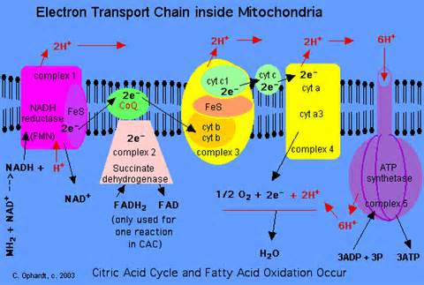

Slide 6
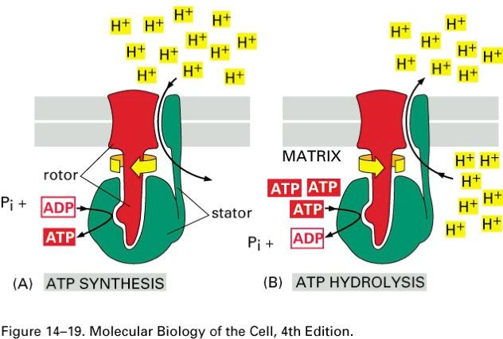

Slide 7
