Slide 1
Genetics of antibiotic resistance
The abilities of bacterial organisms to utilize the various strategies to resist antimicrobial compounds are all genetically encoded.
Intrinsic Resistance
Intrinsic resistance is the innate ability of a bacterial species to resist activity of a particular antimicrobial agent through its inherent structural or functional characteristics, which allow tolerance of a particular drug or antimicrobial class.
This can also be called “insensitivity” since it occurs in organisms that have never been susceptible to that particular drug.
Such natural insensitivity can be due to:
Lack of affinity of the drug for the bacterial target
Inaccessibility of the drug into the bacterial cell
Extrusion of the drug by chromosomally encoded active exporters
Innate production of enzymes that inactivate the drug

Slide 2
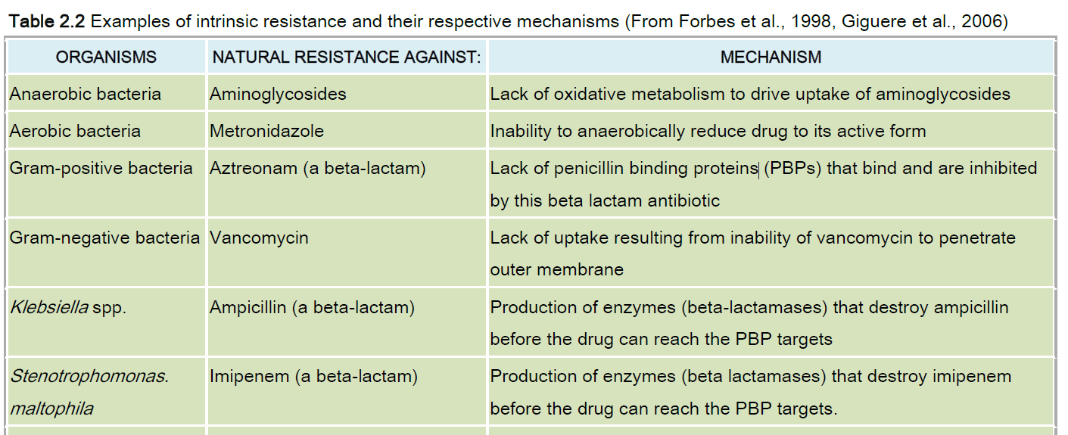

Slide 3
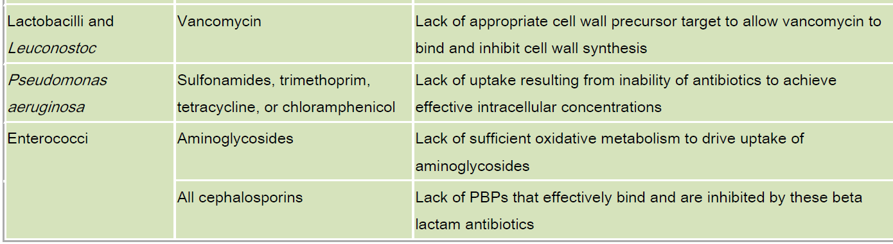

Slide 4
Biofilms, which are an aggregation of bacterial cells firmly attached to a surface via tendrils or filaments, exemplify several forms of intrinsic resistance.
They are surrounded by a slimy protective coating of DNA, proteins, and polysaccharides that forms a barrier to penetration by antibiotics.
Electrical charges on the slime surface further bar entry of some antimicrobial drugs.
The complex three-dimensional structure of biofilms contains transport proteins for nutrient uptake and waste disposal; the latter of these can pump drugs out of cells.
Biofilms can reduce the concentration of some antimicrobial drugs reaching bacterial cells, rendering them less effective in disabling bacteria.
Since the cells deep within a biofilm receive less oxygen and fewer nutrients, they grow relatively slowly and are thus less susceptible to antimicrobial drug action.

Slide 5
Acquired Resistance
Acquired resistance is said to occur when a particular microorganism obtains the ability to resist the activity of a particular antimicrobial agent to which it was previously susceptible.
This can result from the mutation of genes involved in normal physiological processes and cellular structures, from the acquisition of foreign resistance genes or from a combination of these two mechanisms.
Acquired resistance results from successful gene change and/or exchange that may involve: mutation or horizontal gene transfer via transformation, transduction or conjugation.

Slide 6
Unlike intrinsic resistance, traits associated with acquired resistance are found only in some strains or subpopulations of each particular bacterial species.
Laboratory methods are therefore needed to detect acquired resistance in bacterial species that are not intrinsically resistant.
These same methods are used for monitoring rates of acquired resistance as a means of combating the emergence and spread of acquired resistance traits in pathogenic and non-pathogenic bacterial species.

Slide 7
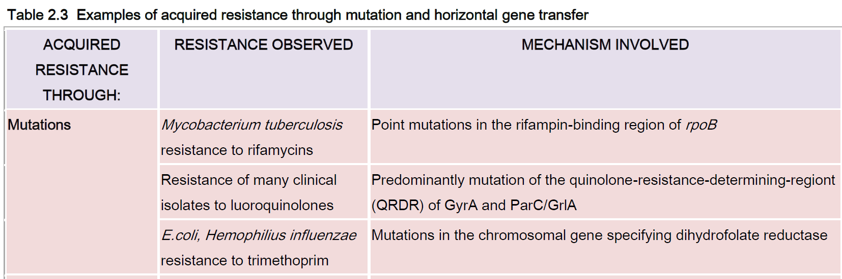

Slide 8
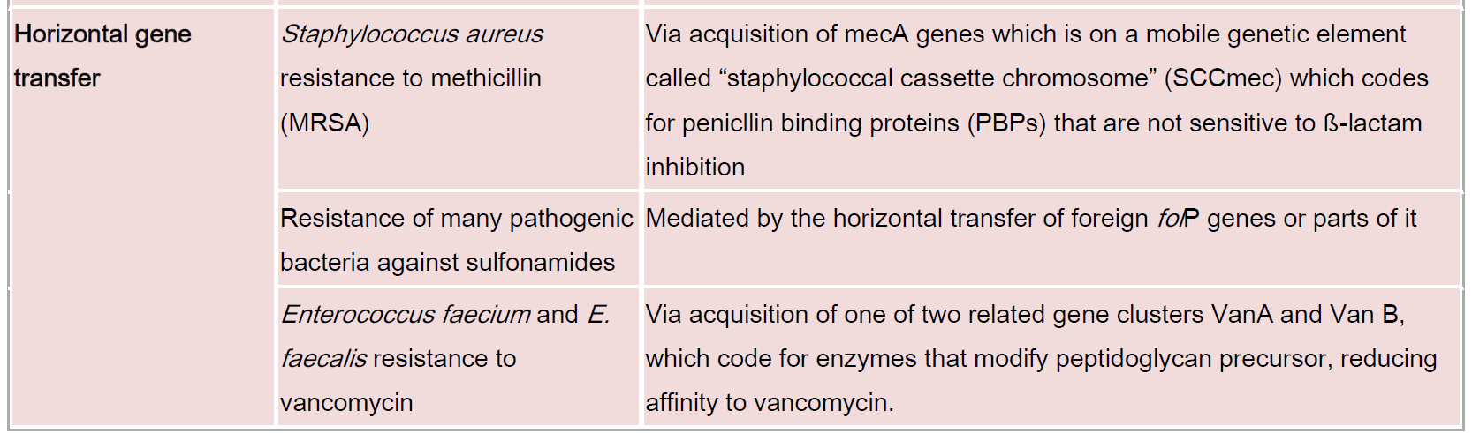

Slide 9
Mechanism of acquired resistance via gene change or exchange
Antibiotics exert selective pressure on bacterial populations by killing susceptible bacteria, allowing strains with resistance to an antibiotic to survive and multiply.
These traits are vertically passed on to subsequently reproduced cells and become sources of resistance.
Because resistance traits are not necessarily eliminated or reversed, resistance to a variety of antibiotics may be accumulated over time.
This can lead to strains with multiple drug resistance, which are more difficult to eliminate due to limited effective treatment options.

Slide 10
Mutation
A mutation is a spontaneous change in the DNA sequence within the gene that may lead to a change in the trait which it codes for.
Any change in a single base pair may lead to a corresponding change in one or more of the amino acids for which it codes, which can then change the enzyme or cell structure that consequently changes the affinity or effective activity of the targeted antimicrobials.
In prokaryotic genomes, mutations frequently occur due to base changes caused by exogenous agents, DNA polymerase errors, deletions, insertions and duplications.
For prokaryotes, there is a constant rate of spontaneous mutation of about 0.0033 mutations per DNA replication that is relatively uniform for a diverse spectrum of organisms.
The mutation rate for individual genes varies significantly among and within genes

Slide 11
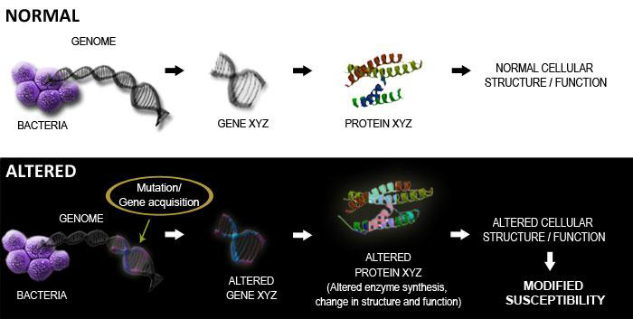

Slide 12
Horizontal gene transfer, or the process of swapping genetic material between neighboring “contemporary” bacteria, is another means by which resistance can be acquired.
Many of the antibiotic resistance genes are carried on plasmids, transposons or integrons that can act as vectors that transfer these genes to other members of the same bacterial species, as well as to bacteria in another genus or species.
Horizontal gene transfer may occur via three main mechanisms: transformation, transduction or conjugation.

Slide 13
Transformation involves uptake of short fragments of naked DNA by naturally transformable bacteria.
Transduction involves transfer of DNA from one bacterium into another via bacteriophages.
Conjugation involves transfer of DNA via sexual pilus and requires cell–to-cell contact.
DNA fragments that contain resistance genes from resistant donors can then make previously susceptible bacteria express resistance as coded by these newly acquired resistance genes.

