Slide 1
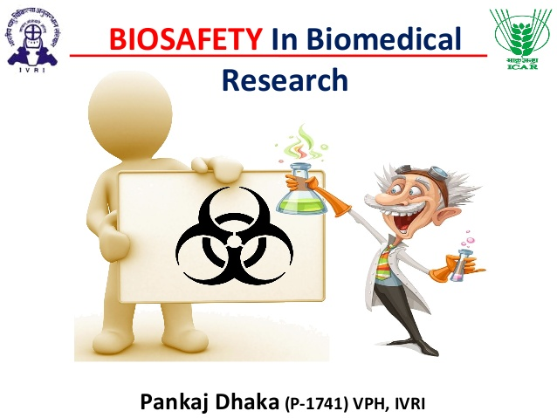
BIOSAFETY

Slide 2
BIOSAFETY
The policies and procedures invariably adapted to ensure the environmentally safe applications of biotechnology.
Biosafety levels (BSL) usually refers to a classification system used to indicate the safety precautions required for those investigation microorganisms, especially viruses known to be dangerous and lethal to those exposed to them.

Slide 3
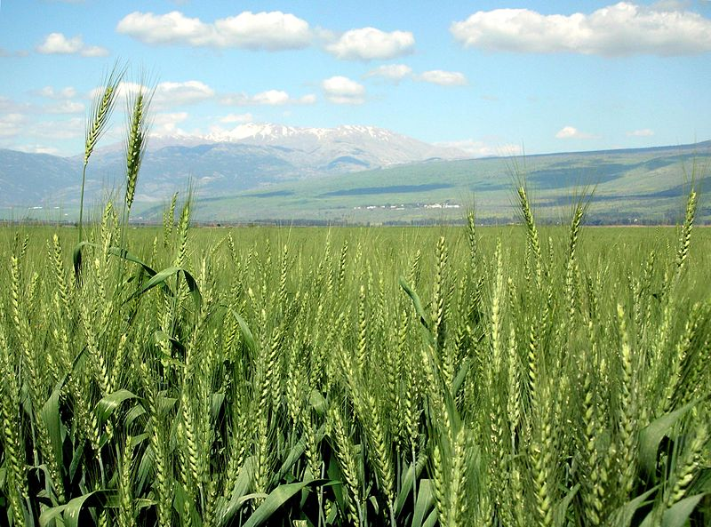
GREEN REVOLUTION TO GENE REVOLUTION

Slide 4
MAJOR CONCERNS
Risks for human health
Risks for environment
Risks for agriculture
Risks for interaction with non-target organism

Slide 5
Risks for human health
Toxicity vs. food quality/safety
Allergies
Pathogens drug resistance i.e. antibiotic resistance

Slide 6
Risks For Environment
Persistence of gene/ transgene/ transgene products
Resistance of target organisms or susceptibility of non-target organisms
Increased usage of chemicals in agriculture
Transgene instability
Unpredictable gene expressions

Slide 7
Risks for Agriculture
Weeds or super weeds
Change in nutritional values
Reduction of cultivars
Loss of biodiversity

Slide 8
Risks for interaction with non-target organism
Genetic pollution via pollen or seed dispersal
Horizontal gene transfer
DNA uptake i.e. transfer of foreign gene to microorganisms.
Generation of new line viruses by Recombinant DNA Technology

Slide 9
BIOSAFTEY GUIDELINES AND REGULATIONS
Several countries have formulated specific biosafety guidelines with the aims:
To reduce the usual probability of infrequent release of GMOs.
To prevent and check the intentional release of such GMOs into the environment.

Slide 10
Worldwide committees for biosafety
Some committees worldwide for biosafety are:
1.Institutional Biosafety Committee; to monitor the ongoing research activities at institutional level
2. Genetic Engineering Approval Committee; to permit the large scale applications of GMOs at commercial levels and to open the field of trials of transgenic substances i.e. agricultural, industrial and health care products.

