Slide 1
CHLOROPLAST
Cell Biology: Lecture 13a

Slide 2
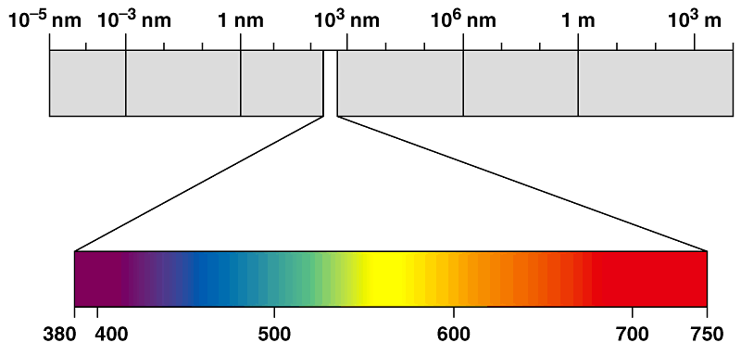
WHY ARE PLANTS GREEN?
Different wavelengths of visible light are seen by the human eye as different colors.
Gamma
rays
X-rays
UV
Infrared
Micro-
waves
Radio
waves
Visible light
Wavelength (nm)

Slide 3
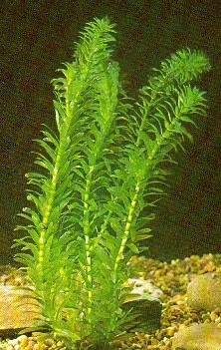
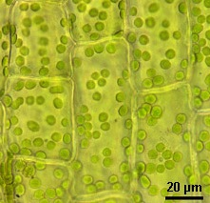
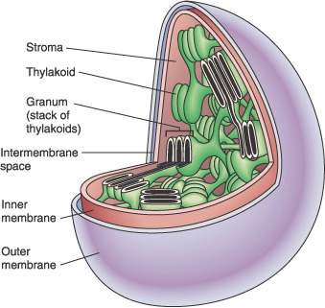
WHY ARE PLANTS GREEN?
Plant Cells have Green Chloroplasts
The thylakoid membrane of the chloroplast is impregnated with photosynthetic pigments (i.e., chlorophylls, carotenoids).

Slide 4
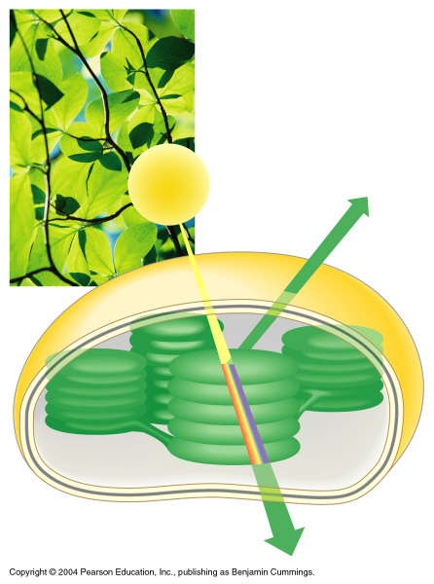
THE COLOR OF LIGHT SEEN IS THE COLOR NOT ABSORBED
Chloroplasts absorb light energy and convert it to chemical energy
Reflected
light
Light
Absorbed
light
Transmitted
light
Chloroplast

Slide 5
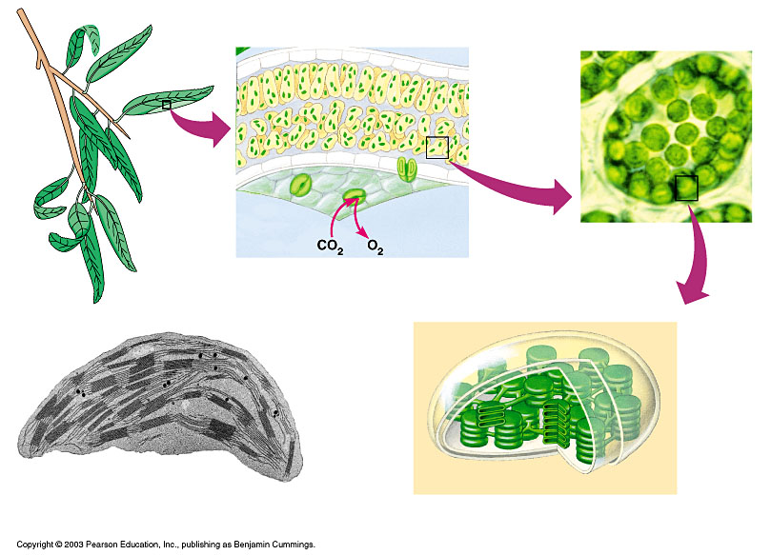
The location and structure of chloroplasts
Chloroplast
LEAF CROSS SECTION
MESOPHYLL CELL
LEAF
Mesophyll
CHLOROPLAST
Intermembrane space
Outer
membrane
Granum
Inner
membrane
Grana
Stroma
Thylakoid
compartment
Stroma
Thylakoid

Slide 6
Chloroplasts
It is a type of plastids
Plastids: A group of plant and algal membrane-bound organelles that include
Amyloplasts,
Chromoplasts and
Chloroplasts.

Slide 7
Amyloplasts : (Amylo= starch) colorless plastids that store starch; found in roots and tubers.
Chromoplasts : (chromo=color) plastids containing pigments other than chlorophyll; responsible for the orange and yellow color of fruits, flowers and autumn leaves.
  Chloroplasts: (Chloro= green) Chlorophyll-containing plastids which are the sites of photosynthesis
    Found in eukaryotic algae, leaves and other green plant organs
    Are lens-shaped and measure about 2µm by 5µm
    Are dynamic structures that change shape, move and divide.

Slide 8
Ultra structure of chloroplast
1. Chloroplast membrane
2. Stroma or Matrix
3.Grana
4. Lamellae
Stroma lamellae
Grana lamellae- Thylakoid -chlorophyll- quantasomes
5. Osmiophilic granules
6. Ribosomes
7. DNA & RNA

Slide 9
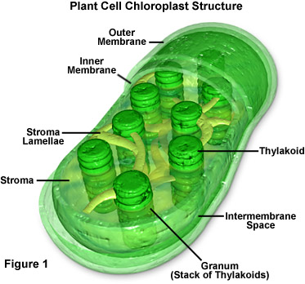
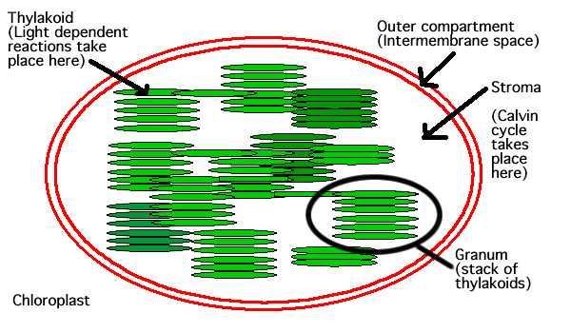

Slide 10
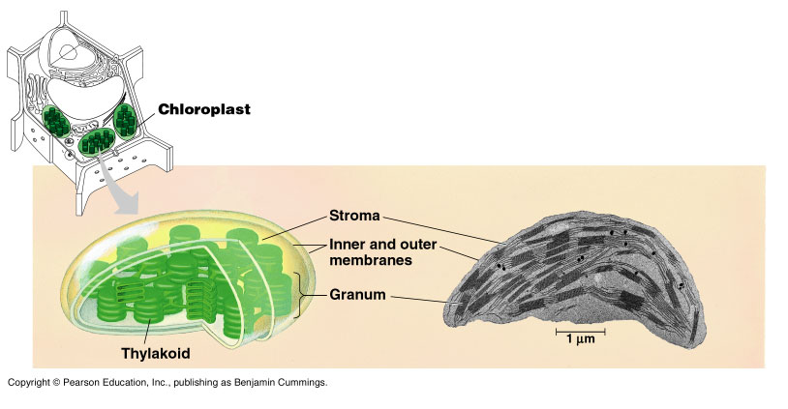

Slide 11
  Chlorophyll is found in the thylakoid membranes
  Thylakoid membrane---230chl molecules+40-50 carotinoids
  Thylakoids function in the steps of photosynthesis that initially convert light energy to chemical energy
  Some thylakoids are stacked into grana
  Grana : (Singular: granum) Stacks of thylakoids in a chloroplast
3. Stroma: Photosynthetic reactions that convert carbon dioxide to sugar occur in the stroma.
Stroma: Viscous fluid outside the thylakoids
Notes:
Like mitochondria, chloroplasts are dynamic structures.
Their shape is plastic and they can reproduce themselves by pinching in two.
Mitochondria and chloroplasts are mobile and move around the cell along tracks in the cytoskeleton.

Slide 12
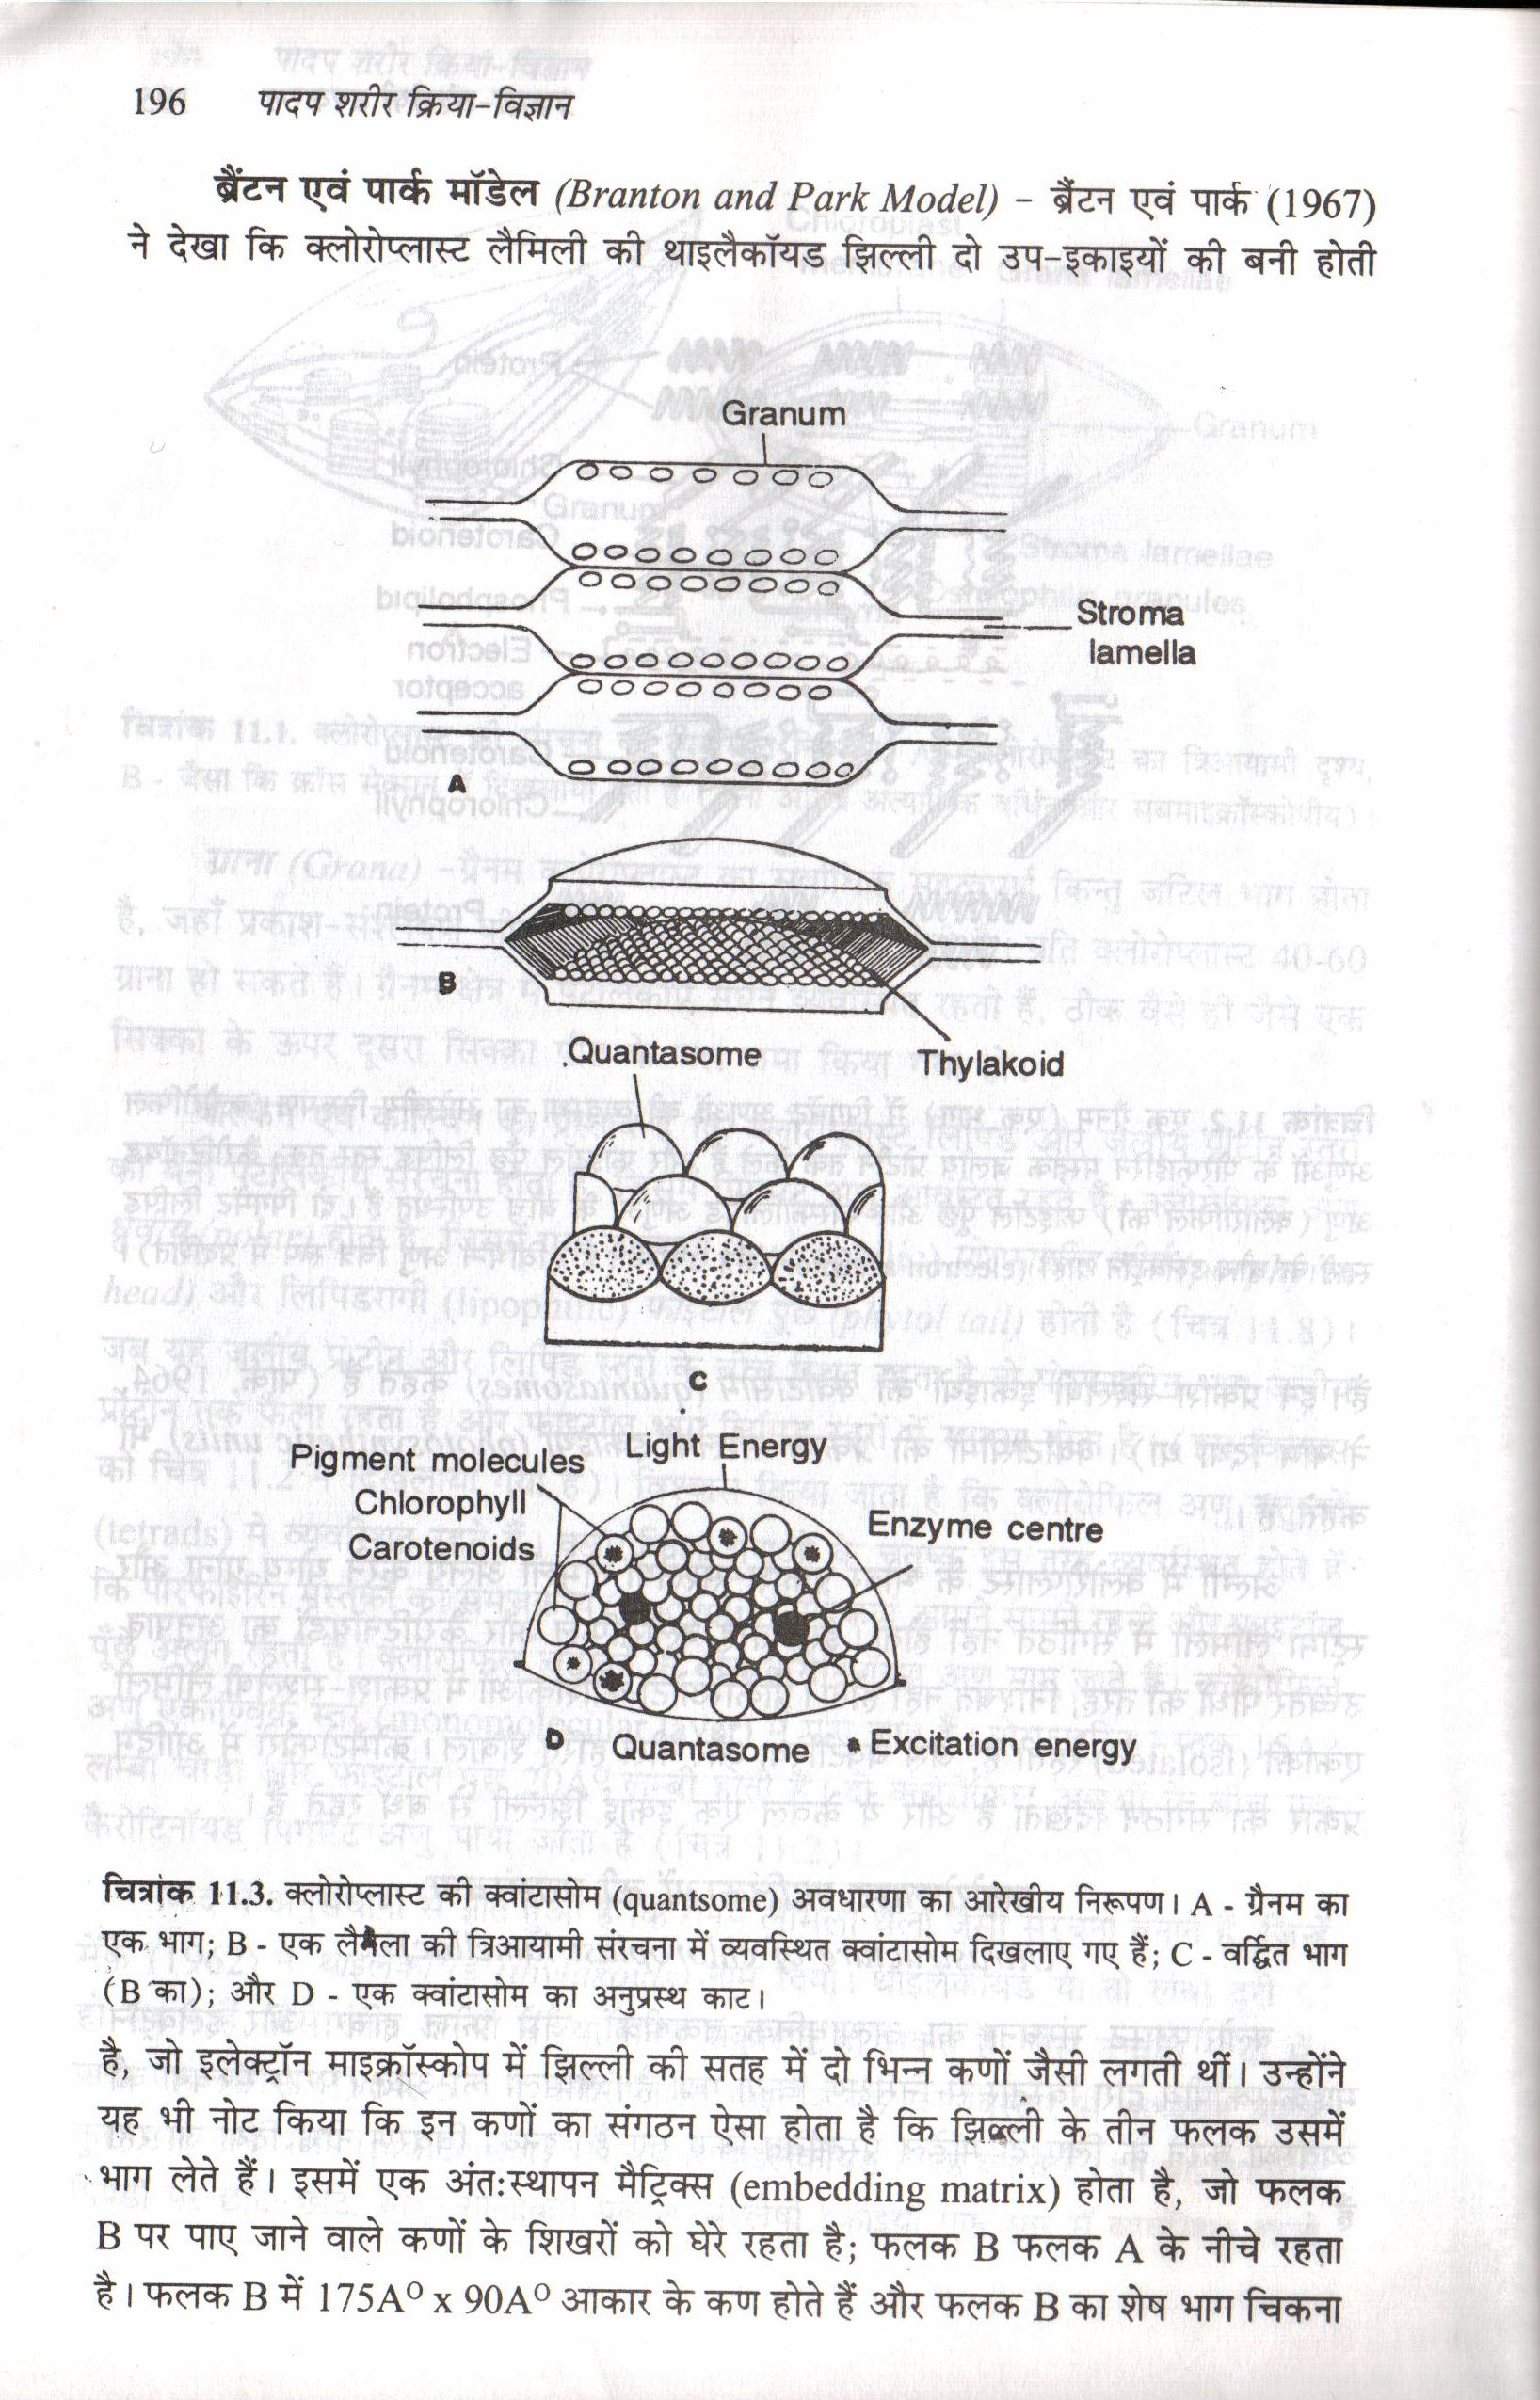
Photosynthetic unit -Quantasomes
Have two zones-
1. Peripheral zone- contains pigment
molecules
2. Middle or Energy zone
Chemical components:-
Chl. A, chl. B, Beta carotine,
vialoxanthin, neoxanthin,
plastoquinone a,b,c, vitamin k,
phaspholipids, nitrogen,
Mn, Fe, Cu etc.
Notes:
The processes in the chloroplast are separated from the cytosol by two membranes.
Inside the innermost membrane is a fluid-filled space, the stroma, in which float membranous sacs, the thylakoids.
The stroma contains DNA, ribosomes, and enzymes for part of photosynthesis.
The thylakoids, flattened sacs, are stacked into grana and are critical for converting light to chemical energy.

Slide 13
Chemical Composition
Protein- 35-55%
Lipids-20-30%
Carbohydrates- 4-7%
Pigments – 9-13%
Osmiophilic granules
Few amount- Nucleic acid, Vitamin K and E, Mg, Fe, Cu, Mn, Zn, P etc.
70s Ribosomes,
Enzymes,
RNA -5%
DNA

Slide 14
Chloroplast DNA:
Plastid DNAs are circular duplex molecules with a total length of 45 mm.
Non Histone
Each plastid consists of 6-30 copies of circular DNAs and most of them are in super coiled state.
Based on its genomic size, it has been calculated that each cp DNA molecule can code for about 110-120 proteins.

Slide 15
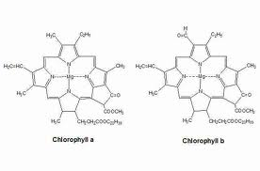
Chloroplast Pigments
Pigments:- Chlorophyll and Carotinoides.
1. Chlorophyll- chl. a,b,c,d,e
Bacteriochlorophyll a and b
Bacteropviridin
Chlorophyll:- a-C55H72O5N4Mg
b-C55H72O6N4Mg

Slide 16
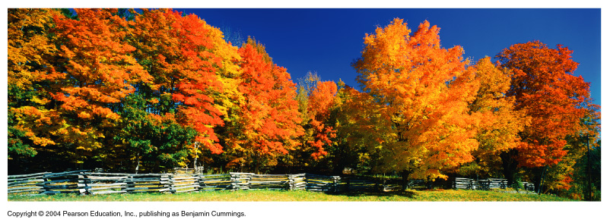
  2. Carotenoids
  Carotins
  Xanthophylls
C40H56

Slide 17
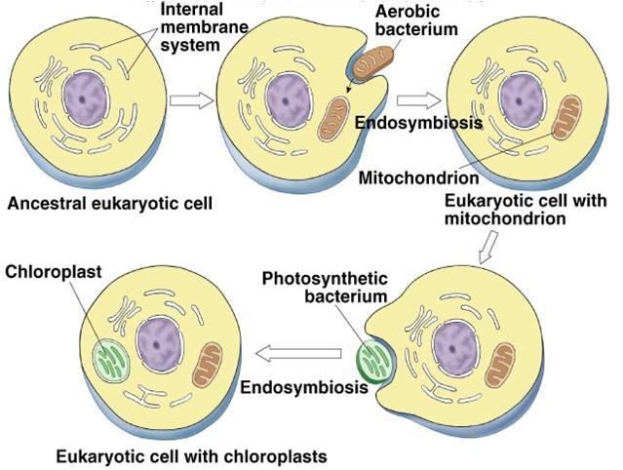
Origin of chloroplsat:
Endosymbiotic theory
Autonoumous theory

Slide 18
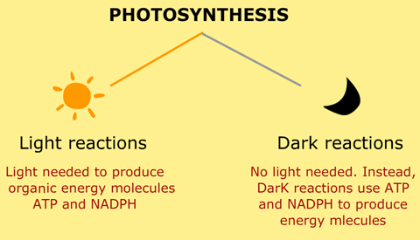
Function:

