Slide 1
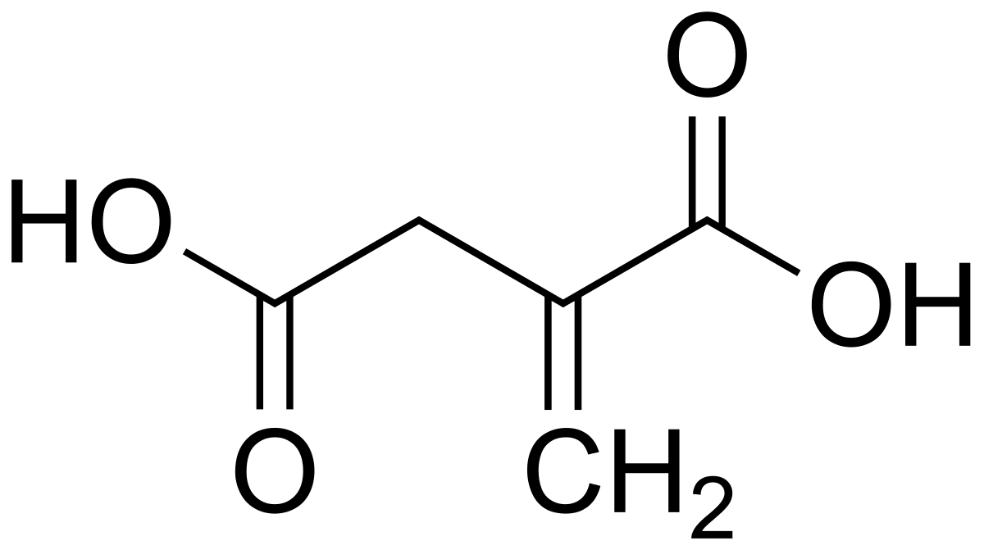
Itaconic Acid

Slide 2
Itaconic Acid
Itaconic acid (or methylenesuccinic acid, CAS 97-65-4) is an unsaturated organic diacid. That unsaturation makes itaconic acid a possible substitute for acrylic acid as a platform chemical, because it can be polymerized in a similar way—by addition. This valuable acid can be produced by several organisms, such as Candida sp., Pseudozyma antarctica, and several species of Aspergillus, but the two most common microorganisms used are Aspergillus terreus, used in industrial processes, and Ustilago maydis, which is currently being actively investigated as a possible industrial product.

Slide 3
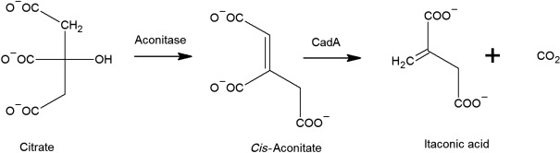

Slide 4
Production of Itaconic Acid
Itaconic acid is an example of a di-carbonic unsaturated acid. These acids are used as building blocks for large numbers of compounds, such as resins, paints, plastics, and synthetic fibers (acrylic plastic, super absorbants, and antiscaling agents).
The CAC intermediate cis-aconitate is enzymatically processed by cis-aconitate dehycarboxylase (CadA) to produce itaconic acid. At the industrial scale the most explored organism for the fermentative production of itaconic acid is Aspergillus terrus.
The biosynthetic pathway of itaconic acid is like citrate biosynthesis, where the flux of the CAC is used in the catalytic conversion of cis-aconitate into itaconic acid.
Thus citrate is synthesized from oxaloacetate and acetyl CoA, while oxaloacetate is synthesized from pyruvate by anaplerosis, which starts from the pyruvate that is the end product of glycolysis. The accepted mechanism for itaconic acid production consists of the conversion of cis-aconitate to itaconate by an enzymatically catalyzed decarboxylation

Slide 5
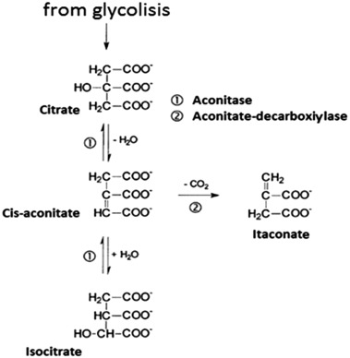

Slide 6
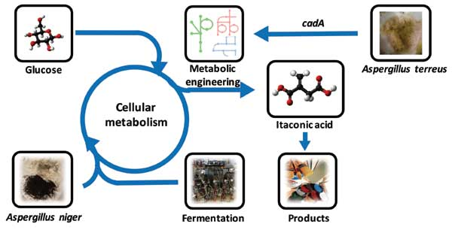

Slide 7
Biosynthesis Pathway
The biosynthesis of itaconic acid was for a long time hotly debated, because it was not clear whether itaconic acid arises from a pathway including parts of the tricarboxylic acid (TCA) cycle or an alternative pathway via citramalate or the condensation of acetyl-CoA.
Bentley and Thiessen (1957) proposed a pathway for the biosynthesis of itaconic acid.
Starting from a sugar substrate like glucose the carbon molecules are processed via glycolysis to pyruvate.
Then the pathway is split and part of the carbon is metabolized to Acetyl-CoA releasing a carbon dioxide molecule. The other part is converted to oxaloacetate so that the previously released carbon dioxide molecule is again incorporated.
In the first steps of the citric acid cycle, citrate and cis-aconitate are formed. In the last step, the only itaconic acid pathway dedicated step, cis-aconitate decarboxylase (CadA) forms itaconic acid releasing carbon dioxide.

Slide 8
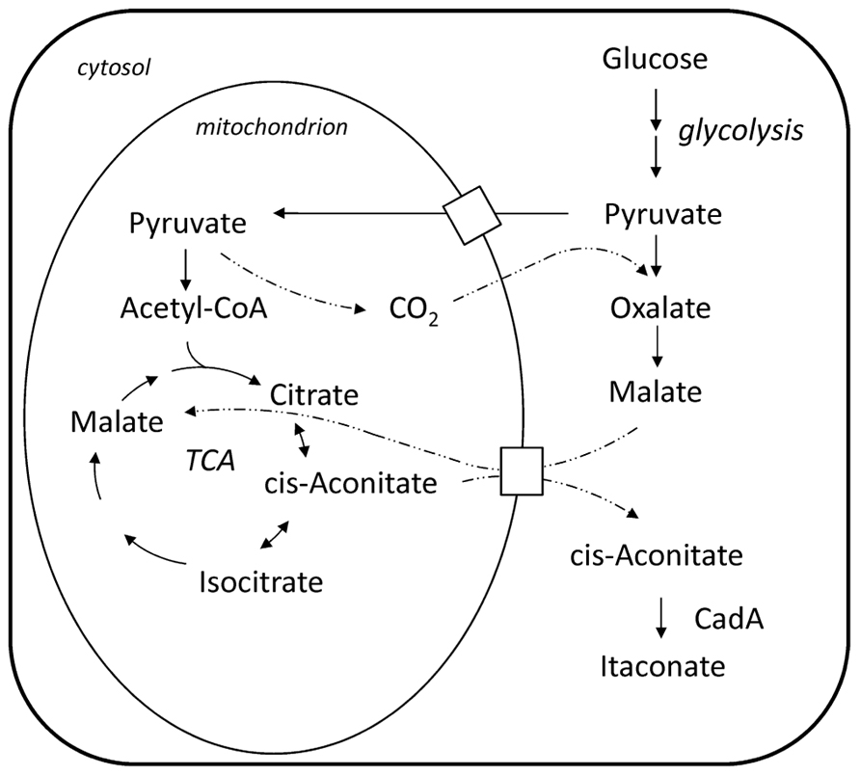
BIOSYNTHETIC PATHWAY OF ITACONIC ACID PRODUCTION

Slide 9
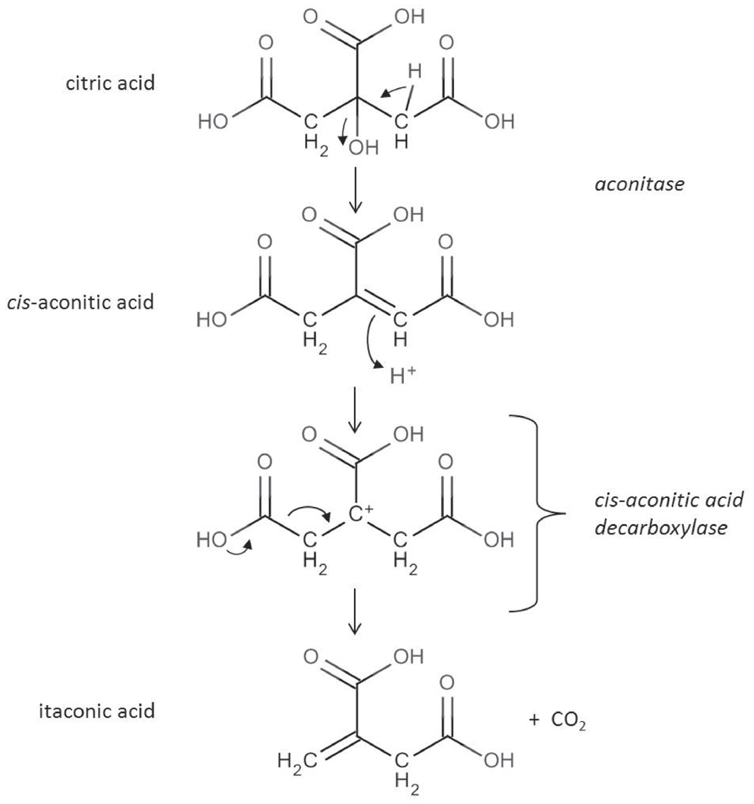
Specific Enzymes Of Itaconic Acid Pathway

Slide 10
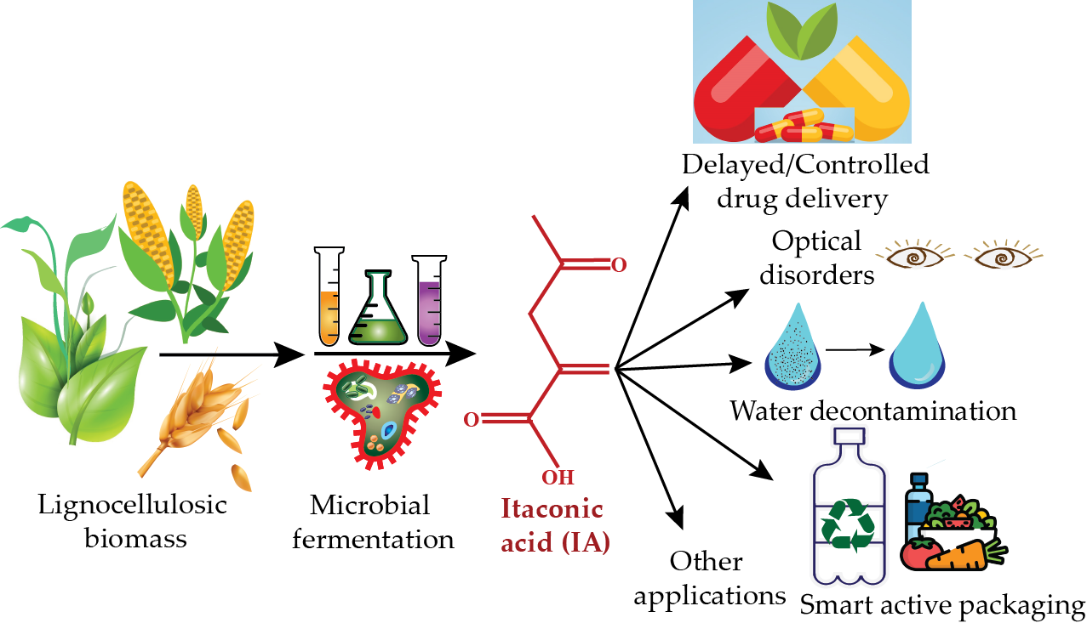
APPLICATIONS

Slide 11
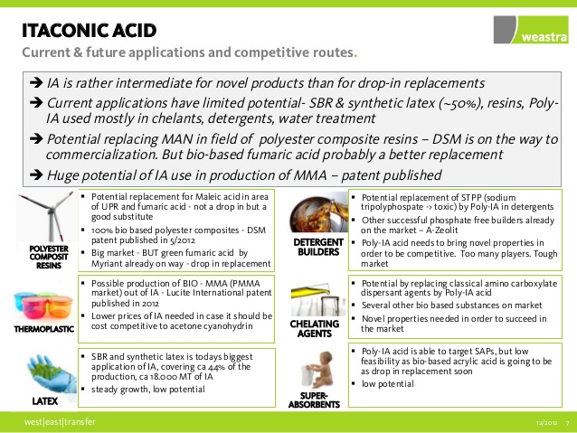

Slide 12
