Slide 1
MOTIVE

Slide 2
MOTIVE
An incentive to act or a reason for doing something or anything that prompted a choice of action.
Anything that arouses the individual and directs his or her behavior towards some goal is called a Motive.

Slide 3
Types of Motives
There are two popular types of motives:
Primary or biological
Secondary or psychosocial

Slide 4
PRIMARY MOTIVE
Primary motives also known as biological motives, have a definite physiological basis and are biologically necessary for survival of the individual or species. These arouse the behavior of the organism in directions that lead to the required change in internal environment. The sources of biological motivational needs include:
Decrease hunger, thirst, discomfort, etc.
maintain homeostasis, balance

Slide 5
SECONDARY MOTIVES
Secondary motives are learned motives and are sometimes known as psychsociological motives. They are not physiologically based. These are the causes of the development of a personality. Secondary motives originate during our life time. They are acquired and learned through our interaction with people. They are classified in two types which are:
Social motives
Psychological motives

Slide 6
SOCIAL MOTIVES
Social motive are those which motivates us to go out, interact with people and do the things that gives a feeling of pleasure and satisfaction. Social motive evoke unity love sympathy love cooperation coordination and the formation of a leadership in a group for its existence and survival. Everybody loves to live according top his social norms. Social Motive helps to
Imitate positive models
Be a part of a group or a valued member
Know one’s self

Slide 7
PSYCHOLOGICAL MOTIVES
Psychological motives are individualistic in nature as they are related to self esteem, self security, self freedom and self assertion.
As psychology is the scientific study of an individual’s behavior in relation to his environment, psychological motives are regarded very important in the development of an individual’s behavior and personality.
Emotions are psychological perspectives and Emotions occur as a result of an interaction between perceptions of environmental stimuli, neural/hormonal responses to these perceptions.

Slide 8
So psychological motives are very important because our emotions motivate us to do thing. Psychological motives help us in many things like:
Maintain attention to something interesting or threatening.
Develop meaning or understanding.
Increase/decrease cognitive disequilibrium; uncertainty.

Slide 9
Secondary or psychosocial motive are important to live a happy life and adequate satisfaction of secondary motives is necessary for mental health to avoid depressions etc.
Psychosocial or secondary motives contain:
Need for affection
Power motive
Need for achievement
Need for affiliation
Need for security
Status motive

Slide 10
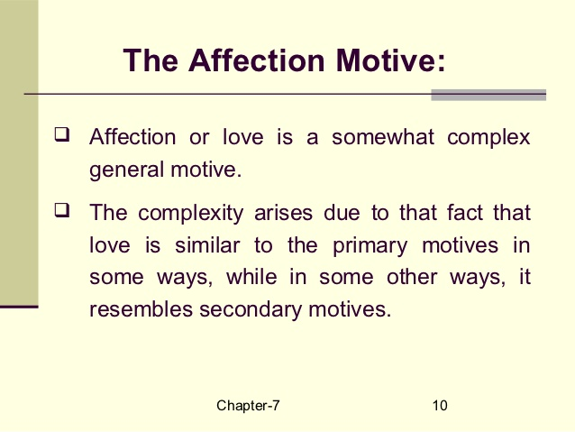

Slide 11
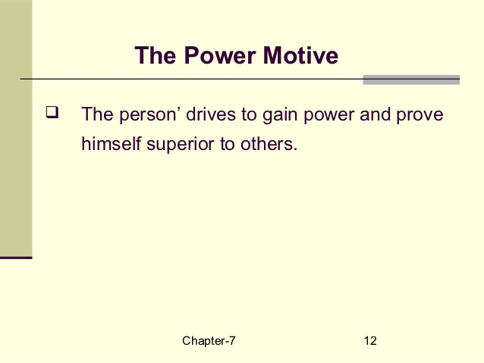

Slide 12
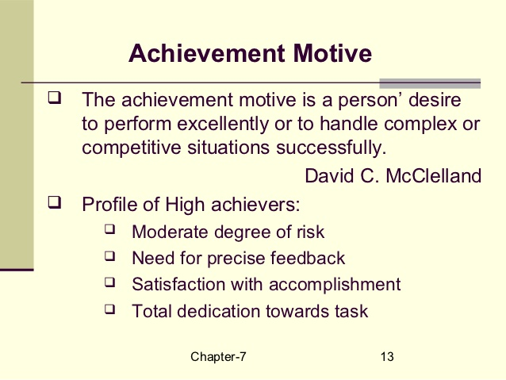

Slide 13
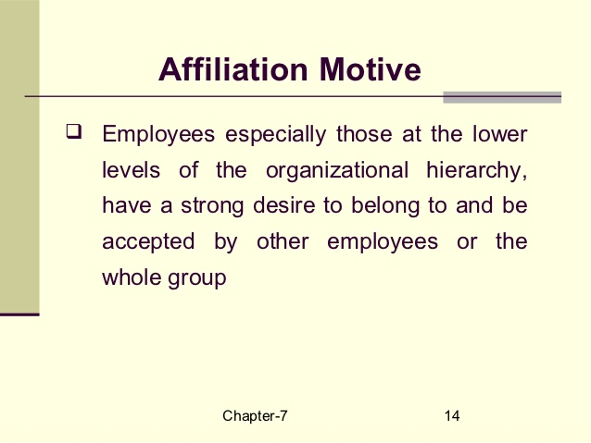

Slide 14
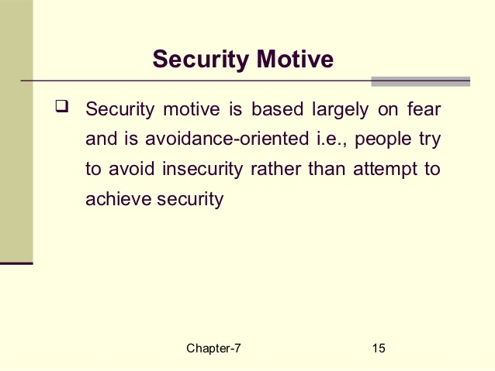

Slide 15
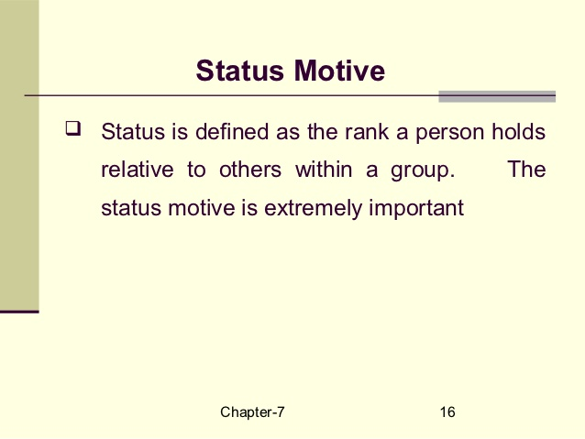

Slide 16
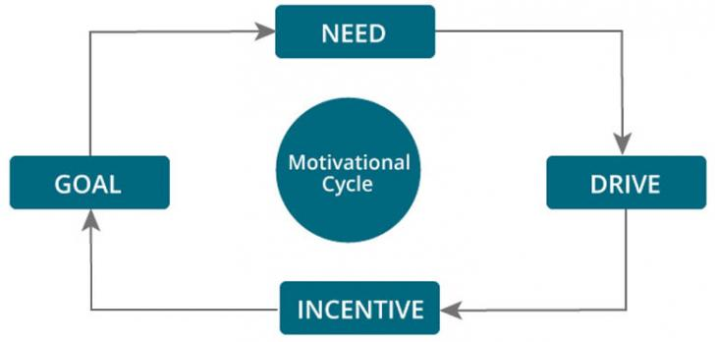

Slide 17
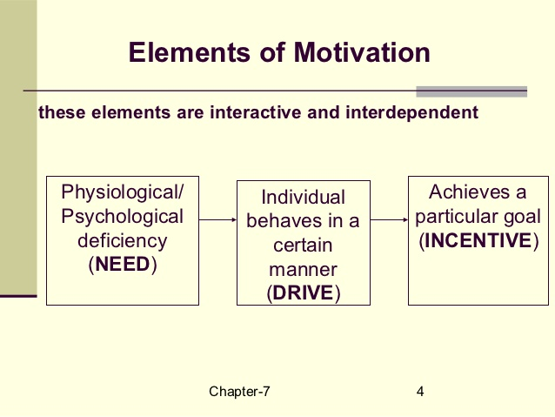

Slide 18
