Slide 1
Efflorescence and Exsiccation
A substance that loses water to form a lower hydrate or becomes anhydrous is termed efflorescent.
Explanation: If the vapor pressure of a hydrated salt is greater than the pressure exerted by the water vapor in the surrounding atmosphere then the salt will attempt to attain equilibrium with its surrounding and therefore tend to loss water to form a lower hydrate or an anhydrous salt.

Slide 2
The pressure of water vapor in the atmosphere is about 13.33x10² N/m² at 293 K, and therefore hydrates with vapor pressures greater than this will tend to exhibit efflorescence and be unstable, provided that the lower hydrate that is formed still exerts a vapor pressure greater then the surrounding atmosphere.

Slide 3
If this is not so, the water will be taken up from the atmosphere by the lower hydrate as fast as it is formed and the final equilibrium will depend on the rates at which water is lost or taken up by the two hydrates.

Slide 4
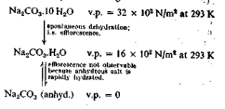
For example the behavior of various forms of sodium carbonate may be represented by the following scheme.

Slide 5
Since the vapor pressure exerted by the decahydrate is much greater than that of normal atmosphere it loses water by the process of efflorescence and is converted to the monohydrate.
The vapor pressure of the later is still above that of the atmosphere but further apparent loss of water does not occur since the anhydrous salt is rehydrated at a faster rate than dehydration of the monohydrate.

Slide 6
The vapor pressure of hydrated salts, and therefore the rate of efflorescence increases with rise in temperature.
The process of accelerating the rate of efflorescence by increasing the temperature in order to remove water of crystallization from a hydrated salt is known as exsiccation.

Slide 7
For example the pentahydrate of copper sulphate may be converted to the trihydrate by heating to 303 K.
Two further molecules of water are removed at 373 K to yield the monohydrate and the remaining molecule of water is removed at 473 K to yield the anhydrous salt.

Slide 8
Since the instability that arises from efflorescence is caused by the loss of water vapor.
The common method of minimizing such deterioration involves the use of containers that prevent the loss of water vapor.

Slide 9
The additional precautions of using well-filled containers with a minimum amount of atmosphere above the efflorescent material and storage in a cool place are also advisable.

Slide 10
Deliquescence and hygroscopicity
A substance that absorbs sufficient moisture from the atmosphere to dissolve itself is deliquescent.
Both of these terms are used to indicate that a material takes up water vapor from the atmosphere and is converted to a more hydrated form.

Slide 11
In the case of hygroscopic substances the more hydrated state is still a solid but deliquescence implies the eventual formation of a liquid phase; i.e. a solution
In both phenomenon, however the final more hydrated state must still exert a lower vapor pressure than that of the water vapor in the surrounding atmosphere.

Slide 12
If this is not so then the newly formed hydrated state will immediately lose water by effloresces and revert to the initial state.
Thus for a liquid phase to be produced by deliquesces it is necessary that the vapor pressure exerted by the saturated solution of the deliquescent material should be less than 13.33x10² N/m²

Slide 13
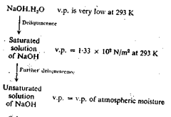
The following scheme showing the behavior of sodium hydroxide may be used as example of deliquescence.

Slide 14
Other deliquescent material include potassium hydroxide, sodium lactate and potassium carbonate while examples of hygroscopic substances include exsiccated sodium sulphate, ammonium chloride etc.

Slide 15
Storage precautions include maintenance of a moisture free atmosphere inside the container .
Official monographs usually directs that such substances should be stored in “well-closed” containers.
A well-filled container limits the volume of atmosphere in the container and therefore further reduces the uptake of moisture by the product.

Slide 16
In certain cases, where the product is particularly susceptible to moisture, a drying agent i.e silica gel may be placed inside the container.
It may contain an indicator to show when its drying properties are no longer satisfactory.

Slide 17
Anhydrous cobaltous chloride, which is blue, may be used as an indicator, since it is converted to a pink hydrate when the silica gel has adsorbed its maximum amount of water vapor.

Slide 18
Lyophilization
Freeze drying (sublimation drying) is a process used to dry extremely heat-sensitive materials.
It allows the drying, without excessive damage, of proteins and blood products.

Slide 19
Freeze-drying is the most commonly used procedure. It is essentially a batch process in which water is removed directly from the solid state. It is generally performed in three distinct phases.
In the first, the water in a solution of the biopharmaceutical agent is converted to ice.
This results in the production of a concentrated frozen macromolecular solid. This freezing step is typically performed in the temperature range of -45°C to -10°C for 2 to 5 hr.

Slide 20
The second stage is referred to as primary drying. This involves the removal of some unfrozen water (15%) and sublimation of ice at -10°C to -40°C for 5 hr to 5 days (this stage is highly variable in time).

Slide 21
The final procedure (secondary drying) involves removal of most of the remainder of the unfrozen water down to 1% to 4% as the temperature is increased from the previous process to 4°C to 50°C for 5 to 15 hr.

Slide 22
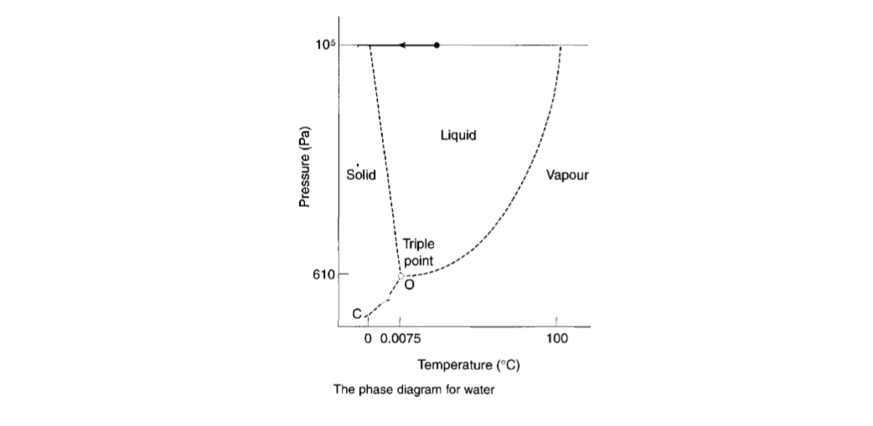
Freeze drying is based on sublimation process.

Slide 23
The figure represents the ice-water-water-vapor system and shows the triple point at 610 N/m² (pascal)and at a temperature of 0.0075⁰.
In principle the freeze drying process is simple but the practice is more complicated and the following aspects must be taken into account.

Slide 24
The temperature must be kept below the triple point temperature and it is usual to work in the range -10 to -40⁰.
Similarly the pressure must be below the triple point and pressure between 10 and 30 N/m² are used.
Thus the vapors must be removed otherwise the vapor pressure would exceed this value very rapidly.

Slide 25
Stages of the freeze drying process
Freezing stage
The liquid material is frozen before the application of vacuum to avoid frothing, and several methods are used to produce a large frozen surface.

Slide 26
Shell freezing
This is employed for fairly large volumes such as blood products.
The bottles are rotated slowly and almost horizontally in a refrigerated bath.
The liquid freezes in a thin shell around the inner circumference of the bottle.
Freezing is slow and large ice crystals form, which is a drawback of this method as they may damage blood cells (there is a mechanical interaction between ice crystals and cells in which cells are pushed and deformed by the ice crystals).

Slide 27
In vertical spin freezing the bottles are spun individually in a vertical position so that centrifugal force forms a circumferential layer of solution, which is cooled by a blast of cold air.
The solution supercools and freezes rapidly, with the formation of small ice crystals.
Small ice crystals are preferred for products such as blood and blood plasma.

Slide 28
Centrifugal evaporative freezing
This is a similar method, where the solution is spun in small containers within a centrifuge.
This prevents foaming when a vacuum is applied.
The vacuum causes boiling at room temperature and this removes so much latent heat that the solution cools quickly and snap (rapid/sudden) freezes.

Slide 29
About 20% of the water is removed prior to freeze drying and there is no need for refrigeration. Ampoules are usually frozen in this way, a number being spun in a horizontal angled position in a special centrifuge head so that the liquid is thrown outwards and freezes as a wedge.

Slide 30
Shelf freezing
The solution can be frozen in the dryer itself.
Trays of bulk material or small containers such as antibiotic vials can be frozen by this method.

Slide 31
Vacuum application stage
The containers and the frozen material must be connected to a vacuum source sufficient to drop the pressure below the triple point and remove the large volumes of low-pressure vapour formed during drying.
Commonly a number of bottles or vials are attached to individual outlets of a manifold, which is connected to a vacuum.

Slide 32
Sublimation stage
Heat of sublimation must be supplied.
Under these conditions the ice slowly sublimes, leaving a porous solid which still contains about 0.5% moisture after primary drying.

Slide 33
Primary drying
Primary drying can reduce the moisture content of a freeze-dried solid to around 0.5%.
Further reduction can be effected by secondary drying. During the primary drying, the latent heat of sublimation must be provided and the vapour removed.

Slide 34
Heat transfer
Heat transfer is critical: insufficient heat input prolongs the process, which is already slow, and excess heat will cause melting.
Prefrozen bottles - of blood, for example - are placed in individually heated cylinders, or are connected to a manifold when heat can be taken from the atmosphere.

Slide 35
Shelf-frozen materials are heated from the drier shelf, whereas ampoules may be left on the centrifuge head or may be placed on a manifold, but in either case heat from the atmosphere is sufficient.
In all cases the heat transfer must be controlled, as only about 5 W m-2 K-1 is needed and overheating will lead to melting.

Slide 36
Vapour removal
The vapour formed must be continually removed to avoid a pressure rise that would stop sublimation.
To reduce the pressure sufficiently it is necessary to use efficient vacuum pumps.
On the small scale, vapour is absorbed by a desiccant such as phosphorus pentoxide, or is cooled in a small condenser with solid carbon dioxide.

Slide 37
On the large scale vapour is commonly removed by pumping, but the pumps must be of large capacity and not affected by moisture.

Slide 38
Rate of drying
The rate of drying in freeze drying is very slow, the ice being removed at a rate of about only 1 mm depth per hour.
Any attempt to increase sublimation involves raising the heat transfer coefficient and would only lead to melting.

Slide 39
Secondary drying
The removal of residual moisture at the end of primary drying is performed by raising the temperature of the solid to as high as 50 or 60°C.
A high temperature is permissible for many materials because the small amount of moisture remaining is not sufficient to cause spoilage.

Slide 40
Packaging
Attention must be paid to packaging freeze-dried products to ensure protection from moisture. Containers should be closed without contacting the atmosphere, if possible, and ampoules, for example, are sealed on the manifold while still under vacuum. Otherwise, the closing must be carried out under controlled atmospheric conditions.

Slide 41
Advantages
As a result of the character of the process, freeze drying has certain special advantages:
1. Drying takes place at very low temperatures, so that enzyme action is inhibited and chemical decomposition, particularly hydrolysis, is minimized.

Slide 42
2. The solution is frozen such that the final dry product is a network of solid occupying the same volume as the original solution. Thus, the product is light and porous.
3. The porous form of the product gives ready solubility.

Slide 43
4. There is no concentration of the solution prior to drying.
Hence, salts do not concentrate and denature proteins, as occurs with other drying methods.
5. As the process takes place under high vacuum there is little contact with air, and oxidation is minimized.

Slide 44
Disadvantages
There are two main disadvantages of freeze drying:
The porosity, ready solubility and complete dryness yield a very hygroscopic product.
Unless products are dried in their final container and sealed in situ, packaging requires special conditions.

Slide 45
2. The process is very slow and uses complicated plant, which is very expensive.
It is not a general method of drying, therefore, but is limited to certain types of valuable products which, because of their heat sensitivity, cannot be dried by any other means.

Slide 46
Uses of freeze drying
The method is used for products that cannot be dried by any other heat method.
These include biological products, for example some antibiotics, blood products, vaccines (such as BCG, yellow fever, smallpox), enzyme preparations (such as hyaluronidase) and microbiological cultures.
The latter enables specific microbiological species and strains to be stored for long periods with a viability of about 10% on reconstitution.

Slide 47
Elutriation
It is a process of sizing particles by means of an upward current of fluid, usually water or air. The process is the reverse of gravity sedimentation.

Slide 48
Elutriation is a technique in which the fluid flows in an opposite direction to the sedimentation movement, so that in gravitational elutriators particles move vertically downwards while the fluid travels vertically upwards.
If the upward velocity of the fluid is less than the settling velocity of the particle, sedimentation occurs and the particle moves downwards against the flow of fluid.

Slide 49
Conversely, if the settling velocity of the particle is less than the upward fluid velocity, the particle moves upwards with the fluid flow.
Therefore, in the case of elutriation, particles are divided into different size fractions depending on the velocity of the fluid.

Slide 50
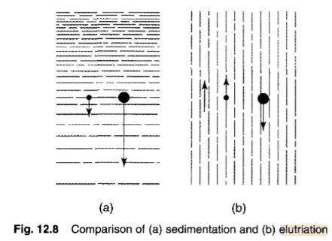
Elutriation and sedimentation are compared in Figure.

Slide 51
Feed particles introduced into the sorting column will be separated into two fractions.
If the velocity of the fluid is less than the setting velocity of the particles, then the particles will move downward against the stream of fluid. If the setting velocity of particles is less than the velocity of fluid, the particles will move upward.

Slide 52
In practice this does not occur, as there is a distribution of velocities across the tube in which a fluid is flowing - the highest velocity is found in the centre of the tube and the lowest velocity at the tube walls.
Therefore, the size of particles that will be separated depends on their position in the tube, the largest particles in the centre, the smallest towards the outside.

Slide 53
In practice, particles can be seen to rise with the fluid and then to move outwards to the tube wall, where the velocity is lower and they start to fall. A separation into two size fraction occurs, but the size cut will not be clearly defined.

Slide 54
Separation of powders into several size fractions can be effected by using a number of elutriators connected in series. The suspension is fed into the bottom of the narrowest column, overflowing from the top into the bottom of the next widest column and so on.
Because the mass flow remains the same, as the column diameter increases the fluid velocity decreases and therefore particles of decreasing size will be separated.

Slide 55
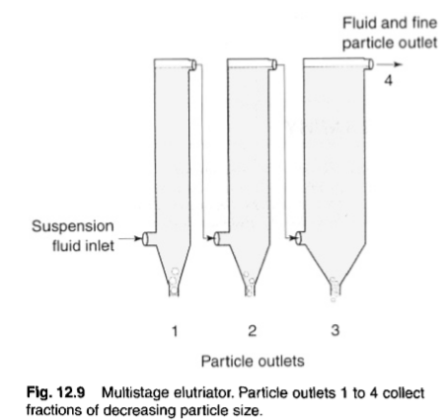

Slide 56
Air may be used as the counter flow fluid in place of water for elutriation of soluble particles into different size ranges.
There are several types of air elutriator, which differ according to the airflow patterns used.
An example of an upward airflow elutriator is shown in Figure. Particles are held on a supporting mesh through which air is drawn.

Slide 57
Classification occurs within a very short distance of the mesh and any particles remaining entrained in the air stream are accelerated to a collecting chamber by passage through a conical section of tube.
Further separation of any fine particles still entrained in the air flow may be carried out subsequently using different air velocities.

Slide 58
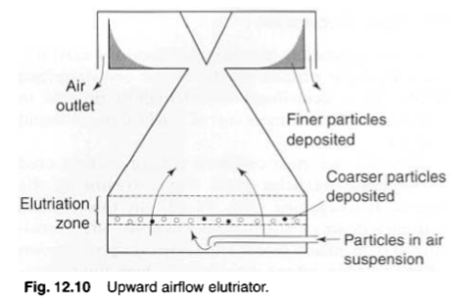

Slide 59
Ignition
It is also called as incineration.
It is the process by which an organic substance is strongly heated until whole of the carbonaceous matter burns and an inorganic residue known as Ash is left behind.
This is a process of heating the organic substances in excess of air, until all the carbon atoms have burnt as CO2 and residue of inorganic matter (Ash) is left behind.
The residue is called as Ash and the process as Ashing.

Slide 60
On laboratory scale ignition is carried out in platinum crucibles.
It consists of strongly heating ("igniting") a sample of the material at a specified temperature, allowing volatile substances to escape, until its mass ceases to change.
The simple test typically consists of placing a few grams of the material in a tarred crucible and determining its mass, placing it in a temperature-controlled furnace for a set time, cooling it in a controlled (e.g. water-free, CO2-free) atmosphere, and re determining the mass.

Slide 61
Applications
This process is mainly used for the standardization of organic substances and crude drugs
Used to determine impurities of organic salts of alkali metals such as tartrates, citrates, Benzoates and many drugs.
Purity of a drug is determined by its ash content

Slide 62
Fusion
It is the process by which the solids get converted into liquids without the addition of any solvent.
In other words it is defined as the process of heating the solids until they melt.
In a pure crystalline solid, this process occurs at a fixed temperature called the melting point
An impure solid generally melts over a range of temperatures below the melting point of the principal component.

Slide 63
Applications
Fusion is done to purify certain solid and semisolid substances e.g., substances like Bees wax, hard paraffin, soft paraffin and wool fat are heated to melt and filtered while hot to remove the dissolved impurities. Then cooling is done to obtain a product free from dissolved impurities.

Slide 64
This method is also applied for the preparation of ointments when they contain solids and semisolids in the formulation.
All the substances are first melted and then cooled slowly with constant stirring until a uniform product is obtained.
To avoid overheating, the substances with higher melting points are melted first to which substances with lower melting points are added.

Slide 65
Centrifugation
It is a process used to separate or concentrate materials suspended in a liquid medium.
Centrifugation is useful particularly when separation by ordinary filtration is difficult, as in separating a highly viscous mixture.
Separations may be accomplished more rapidly in a centrifuge than under the action of gravity. In addition, the degree of separation that is attainable may be greater because the forces available are of a far higher order of magnitude.

Slide 66
Principles of centrifugation
Centrifugal force can be used to replace the gravitational force in sedimentation processes
Consider a body of mass m rotating in a circular path of radius r at a velocity v.
The force acting on the body in a radial direction is given by
F= mv²/r

Slide 67
Where
F= centrifugal force
m= mass of body
v=velocity of body
r= radius of circle of rotation

Slide 68
The same body will be acted upon by a gravitational force
G=mg
Where
G=gravitational force
g=gravitational constant
The centrifugal effect is the ratio of the two forces
C=F/G

Slide 69
C=mv²/mgr
C=v²/gr
But
v=2ᴨrn
Where
n=speed of rotation

Slide 70
F/G=(2ᴨrn)²/gr
F/G=4ᴨ²r²n²/gr
F/G=2ᴨ²n²d/g
(d=2r)
Where
d=diameter of rotation

Slide 71
The gravitational constant (g) has a valve of 9.807 m/s²
So the equation may be simplified to
Centrifugal effect=2.013n²d
Where, 2ᴨ²=19.73
n is expressed in s⁻¹ and d is in m.

Slide 72
From the above equation it is clear that centrifugal effect is directly proportional to the diameter and is proportional to the square of the speed of rotation.
Thus if it is necessary to increase the centrifugal effect, it is of great advantage to use a centrifuge of the same size at a higher speed, rather than use a larger centrifuge at the same speed of rotation.

Slide 73
In larger centrifuge, doubling the speed had the result of quadrupling the centrifugal effect, while the high speed of rotation of a small centrifuge gave a very high value to the centrifugal effect.

Slide 74
Industrial centrifuges
There are two main types of centrifuge used to achieve separation on an industrial scale, those using perforated baskets, which perform a filtration-type operation
and those with a solid walled vessel, where particles sediment towards the wall under the influence of the centrifugal force

Slide 75
Perforated-basket centrifuges (centrifugal filters)
It consists of a stainless steel perforated basket (typically 1-2 m in diameter) lined with a filter cloth.
The basket rotates at a speed which is typically <25 s⁻¹.
The product enters centrally and is thrown outwards by centrifugal force and held against the filter cloth.
The filtrate is forced through the cloth and removed via the liquid outlet; the solid material is retained on the cloth.
The cake can be washed if required by spraying water into the centrifuge.

Slide 76
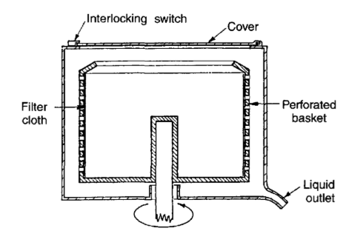

Slide 77
Applications
The centrifugal filter has been used for separating crystalline materials from the preparation liquor, e.g. in the preparation of aspirin, and for removing precipitated proteins from insulin.

Slide 78
Advantages
The centrifuge is very compact, occupying very little floor space compared with filters of similar capacity.
It is very efficient, a 1m centrifuge being able to process about 200 kg in 10 minutes.
It can also handle concentrated slurries which might block other filters, and gives a product with a very low moisture content (typically around 2% w/w), which saves energy during drying.

Slide 79
Centrifugal force removes the liquid from the cake in producing a dry product, so that dissolved solids are separated from the cake.
In conventional drying dissolved solids are deposited on the insoluble solid of the cake.

Slide 80
Disadvantages
The complicated cycle of operation involves considerable labor cost, making the process expensive.
The process is intermittent, working on the batch principle.
There is considerable wear and tear because the solid form a hard, abrasive cake due to the consolidating effect of the centrifugal force.

Slide 81
Tubular-bowl centrifuges (centrifugal sedimenters)
These consist of a cylindrical 'bowl', typically around 100 mm in diameter and 1 m long, which rotates at 300-1000 s⁻¹.
The product enters at the bottom and centrifugal force causes solids to be deposited on the wall as it passes up the bowl, the liquid overflowing from the top.

Slide 82
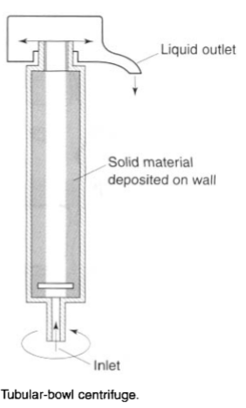

Slide 83
Uses
The uses of centrifugal sedimenters include
Liquid/Liquid separation, e.g. during antibiotic manufacture Purification of fish oils,
The removal of very small particles,
The removal of solids that are compressible or 'slimy' and which easily block the filter medium,
The separation of blood plasma from whole blood (need C = 3000),
The separation of different particle size fractions.

Slide 84
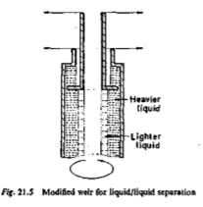

Slide 85
Decantation
It is a method of separating a mixture of a liquid and a heavier solid.
In this process the solid impurities are allowed to sediment at the bottom of the container.
Then the pure liquid is poured out carefully from the container into another container.
The precipitate or solid is left behind at the bottom of the container.

Slide 86
The simplest method available for the separation of a solid from its soluble impurities.
This method involves washing and subsequent agitation of the solid with an appropriate solvent, allowing the solid to settle and removing the supernatant solvent.
These three steps are repeated as often as required to attain the desired purity of the solid.

Slide 87
This method also is applicable to the simple separation of solids and liquids, such as after precipitation of a material from a mother liquor.
Decantation provides an effective method for washing magmas and other gelatinous products.
Some degree of skill is required to decant liquids effectively.
It is most convenient to decant from a lipped vessel that is not filled to capacity.
Glass micropipette can be used to remove small quantities of supernatant close to the interface boundary.

Slide 88
Desiccation
The process of removing adhered moisture from liquid or solid substances.
The term desiccated should be used for those substances from which water has been completely removed.

Slide 89
On laboratory scale desiccation can be carried out in a desiccator, which consists of a tightly closed glass vessel containing a drying agent at its bottom, which absorbs moisture from the substance being desiccated.
The commonly used drying agents include concentrated sulphuric acid, phosphorous pentoxide, exsiccated calcium chloride and silica gel.

Slide 90
The drug to be dried is taken in a dish, which is placed inside the desiccator above the surface of drying agent.
For continuous operation the desiccator may sometimes be connected to a vacuum pump.

Slide 91
Levigation
Levigation is commonly used in small-scale preparation of ointments and suspensions to reduce the particle size and grittiness of the added powders.
A mortar and pestle or an ointment tile may be used.

Slide 92
A paste is formed by combining the powder and a small amount of liquid (the levigating agent) in which the powder is insoluble.
The paste is then triturated, reducing the particle size.

Slide 93
The levigated paste may then be added to the ointment base and the mixture made uniform and smooth by rubbing them together with a spatula on the ointment tile.
A figure 8 track is commonly used to incorporate the materials.
Mineral oil and glycerin are commonly used levigating agents.

Slide 94
The levigating agent should be physically and chemically compatible with the drug and base. (e.g., mineral oil for bases in which oils are the external phase or glycerin for bases in which water is the external phase).
The powder to be levigated should be insoluble in the levigating agent

Slide 95
Trituration may be employed both to comminute and to mix powders.
If simple admixture is desired without the special need for comminution, the glass mortar is usually preferred.
When a small amount of a potent substance is to be mixed with a large amount of diluent, the geometric dilution method is used to ensure the uniform distribution of the potent drug.

Slide 96
This method is especially indicated when the potent substance and other ingredients are the same color and a visible sign of mixing is lacking.
By this method, the potent drug is placed with an approximately equal volume of the diluent in a mortar and is mixed thoroughly by trituration.

Slide 97
Then, a second portion of diluent equal in volume to the mixture is added and the trituration repeated.
This process is continued by adding an equal volume of diluent to the powder mixture and repeating this until all of the diluent is incorporated.
Some pharmacists add an inert colored powder to the diluent before mixing to permit visual inspection of the mixing process.

