Slide 1
Attention

Slide 2
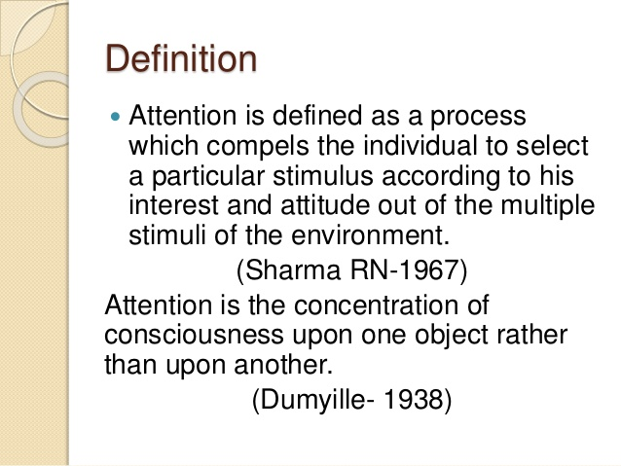

Slide 3
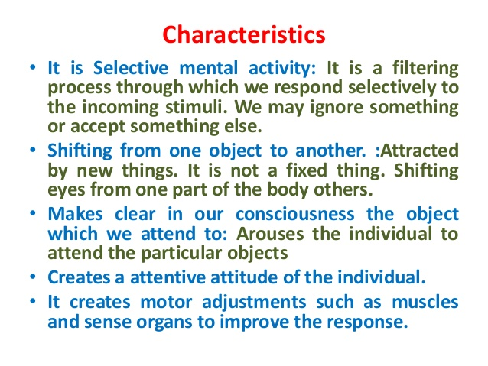

Slide 4
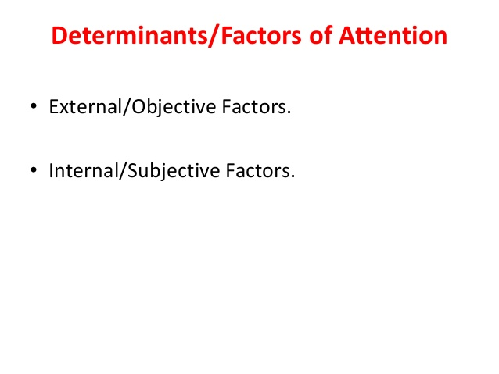

Slide 5
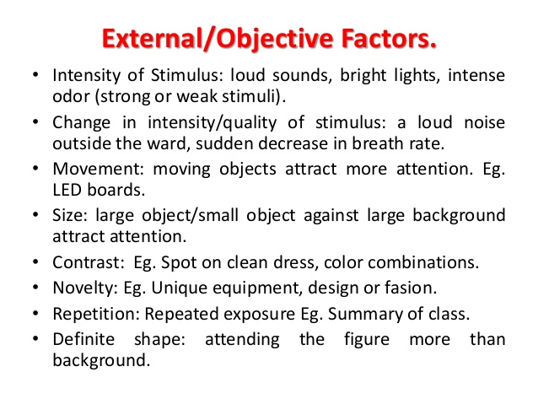

Slide 6
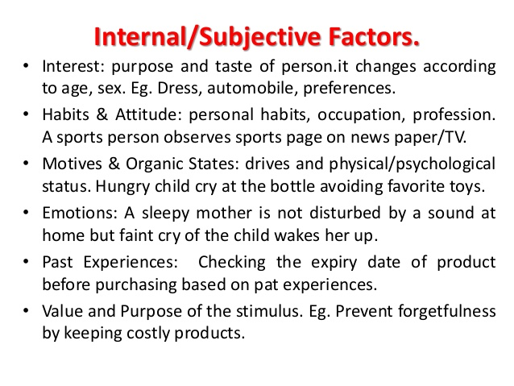

Slide 7
Attention: 4 Major Conditions of Attention

Slide 8
Span of Attention/Apprehension
Distraction of Attention
Distraction of Attention ​
Fluctuation of Attention

Slide 9
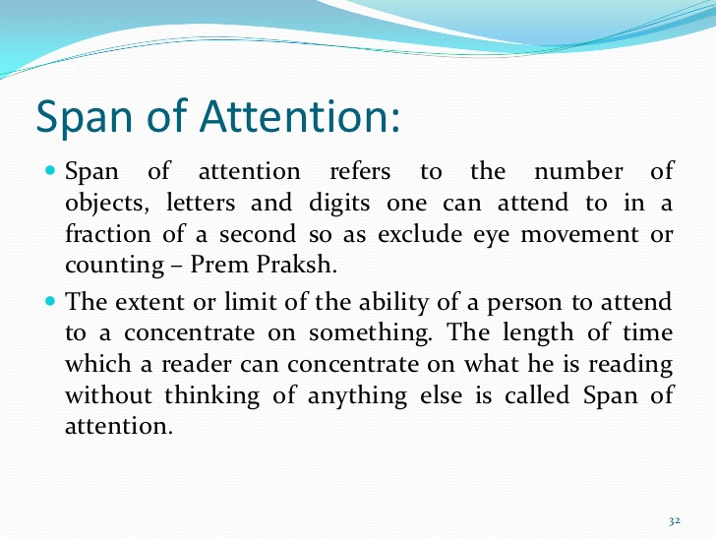

Slide 10
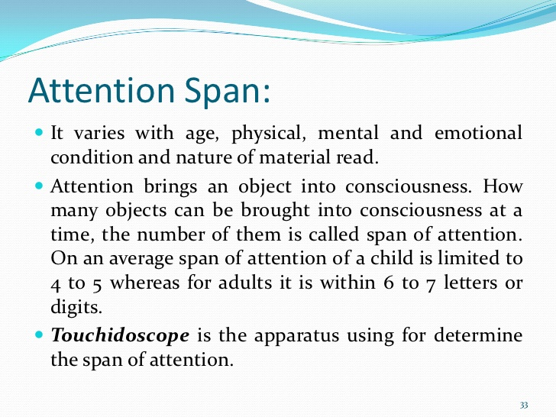

Slide 11
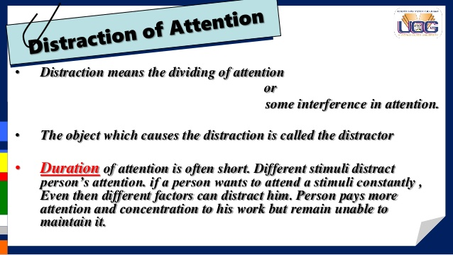

Slide 12
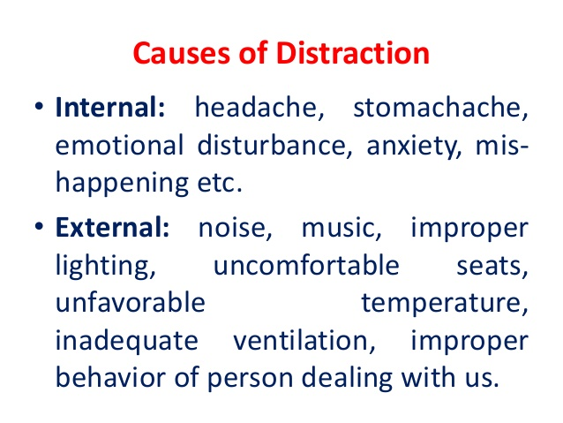

Slide 13
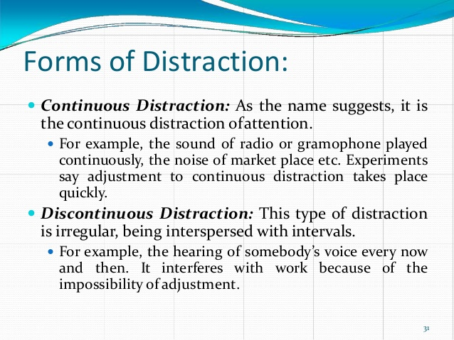

Slide 14
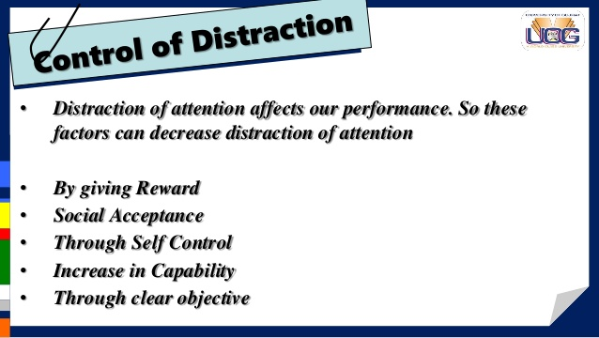

Slide 15
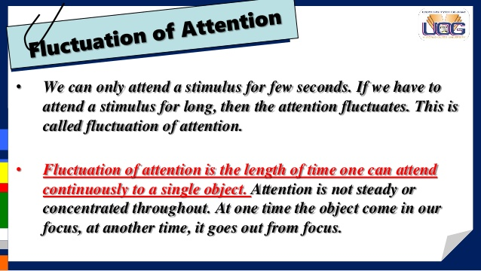

Slide 16
Division of Attention
Attending to more than one act at a time is known as division of attention. In such situations, we will divide our attention towards more than one act.
For example, a tailor will be stitching the cloths and also speaking to his customers.
In such activities the attention is not divided, but it is possible to perform more than one act because, either our attention is shifted from one act to another rapidly, or our attention is concentrated on only one act and the remaining activities are carried on automatically.

