Slide 1
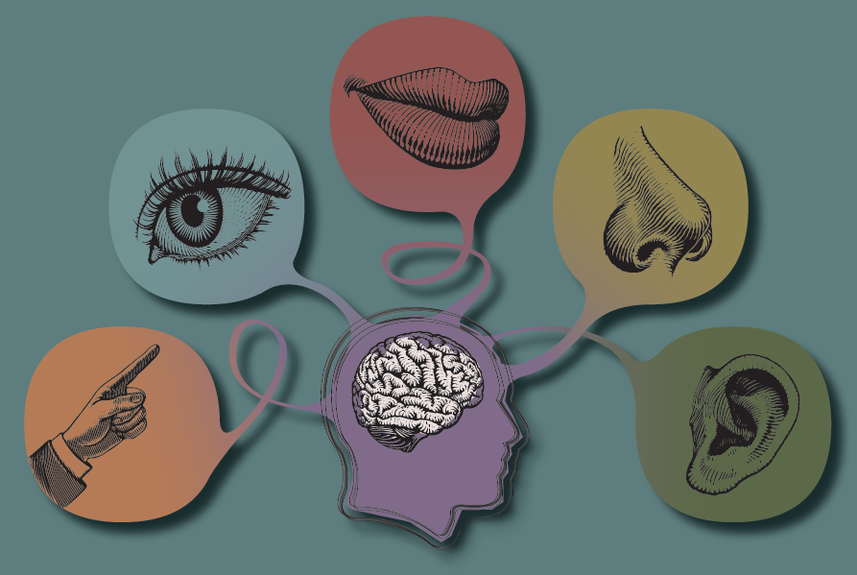
Sensation and Perception

Slide 2
Sensation: your window to the world
Perception: interpreting what comes
in your window.

Slide 3
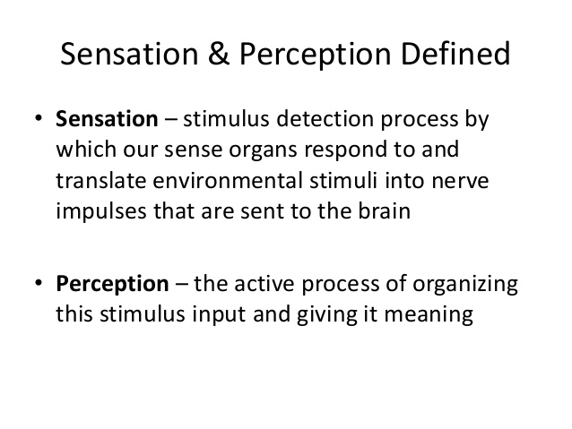

Slide 4
What is Sensation?
●
A stimulus is any object or event that elicits a sensory or behavioral response in an organism.
A Sensation occurs anytime a stimulus activates one of your receptors.
The sense organs then detect any change in energy, such as light, heat, sound, and physical pressure.
●
●

Slide 5
What is Sensation?
Sensation occurs when special receptors in the sense organs—the eyes, ears, nose, skin, and taste buds—are activated, allowing various forms of outside stimuli to become neural signals in the brain. (This process of converting outside stimuli, such as light, into neural activity is called transduction.)

Slide 6
Sensory systems
Transduction - Communication between the brain & the rest of the body occurs via neuron. Information goes from the senses to the thalamus , then to the various areas in the brain.
All senses involve something called receptor cells. Their job is to transduce (transform or even “translate”) physical stimulation/physical energy from the environment into electrochemical messages that can be understood by the brain.

Slide 7
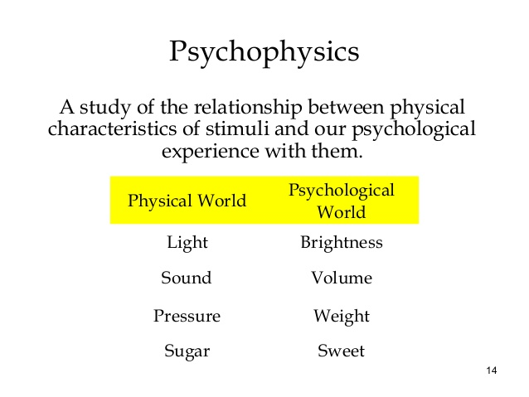

Slide 8
Psychophysics
This explains how sensation and perception are related
Psychophysics: The study of the relationships between sensory experiences and the physical stimuli that cause them!

Slide 9

So where do vision and hearing (& the other senses) happen?
The Brain!
The physical energy in the environment is detected by the eyes, ears, etc. but we can’t see, hear, etc. until the brain interprets them— i.e., makes sense of them. So in a way, we see, hear, smell, etc. in our brains!

Slide 10
Threshold

Slide 11
Absolute Threshold
The Absolute Threshold is the level of stimulus that produces a positive response of detection 50% of the time.
the lowest level of stimulation that a person can consciously detect 50 percent of the time the stimulation is present.

Slide 12
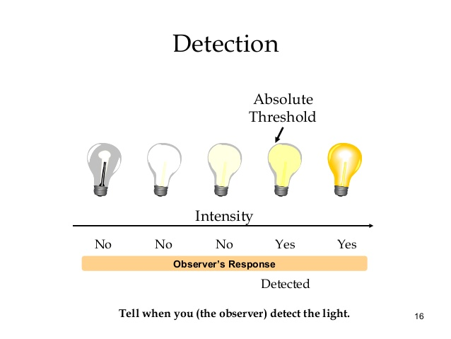

Slide 13
Weber’s law of just noticeable differences (jnd, or the difference
threshold).
The difference threshold is the amount of change needed for us to recognize that a change has occurred.
It’s the smallest difference between two stimuli that is detectable 50 percent of the time
Weber's Law states that “The larger or stronger the stimulus, the larger the change required for a person to notice that anything has happened to it.”

Slide 14


Example
Imagine holding a five pound weight and one pound was added. Most of us would notice this difference. But what if we were holding a fifty pound weight? Would we notice if another pound were added? The reason many of us would not is because the change required to detect a difference has to represent a percentage. In the first scenario, one pound would increase the weight by 20%, in the second, that same weight would add only an additional 2%.

Slide 15
Sensory Adaptation
●
Adaptation (sometimes called habituation) is a part of everyday experience. It’s a decreased responsiveness to stimuli due to constant stimulation.
We are able to respond to the changes in our environment because our senses have the ability to adapt, or adjust themselves, to a constant level of stimulation.
Once your senses get used to a new level of a stimulation, they respond only to deviations from it.
●
●

Slide 16
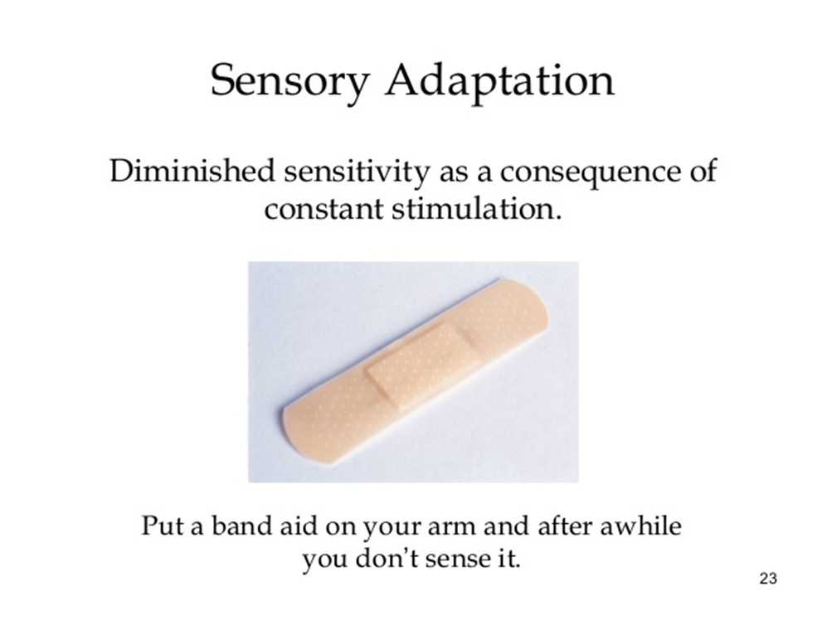

Slide 17
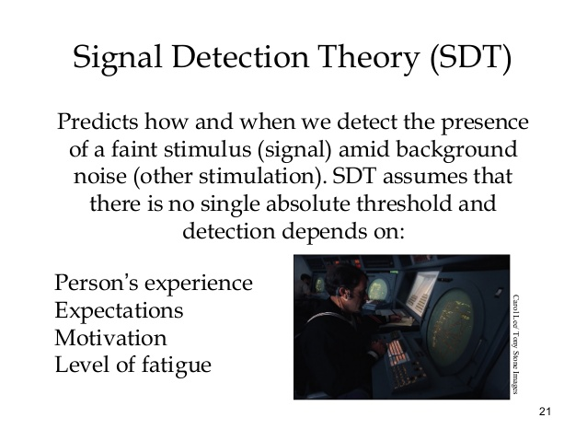

Slide 18
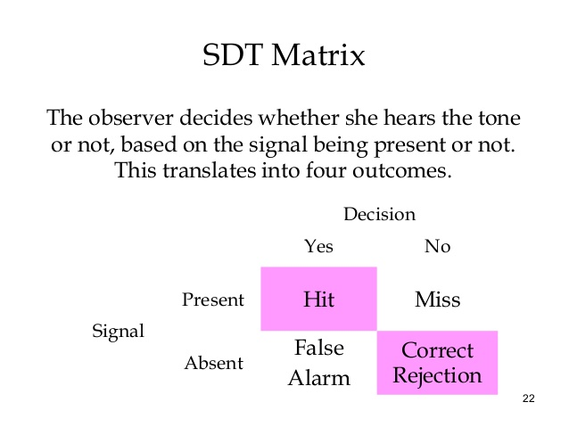

Slide 19
Signal detection theory (SDT) was originally developed to describe the performance of radars, which must detect signals against a background of noise.
As radars become more sensitive (capable of detecting weaker and weaker signals), they are increasingly able to correctly detect when signals are present; these events are called hits, and their probability of occurrence is the hit rate.
However, radars may also mistake noise for signals; these events are false alarms, and the corresponding probability is the false alarm rate.

